Slide 1
Lynching in Salisbury, Md
What dispute led to the death of Daniel Elliott?
Where was Williams lynched?
What conflict is shown within the state of Maryland as a result of the lynching?
Why did Salisbury residents advocate a boycott of the Baltimore Sun?
Why was no one charged with the lynching?

Slide 2
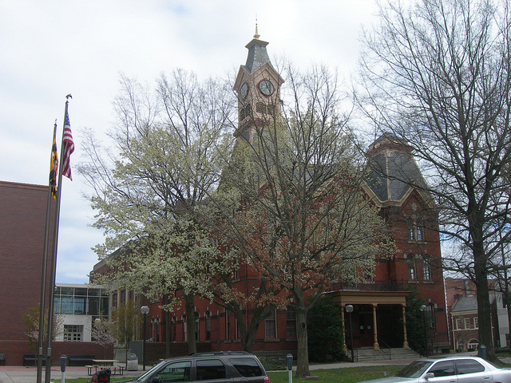
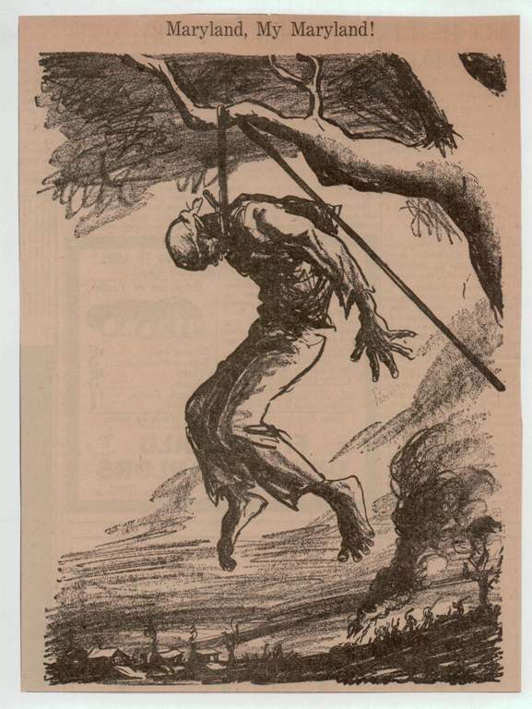

Slide 3
