Slide 1
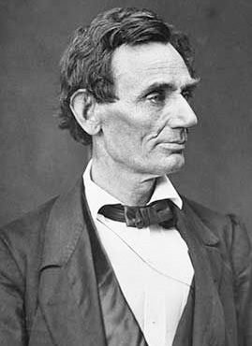
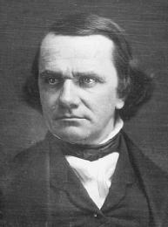

Slide 2
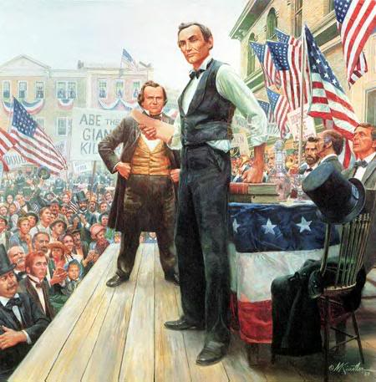

Slide 3
Lincoln Douglas Debate
What are the two things that Douglas warns will happen if Lincoln is elected?
On what points is Lincoln willing to agree with Douglas? On what points does he differ from Douglas?

