Slide 1
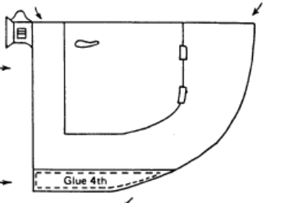
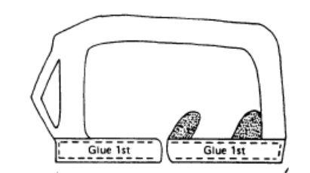
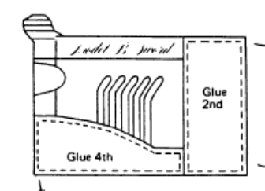

Slide 2
Assembly Line
Meet with your group, you will have a few minutes to come up with a name for your car company.
There will be two rounds of car construction. The car company that builds the most cars over the two rounds wins.
In between the two rounds will be a break for you to reflect on what worked and what didn’t for your car company and to alter the process to make it more efficient.
At the end each company member will take one of the cars and create an advertisement for their car. (Name of the car, cost, where to get one, attributes of car, etc.)
On the back of your advertisement you will answer the following. How do you think your car company did? What worked and what didn’t? If there was a third round what could be done to make your car company even more efficient?

