Slide 1
Election of 1860
Color Code each state according to who won the electoral votes for that state.
Would Lincoln still have won the election of 1860 if he was running against only one candidate instead of three. See if enough states changed hands to give the single Democratic candidate the victory.

Slide 2
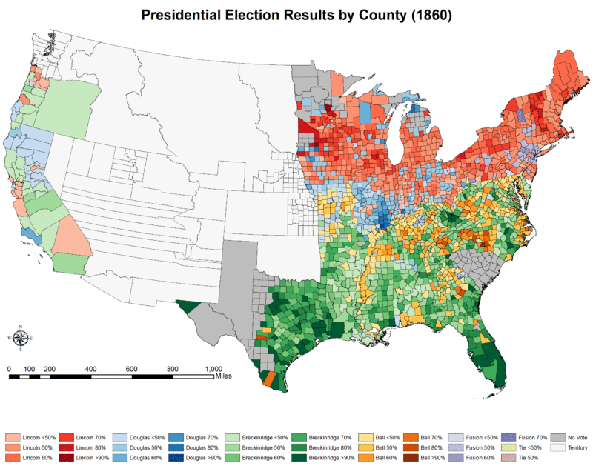

Slide 3
