Slide 1
Unreliable militia & the hanging of a loyalist
What are three reasons why the militia are unreliable?
What suggests that a large professional army is frowned upon by the colonies? Why do you think that might be the case?
How did the colonists attempt to get information out of Wilson?
What acts did they blame Wilson for?
Why did Wilson say he was loyal to the king?
What opportunity did Wilson want?
What offer did the colonists make to Wilson?
What happened to Wilson?

Slide 2
Period 3 & 7
We will examine the important role played by France in helping America gain its independence.
Warm Up: An old saying goes that “history is written by winners.” Had the British won the war, what might the “patriots” have been called in the history books?
Chapter 8 notes
Territorial Expansion Map
Revolution

Slide 3
Colonial War Becomes a World War
1779 – Holland and Spain join war against England
America had stayed in the war long enough for help to arrive
Britain was busy fighting all over the globe

Slide 4
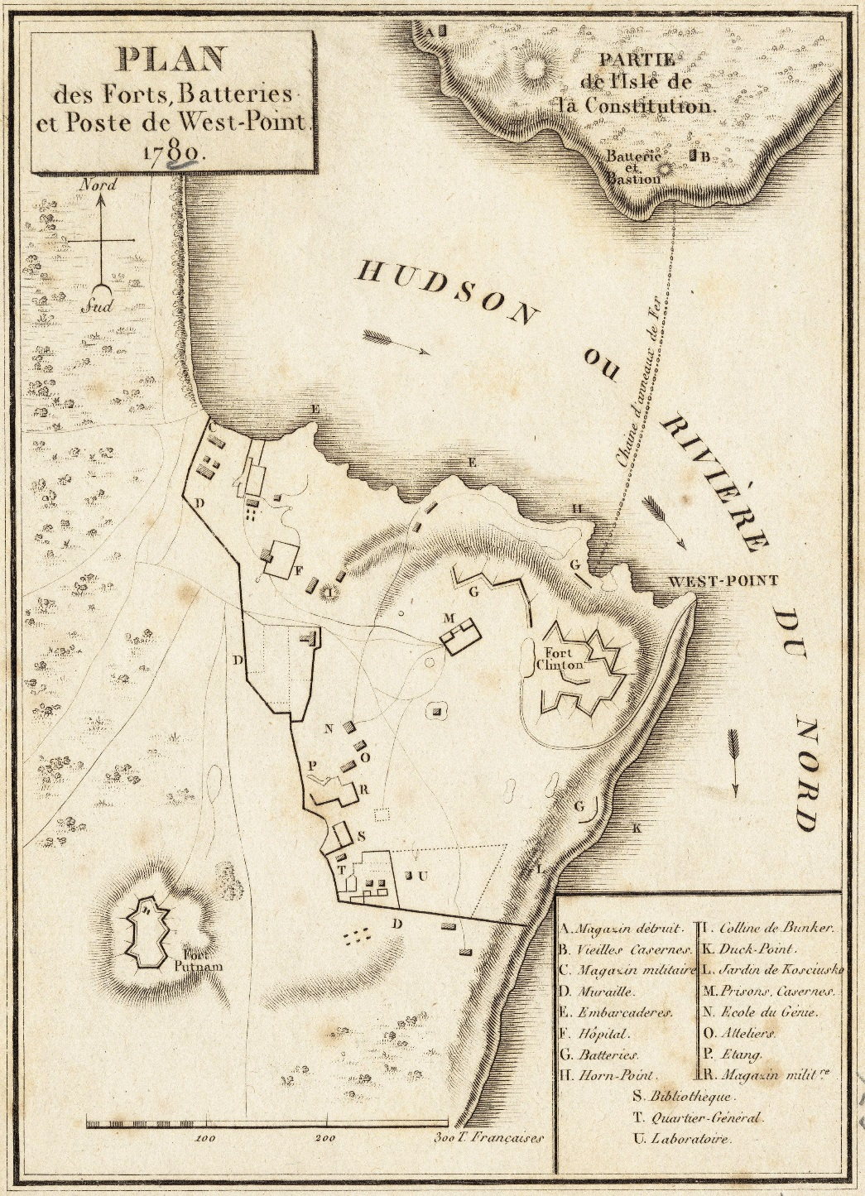
1780 the first French soldiers arrived in Americas
Benedict Arnold feeling unappreciated attempted to sell West Point to the British
Plot to sell West Point for 6300 pounds is discovered and Arnold flees to England

Slide 5
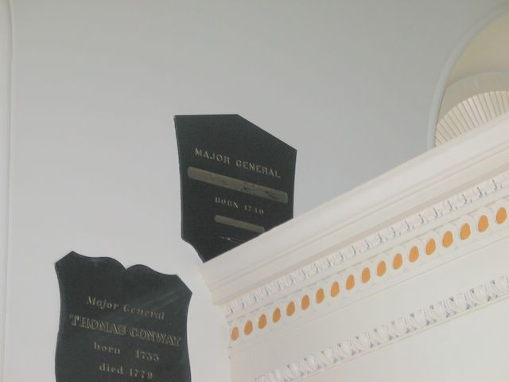
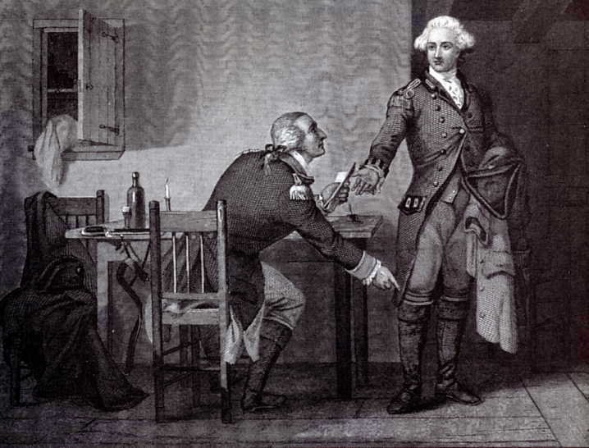

Slide 6
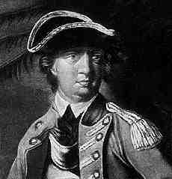

Slide 7
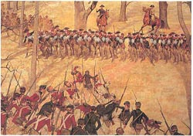
British have a new plan to take over the colonies from the South to the North
Lord Cornwallis runs into defeat at Kings Mountain and Cowpens

Slide 8
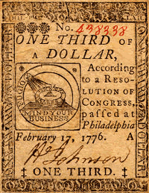
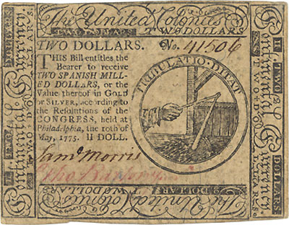
Inflation became a big problem for the colonists
For every dollar of debt the continental government could only pay back 2.5 cents

Slide 9
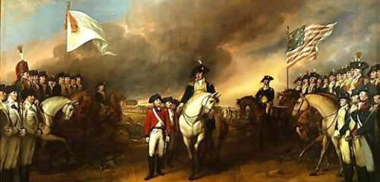
Cornwallis moves up to Virginia along the Chesapeake Bay
Assumes he can get reinforced and supplied by the British Navy
French navy blocks the British by sea and Washington blocks them by land

Slide 10
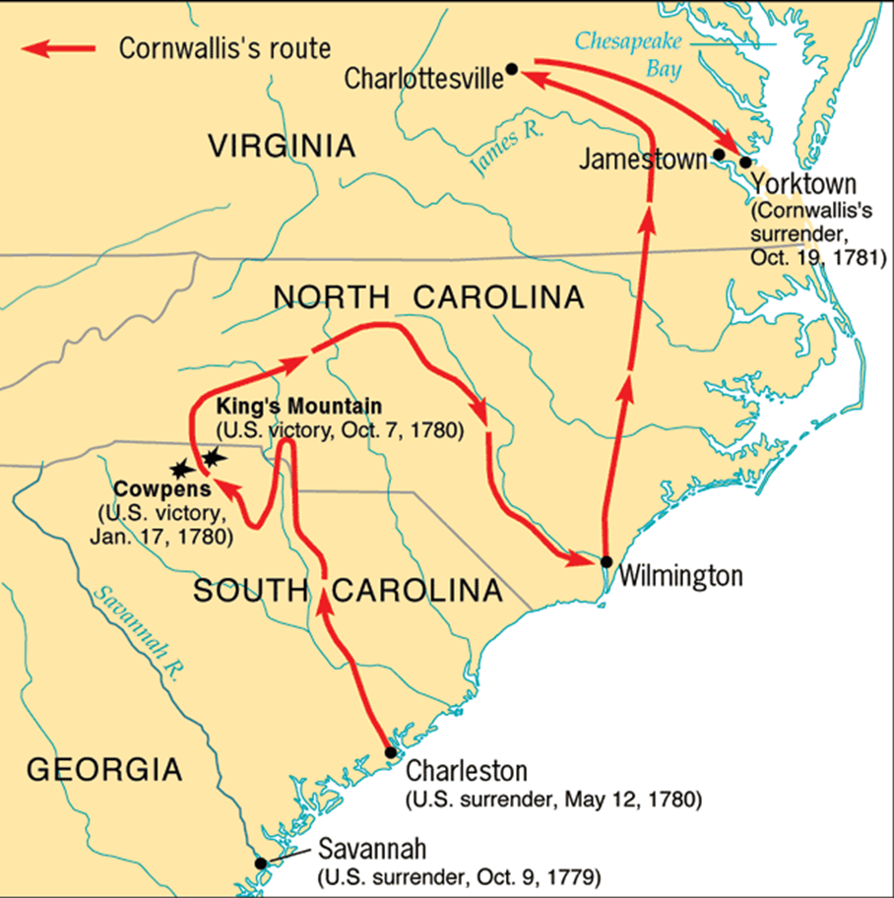

Slide 11
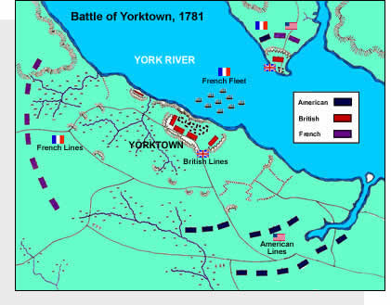

Slide 12
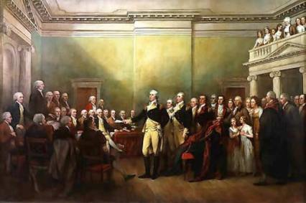
Britain was tired of the war
Fighting was occurring in the Mediterranean, West Indies, India, and North America
Once Cornwallis is defeated the British stay in America another year before war is officially over.

Slide 13
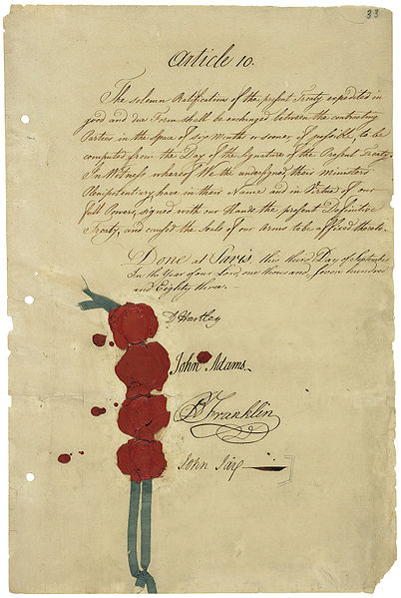
Treaty of Paris
Britain formally recognizes America’s independence
Gives US land all the way to the Mississippi
Americans promise not to persecute loyalists
Britain was friendly to the US because it wanted to drive wedge between US and France

Slide 14
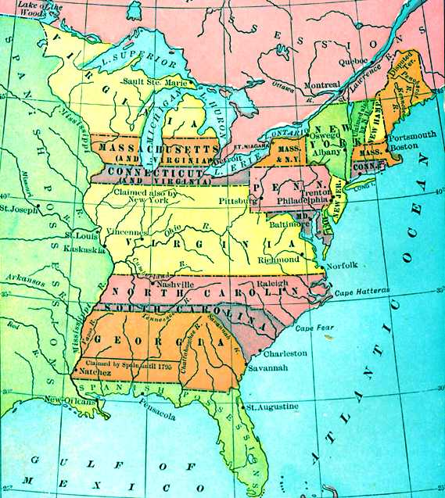

Slide 15
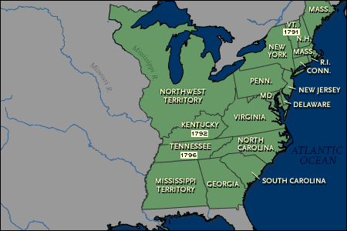

Slide 16
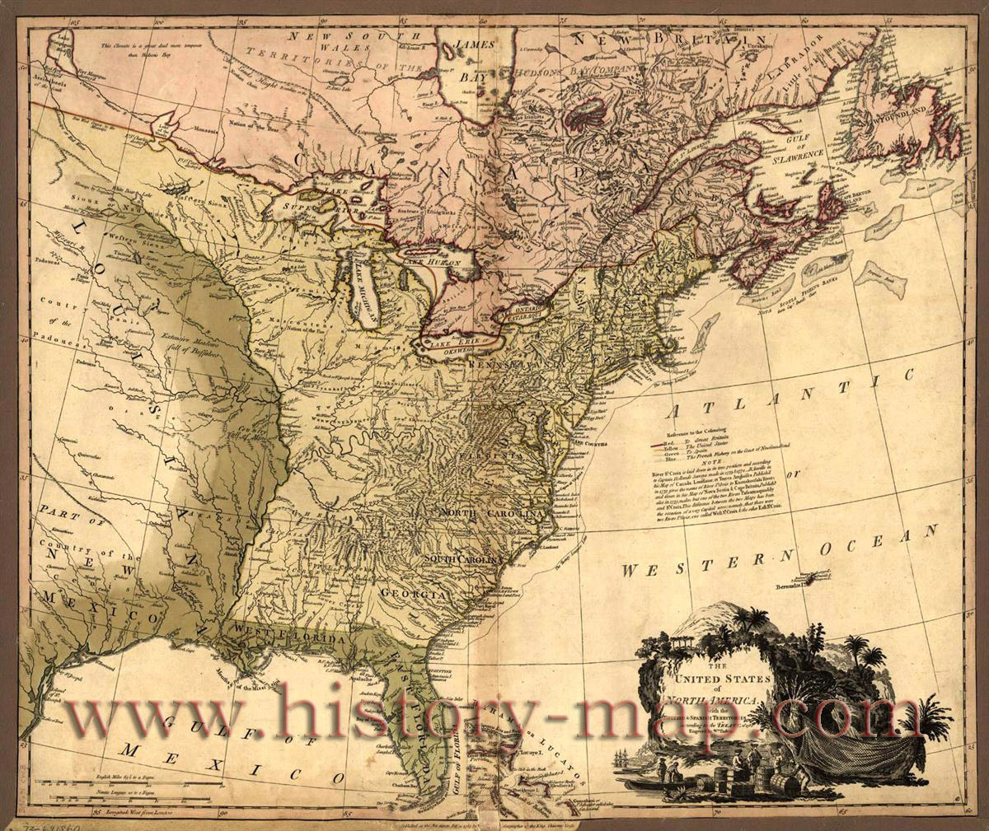

Slide 17
Territorial Expansion
1. Label the states
2. The area of the original 13 states
3. The area gained by the United States from the British as a result of the American Revolution

