Slide 1
Period 2, 5, & 6
We will examine life in the growing cities.
Finish Computer work and life of a sweatshop girl
Cities today
Chapter 7.2 Notes

Slide 2
What are some advantages of living in a city? What are some disadvantages? What are some problems that are specific to cities today?

Slide 3
Chapter 7 Section 2
Most immigrants became city dwellers
Cheap places to live
Convenient
Offered unskilled laborers steady jobs
Immigrants made up more than half the population of major cities

Slide 4
Many immigrants moved into ethnic communities
Provided social support
Speak their own language
Practice their customs and religion

Slide 5
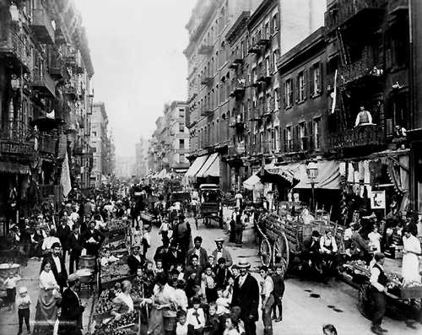

Slide 6
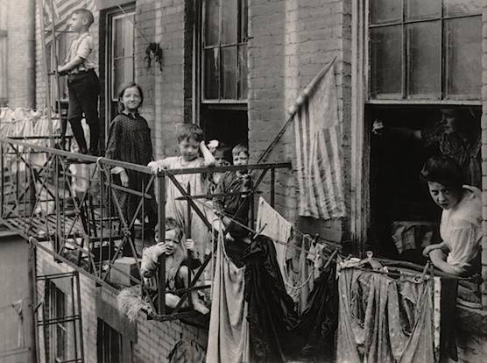

Slide 7
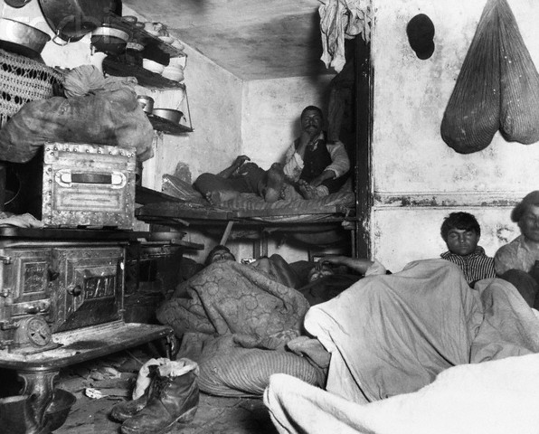

Slide 8
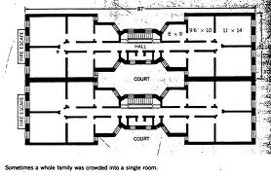

Slide 9
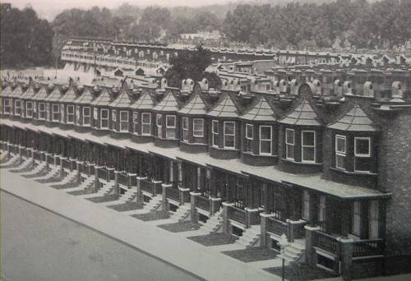

Slide 10
Cities became overcrowded
Americans from rural areas no longer needed to farm
200,000 African Americans left the South for Northern cities like Chicago and Detroit
Segregation was rampant in Northern Cities
Fight over jobs between immigrant groups and blacks developed

Slide 11
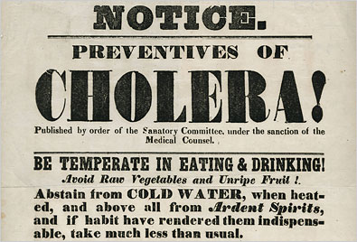

Slide 12
Urban Problems
Housing
Tenements were built to house city dwellers
Multi-story apartments that had minimum standards for plumbing and ventilation
Water
Large cities had trouble providing water for residence
Cholera and typhoid fever were contracted from drinking unsafe water
Filtration started in 1870s and chlorination in 1908

Slide 13
Crime
pickpockets and thieves flourished
New York City organized first salaried police force in 1844
Fire
Cities lacked water to fight fires
Most buildings were made out of wood
Candles and kerosene heaters added to fire hazard

Slide 14
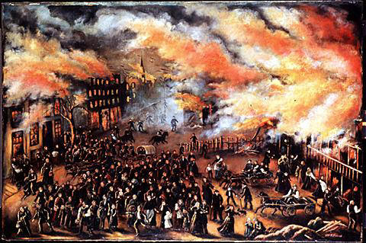

Slide 15
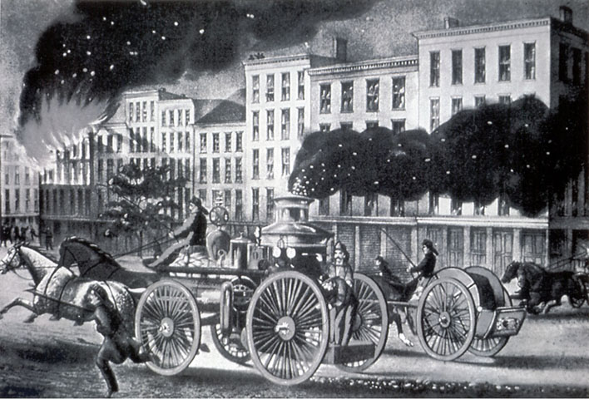

Slide 16
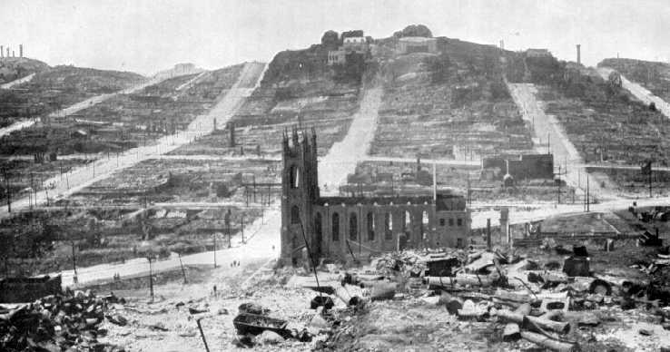

Slide 17
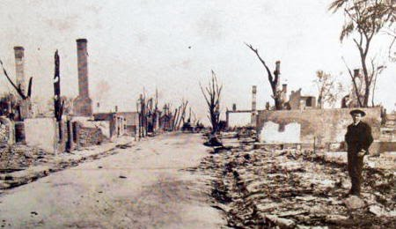

Slide 18
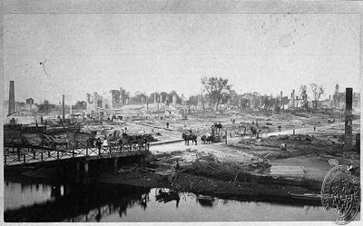

Slide 19
How can one improve the layout of a city to prevent more fires?

