Slide 1
Period 2,5,6,&7
We will examine the Reign of Terror and the use of the guillotine
Warm Up: Is a person’s head still alive after it gets guillotined?
Return Map Test
Finish Up classwork Reading/Questions/Video Clip
Louis XVI’s execution
Chapter 7.2 Notes
End of the week video

Slide 2
Chapter 7 Section 2
The Rights of Man
The rights included liberty, property, security, and resistance to oppression
Leaders of the Revolution adopted idea of Liberty, Equality, Fraternity
Louis XVI tries to escape
Tried to escape to neighboring Netherlands
Near the border they were captured and returned to Paris
His attempt to escape led to his execution

Slide 3
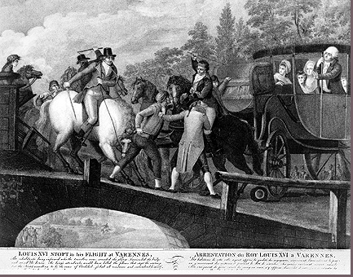
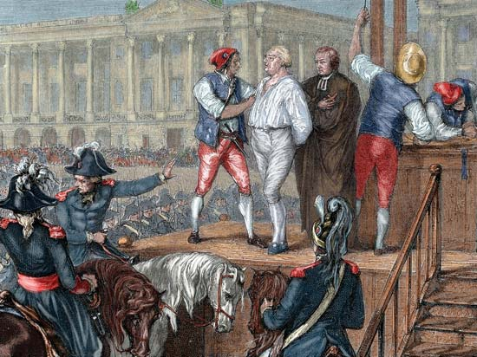

Slide 4
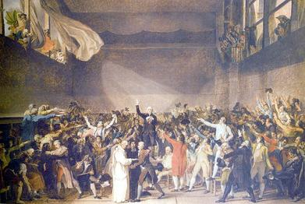
Factions in France
Radicals
Jacobins – sat on left of assembly, opposed monarchy
Moderates
Sat in center of assembly, wanted some changes
Conservatives
Sat on the right of assembly, supported limited monarchy

Slide 5
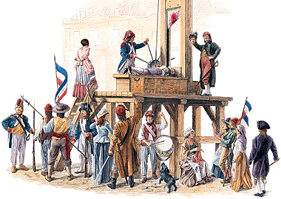
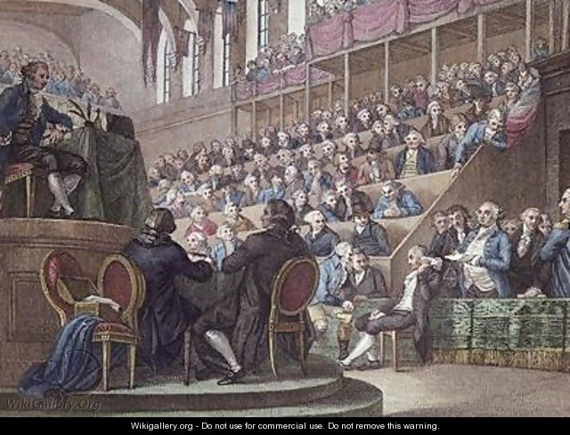
King’s trial and execution
Jacobins wanted King Louis gone
King Louis XVI tried for treason
Found guilty by one vote
Sentenced to die by guillotine

Slide 6
Period 2,5,6, & 7
We will examine the rise of Napoleon Bonaparte to become leader of France
Warm Up: What are the characteristics of a tyrant?
Finish Up Chart of Declarations
Finish Up 7.2 Notes
Timeline
Document Based Question

Slide 7
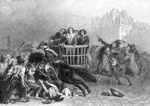
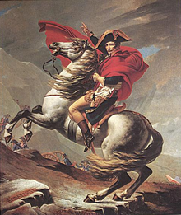
The Reign of Terror
Maximilien Robespierre took control of France as a dictator
Anyone who he felt was a threat to the Revolution was killed
Many who had led revolution were guillotined
Possibly as many as 40,000 killed, 85% were from the third estate
Eventually Revolution turns on Robespierre and he is guillotined
New government looks to Napoleon Bonaparte for leadership

Slide 8
Place the following events in order from first occurring to last, include date. (Pages 217 – 237)
Jacobins Gain Power
Great Fear
Napoleon’s Coup
Peninsula War
Reign of Terror
Invasion of Russia
Napoleon crowned Emperor
Storming of the Bastille
Louis XVI attempts to escape
Louis XVI Executed
Napoleon appointed head of army
Battle of Waterloo
Robespierre takes power
Plebiscite vote for New Constitution
Third Estate Creates National Assembly

Slide 9
DBQ
In your notes write out Document 1 through Document 10
Examine each document and explain the following
What is the document about
Does it support the idea of Napoleon as a tyrant or a hero?

