Slide 1
Chapter 6 The French and Indian War
Fought in America, West Indies, Europe, Africa, and the Philippines
Britain and Prussia v. France, Russia, Spain, and Austria
Most of the French army was kept in Europe where the war was known as the Seven Years War

Slide 2
In 1754, 7 of the 13 colonies met for an inter-colonial congress held in Albany, New York, known simply as the Albany Congress.
A month before the congress, Ben Franklin had published his famous “Join or Die” cartoon
The Albany plan failed because the colonies were reluctant to give up their sovereignty or power.

Slide 3
In 1754, the governor of Virginia sent 21 year-old George Washington to the Ohio country in command of about 150 Virginia minutemen.
Encountering some Frenchmen, the troops opened fire, killing the French leader.
Later, the French returned and surrounded Washington’s hastily constructed Fort Necessity, and made him surrender.

Slide 4
Period 3 & 7
We will examine the Albany Plan of Union and its attempts to establish a unified colonial government.
Warm Up: Using the two maps on 116, how did the French and Indian War impact the power structure of North America?
Scalping
Chapter 6 Notes
Albany Plan of Union
Chapter 7 Reading

Slide 5
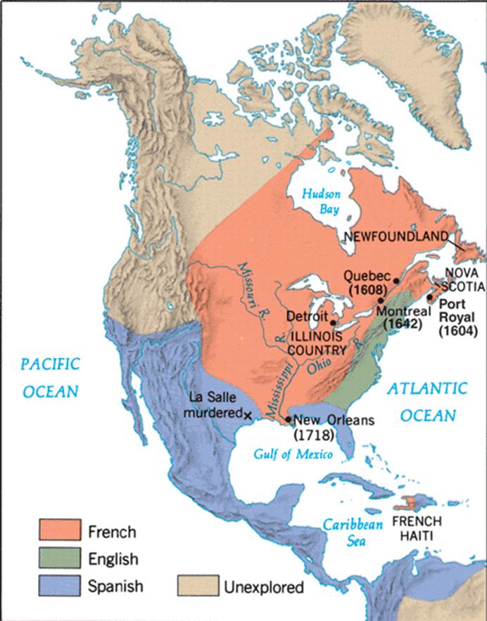

Slide 6
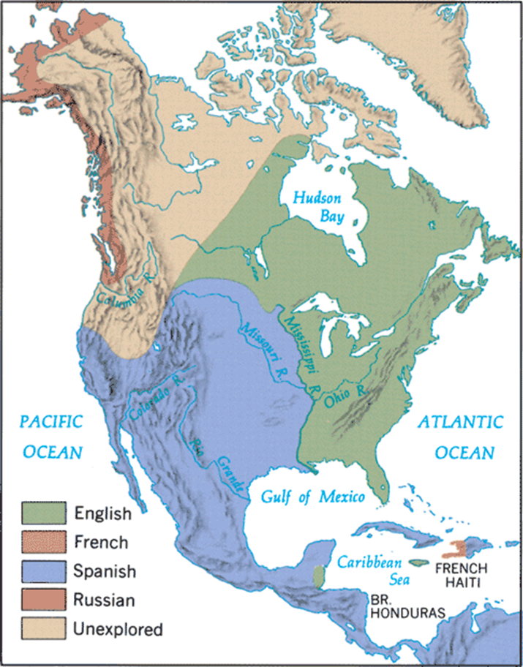

Slide 7
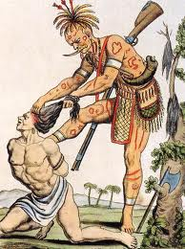
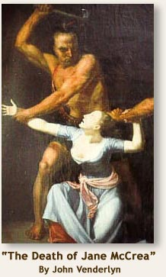
Scalping During the French and Indian War
Based on the first hand accounts, what purpose do you think scalping served?

Slide 8
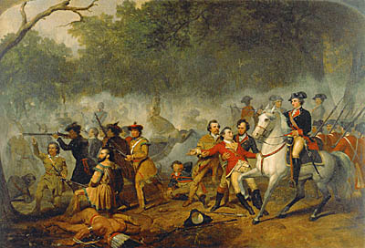
General Braddock’s failed attempt to capture Fort Duquesne left frontier wide open to attack
Afterwards, the frontier from Pennsylvania to North Carolina felt the Indian wrath, as scalping occurred everywhere.

Slide 9
William Pitt becomes the leader of the British government “the great commoner”
Picks James Wolfe to lead assault on Quebec
British defeat French at Quebec (1759) and then Montreal (1760)
Looking at the map on 115 why are those cities so important?

Slide 10
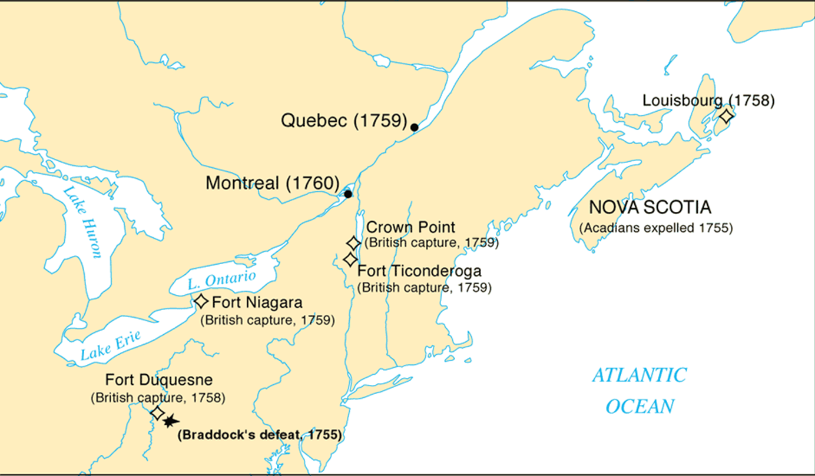

Slide 11
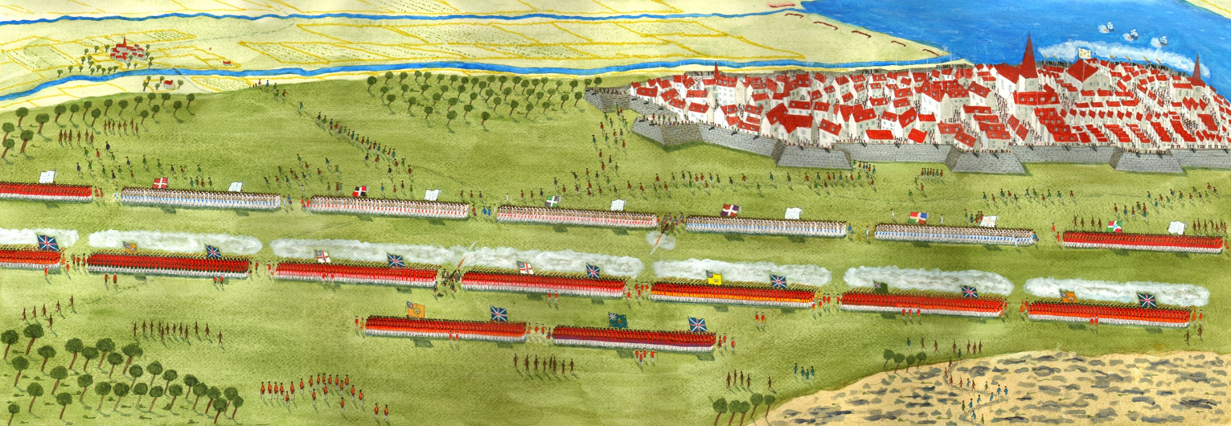

Slide 12
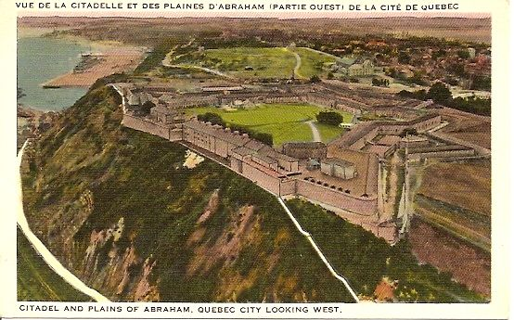

Slide 13
Causes for Colonial Disunity
Geographical boundaries and distance
Religion
Varied nationalities
Different colonial governments
Boundary disputes
Frontier v. land owning aristocracy

Slide 14
Proclamation of 1763 cuts off access to land west of Appalachian Mountains
British want to keep Native Americans and Colonists separate
Colonists disregarded order and moved West

Slide 15
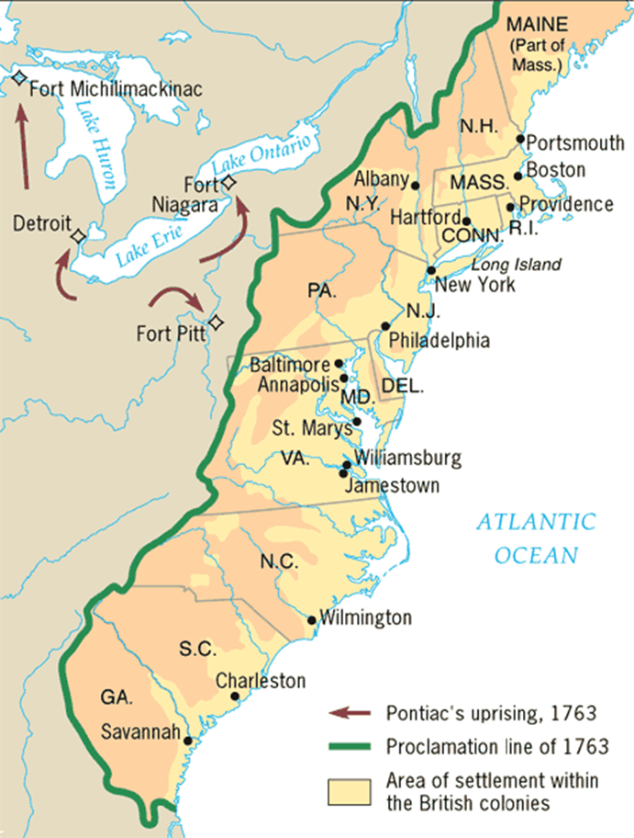

Slide 16
Albany Plan of Union
Who made up the union government? How were they chosen?
Why do you think some colonies received more members than others?
What colonies were not included in the Grand Council?
What powers did the government have? Give two examples.
How is this document a step toward a unified colonial government? Give 1 example.

Slide 17
