Slide 1
Period 1, 5, & 6
We will examine the growth of industry in the United States during the second half of the 19th Century.
ISS view of Earth at Night
America the Story of US clip
Thomas Edison Predicts the Future
Shock Treatment

Slide 2
Edison Predicts the Future
1. What were two predictions that Edison made that were inaccurate?
2. Were there any predictions that Edison got correct? What were they?
3. What technology prediction can you make about the future 100 years from now?

Slide 3
Chapter 6 Section 1
Factors in America’s industrial boom
Wealth of natural resources
Government support for business
Growing urban population
Cheap labor
Markets to sell goods
60 years America goes from agriculture to industry

Slide 4
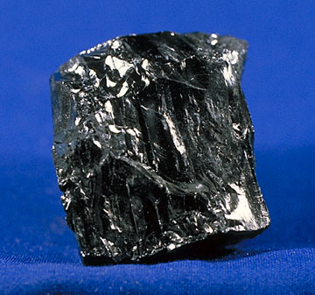
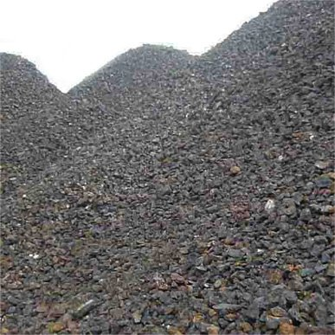
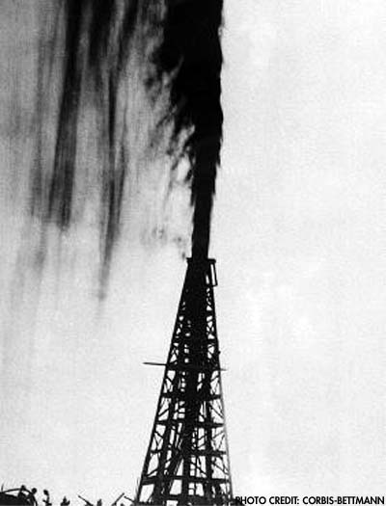

Slide 5
Black Gold
Got kerosene from oil
Gasoline was originally thrown away until the car became popular
Bessemer Process
Iron would break and rust
Remove carbon from Iron turns it into steel
steel was rust resistant, stronger, more flexible

Slide 6
Uses for steel
Railroads used steel for thousands of miles of track
Steel allowed Brooklyn Bridge to be built
At the time only pyramids were taller
First skyscrapers were built
Home Insurance Building in Chicago 138 feet tall

Slide 7
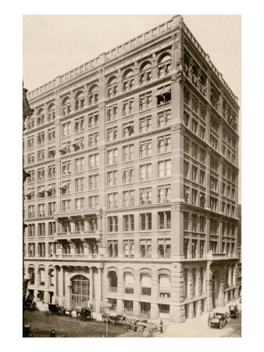

Slide 8
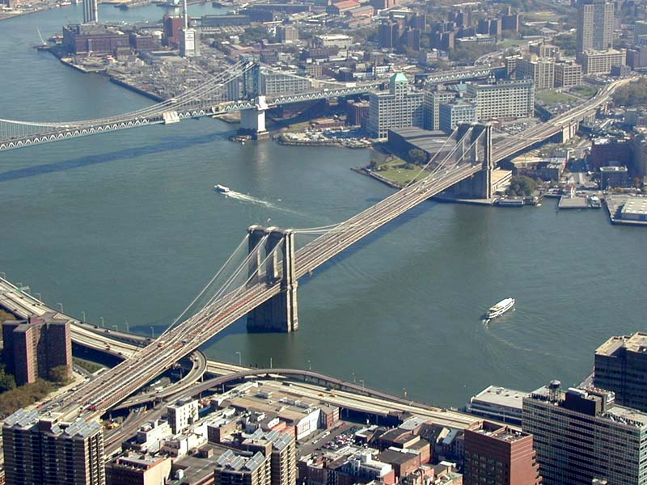

Slide 9
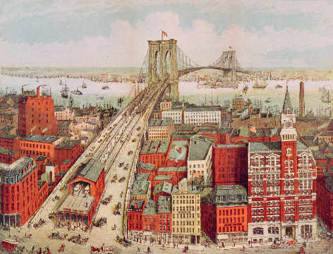

Slide 10
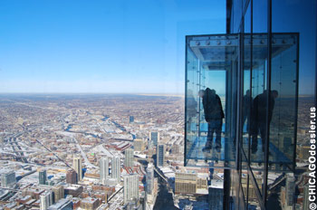
Burj Khalifa
2717 Feet Tall

Slide 11
Inventions
Thomas Edison perfects the incandescent light bulb
Harnessing electricity allows businesses to run machines, time saving appliances in the home, electric streetcars expand cities.

Slide 12
Invention of typewriter and telephone changes life of women
For the first time a large number of jobs were available to women outside of the home.
Secretaries
Telephone operators

Slide 13
