Slide 1
Current Events

Slide 2
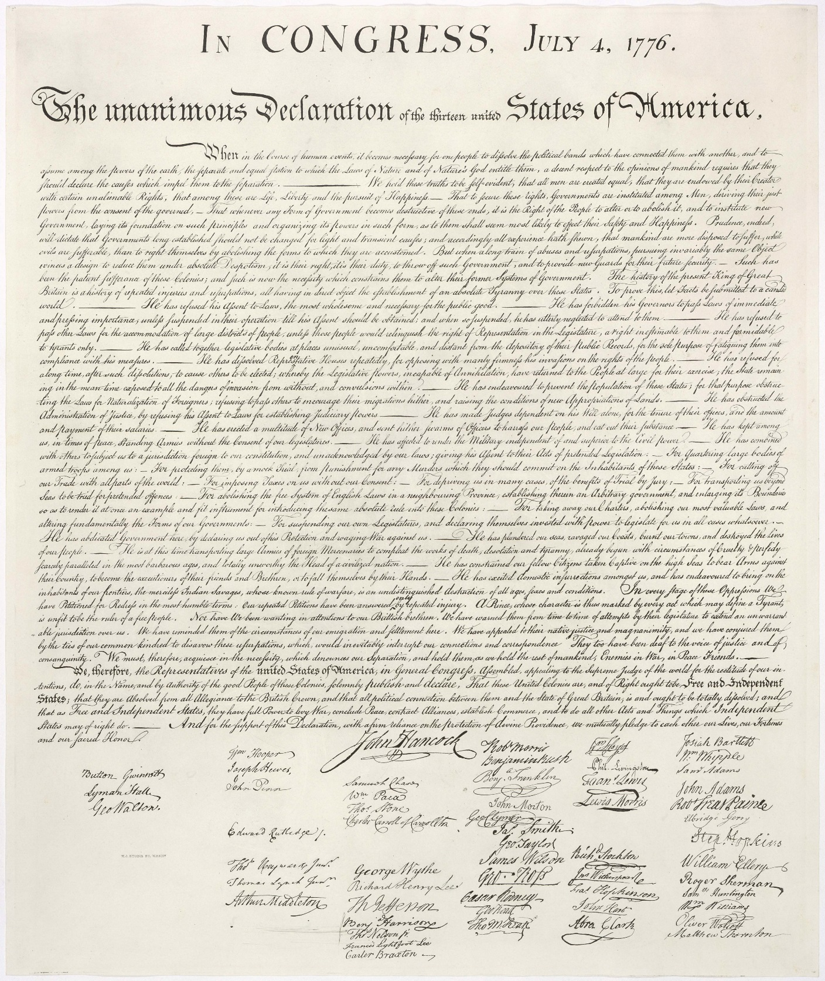

Slide 3
Declaration of Independence
Why is the Declaration of Independence written?
What are three unalienable rights?
Who gives people these rights?
Where does government get its power from?
What are people supposed to do if government doesn’t work?
Who do you think the colonists are blaming for their separation?
What are three things this person has done?

Slide 4
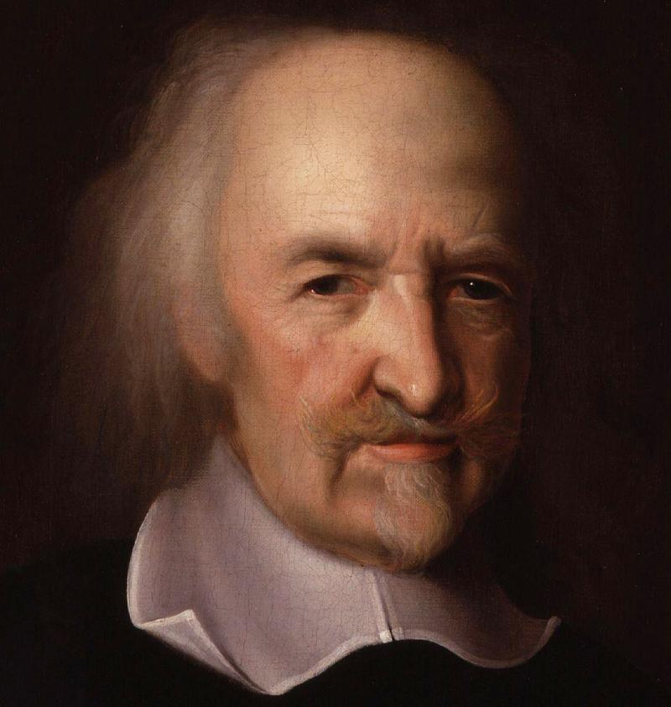
Two Views on Government
Thomas Hobbes’s
Expressed views in Leviathan
Believed people were wicked and selfish
Government was needed to keep people in line
People had to hand over rights to a strong ruler
Social Contract gave them law and order
Best government was absolute monarchy

Slide 5
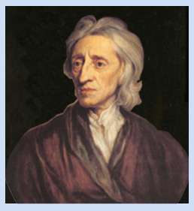
John Locke
People could learn from experience and improve themselves
Believed in self-government
All people are born free and equal
3 Natural Rights – life, liberty, and property
Government’s purpose is to protect these rights
If government fails to do so citizens have the right to overthrow it

Slide 6
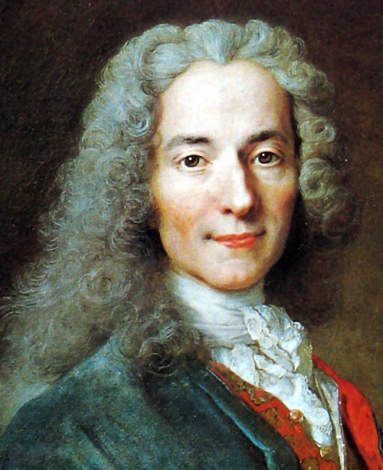
Voltaire
Targeted the clergy, aristocracy, and the government
Wrote against intolerance, prejudice, and superstition
Was imprisoned twice and exiled to England
“I do not agree with a word you say but will defend to the death your right to say it.”

Slide 7
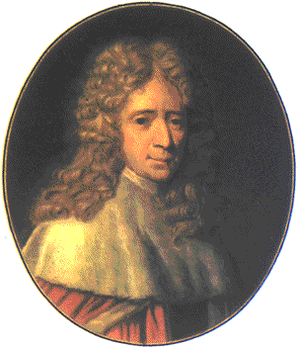
Montesquieu
Believed Britain had the best-government
Proposed that separation of powers would keep individual or group from gaining too much control
Believed in one part of government checking the other.

Slide 8
Period 2,5,6, & 7
We will examine the political thinking of the Enlightenment and its influence on America
Warm Up: If you are accused of a crime what rights do you have?
Chapter 6 Section 2 Notes
Chapter 6 Notequiz
Chapter 6 Section 3 Reading

Slide 9
Rousseau
Civilization corrupted people’s natural goodness
Only good government was formed by the people
People give up some liberty in favor of the common good
Believed in a social contract between people

Slide 10
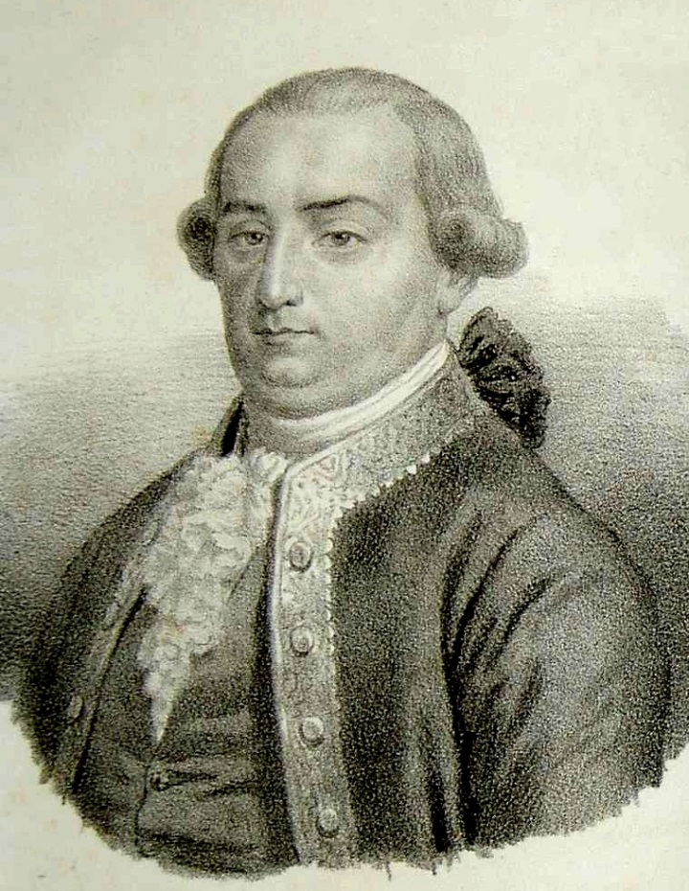
Beccaria
Focused thoughts on the justice system
Laws exist to preserve social order
Person accused of a crime should receive a speedy trial
Torture should never be used
Punishment should be based on seriousness of the crime

