Slide 1
Period 2,5,6, & 7
We will examine the key scientists in the Scientific Revolution.
Warm Up: Why do you have to wear a seat belt in the car?
Go over test
Complete Scientist Chart
Isaac Newton
Newton’s First Law
Who would be the most influential people in world history?

Slide 2
Alternative Lessons
Apply to college
Change a tire
Get insurance
Buy/ rent a house
Buy a car
Taxes
Balance checkbook
Change oil
Military information
How to get a credit card
Manage/ budget money
Write a resume

Slide 3
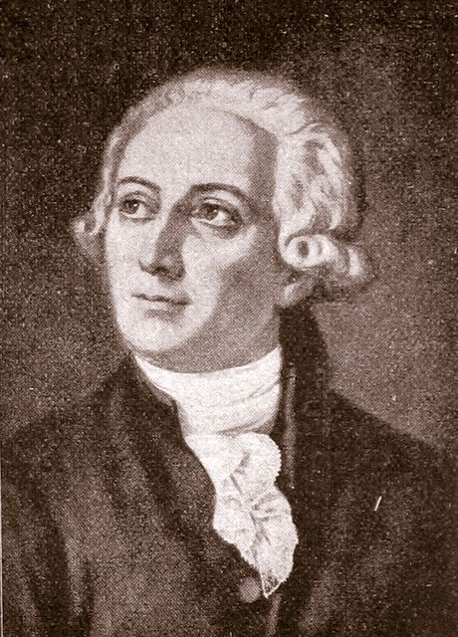
Antoine Lavoisier
Scientist who discovered the role of oxygen in combustion
Identified oxygen and hydrogen

Slide 4
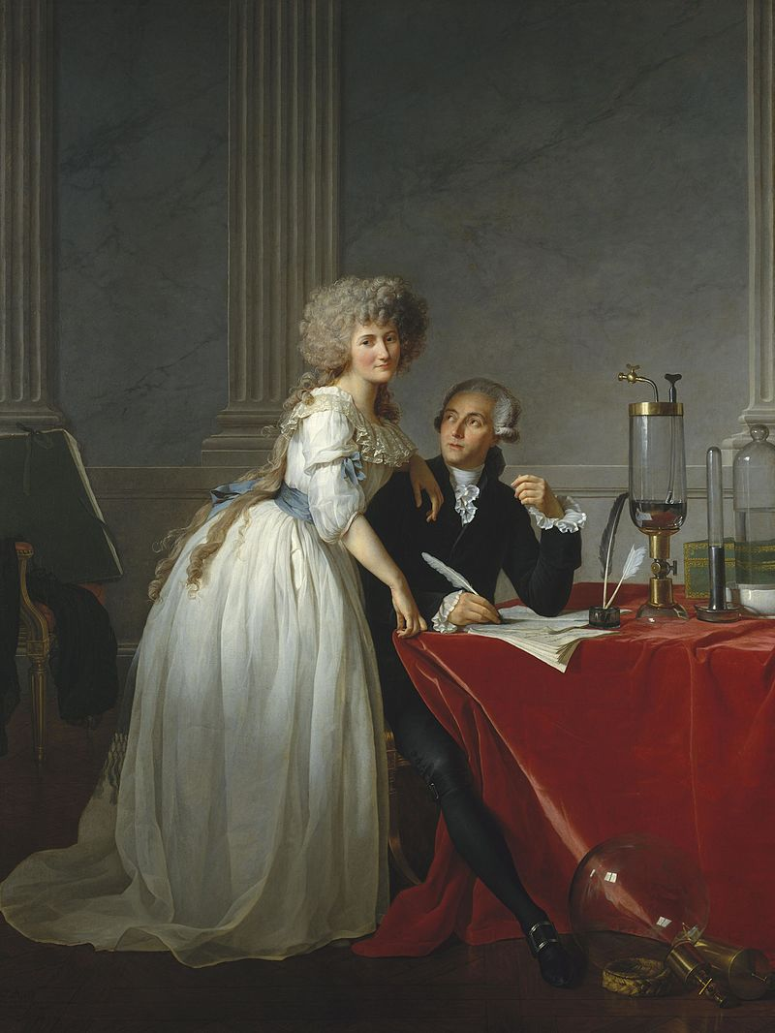
Marie Lavoisier
Important in standardizing the scientific method

Slide 5
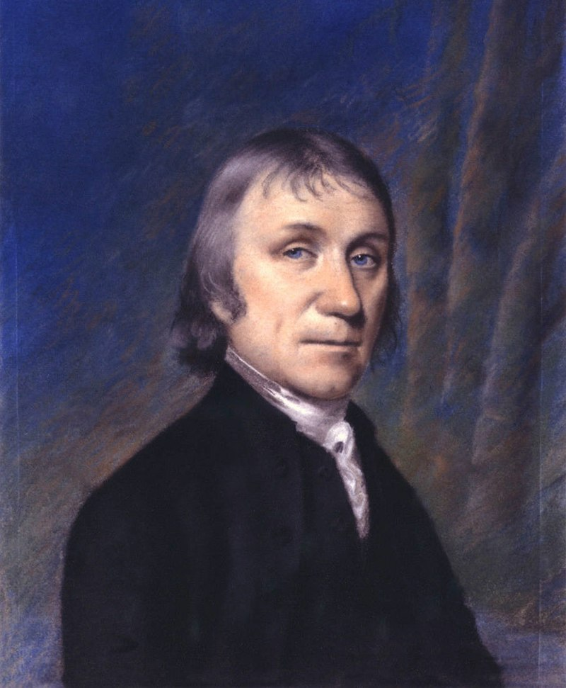
Joseph Priestley
Also credited with identifying oxygen
Invented soda water

Slide 6
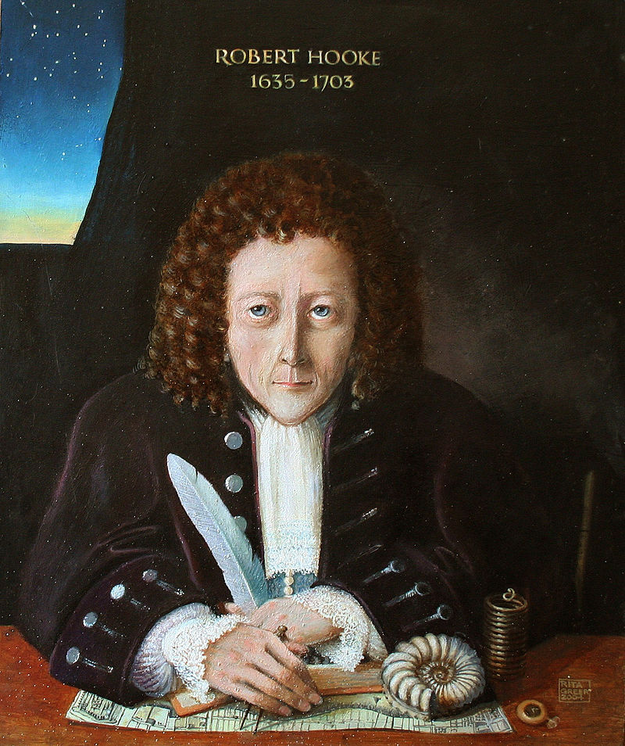
Robert Hooke
Develops successful microscope

Slide 7
Sir Isaac Newton
Comes up with the laws of motion
An object in motion stays in motion and an object at rest stays at rest unless acted on by an outside force
Comes up with the law of gravity
Every object in the universe attracts every other object.
The degree of attraction depends on the mass of the object and the distance between

Slide 8
Newton’s First law in the NFL
How is inertia represented in the NFL?
How is Newton’s First Law represented in the football game?
What is the difference between mass and weight, and how does it apply to Newton’s first law?

