Slide 1
Period 3 & 7
We will examine life in the New England Colonies and the impact of religion on society.
Chapter 4 Notes
Salem Witch Trials
Chapter 4 Guidebook

Slide 2
New England Family
In New England, there was clean water and cool temperatures, so disease was not as predominant as in the South.
The first New England Puritans had an average life expectancy of 70 years.
In contrast to the Chesapeake, the New Englanders tended to migrate as a family, instead of individually.
A typical woman could expect to have ten babies and raise about eight of them.
Death in childbirth was not uncommon

Slide 3
In the South, women usually had more power, since the Southern men typically died young and women could inherit the money, but in New England, the opposite was true.
New England law was very severe and strict.
For example, adulterous women had to wear the letter “A” on their chest if they were caught (as with The Scarlet Letter by Nathaniel Hawthorne).

Slide 4
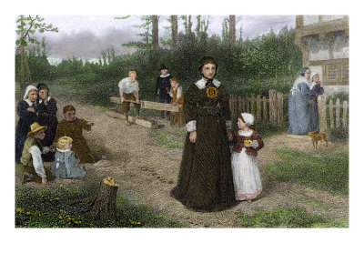

Slide 5
Education in New England Towns
A town usually had a meetinghouse surrounded by houses and a village green.
Towns of more than 50 families had to provide primary education.
Towns of more than 100 had to provide secondary education.
In 1636, Massachusetts Puritans established Harvard College to train men to become ministers.

Slide 6
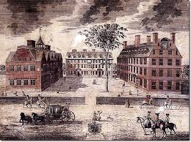
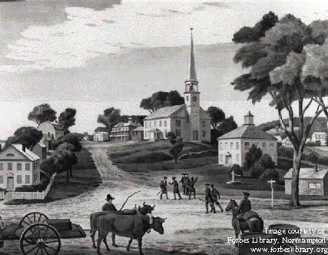

Slide 7
Troubled ministers announced a new formula for church membership in 1662, calling it the “Half-Way Covenant.”
In the Half-Way Covenant, all people could come and participate in the church, even if they fell short of the “visible-saint” status and were somehow only half converted

Slide 8
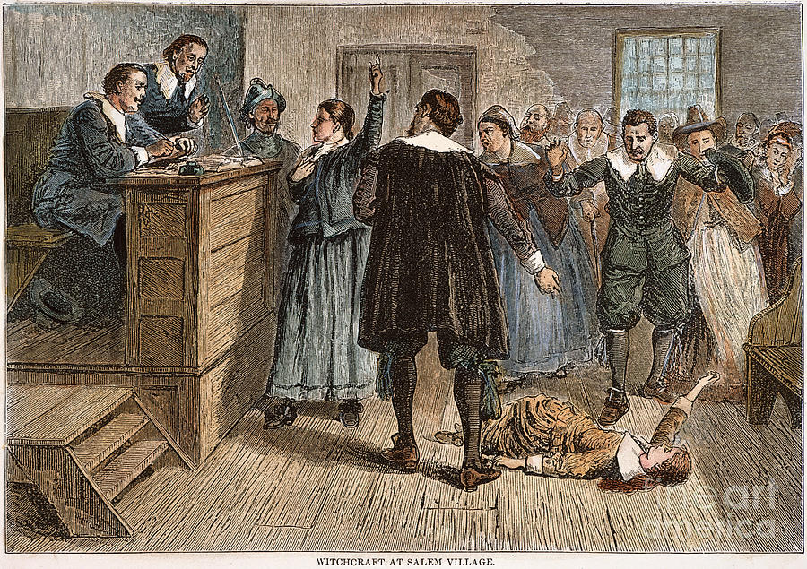

Slide 9
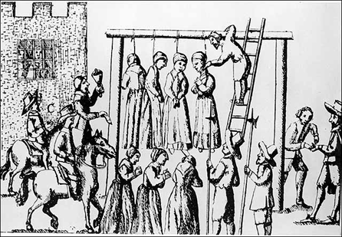
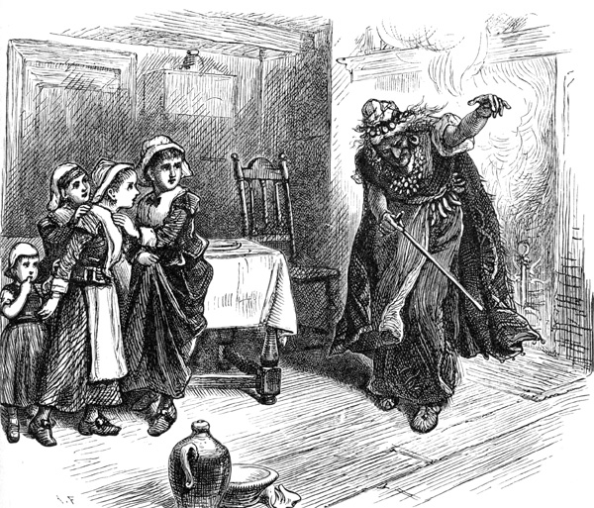

Slide 10
New England Way of Life
Due to the poor New England soil, New Englanders became great traders.
New England was also less ethnically mixed than its neighbors.
The climate of New England encouraged diversified agriculture and industry.
Slavery was attempted, but didn’t work.
New England was made of small farms rather than plantations.

Slide 11
Salem Witch Trials
Why did Salem villagers believe Satan was at work in their town?
Who was Tituba? How did she help initiate the witch trials?
Why was the trial of Martha Corey different from previous trials?
How many people died as a result of the trials? How did they die?
What did the girls see and do during Corey’s interview?
How many girls were afflicted?
What did Corey think of the girls testimony?
What happened to the afflicted when Corey bit her lip?
What happened to Corey as a result of the interview? How did the girls react afterward?

