Slide 1
Period 3 & 7
We will examine events from the Nixon presidency that impacted Americans at home and abroad.
Who was the president that was never elected?
AP Review
Chapter 40 Notes

Slide 2
Critical Events
Find the critical event for the following years and write down why its significant.
1763
1776
1789
1800
1803
1814
1848
1861
1865
1877
1914
1918
1929
1941
1945
1954
1960
1964
1968
1973

Slide 3
Chapter 40 Nixon’s Presidency
Nixon's announced policy, called "Vietnamization," was to withdraw the 540,000 U.S. troops in South Vietnam
November 3, 1969, Nixon delivered a televised speech to the "silent majority," who presumably supported the war

Slide 4
Nixon’s Policies in America
In 1971, the 26th Amendment was passed, lowering the voting age to 18
Nixon expanded the Great Society programs by increasing funding for Medicare, Medicaid
The Clean Air Act of 1970 and the Endangered Species Act of 1973 both aimed at protecting the environment
Took nation off of the gold standard

Slide 5
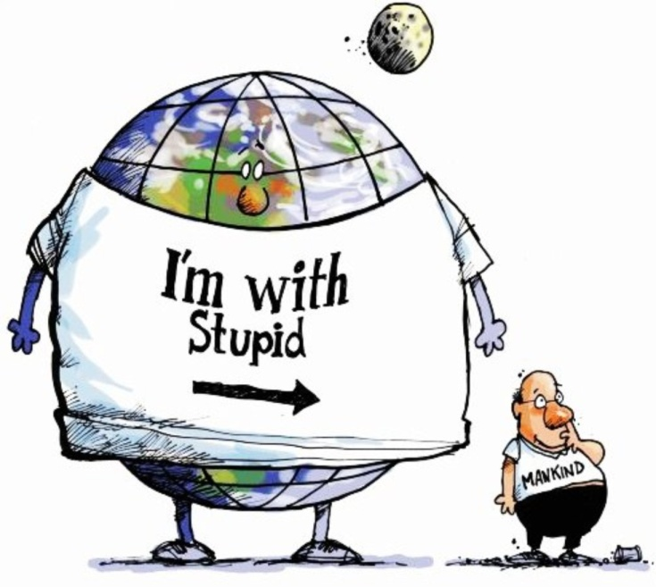

Slide 6
Nixon’s Foreign Policy
Nixon's visits ushered in an era of détente, or relaxed tensions between the Soviet Union and China
SALT (Strategic Arms Limitation Talks), froze the numbers of long-range nuclear missiles for 5 years
January 23, 1973, North Vietnamese negotiators agreed to a cease-fire

Slide 7
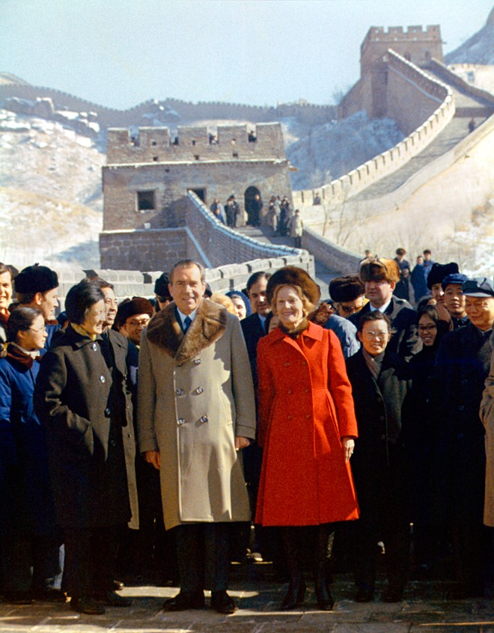
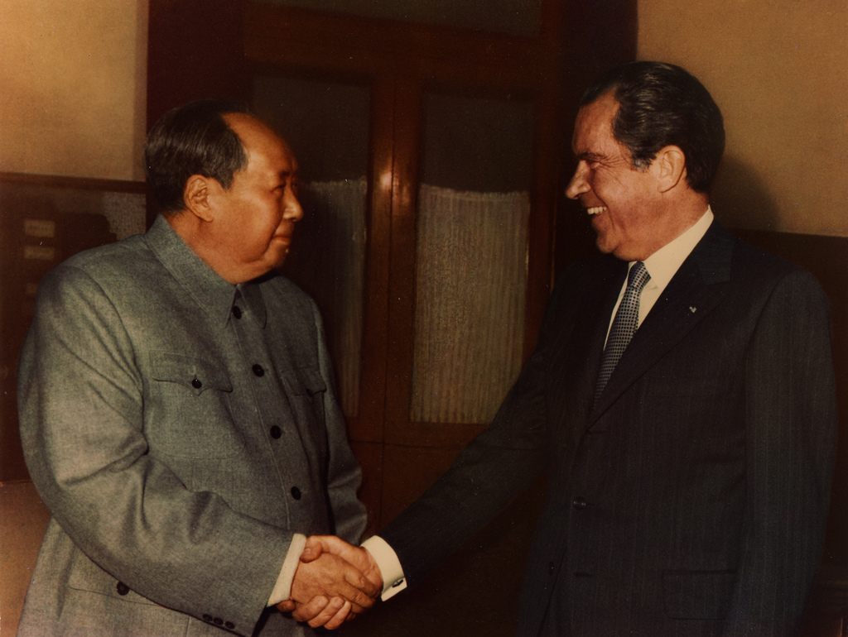

Slide 8
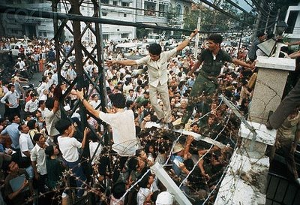
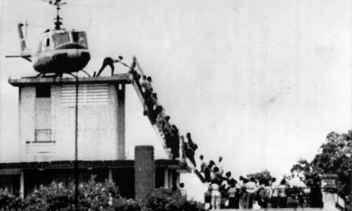
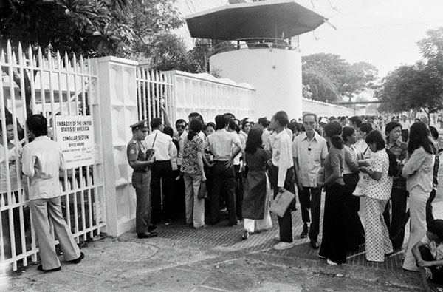

Slide 9
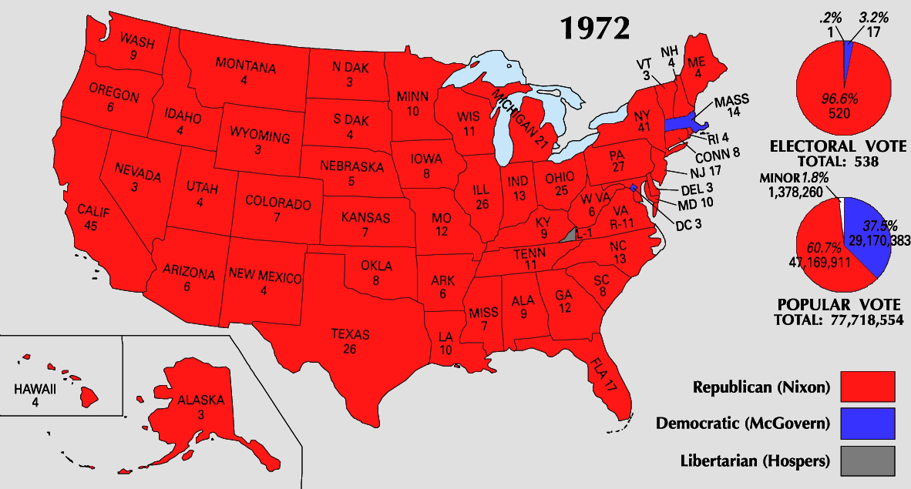

Slide 10
Watergate
five men working for the Republican Committee for the Re-election of the President were caught breaking into the Watergate Hotel and bugging rooms.
August 1974, Nixon resigns rather than be impeached

Slide 11
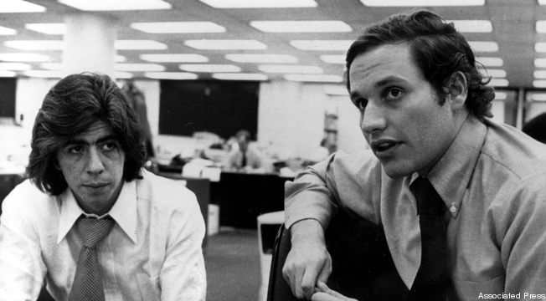
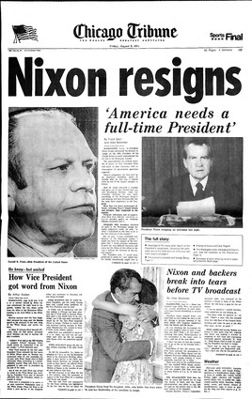
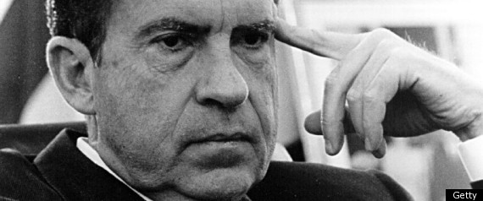

Slide 12
