Slide 1
Period 3 & 7
We will examine the events surrounding the establishment of Plymouth and Puritan Massachusetts.
Go over homework
How to fire a matchlock musket
Chapter 3 Notes
Life in Puritan Massachusetts
Pilgrim Clip

Slide 2
Chapter 3 Settling the Northern Colonies
Group of Separatists in Holland felt they were losing their English identity headed to America
Before leaving the Mayflower 41 men signed the Mayflower Compact
- agreed to submit to the will of the majority
- first example of government in America
First winter only 44 of 102 survive

Slide 3
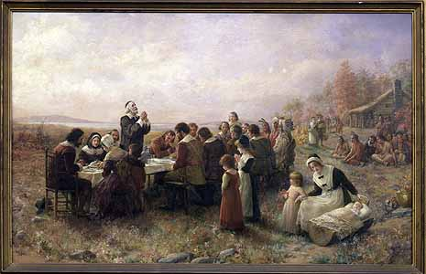
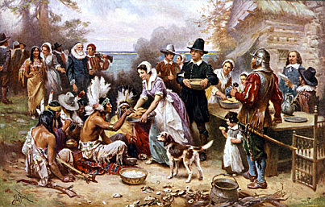

Slide 4
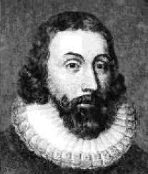
William Bradford, chosen governor of Plymouth 30 times in the annual elections, was a great leader, and helped Plymouth to survive and trade fur, fish, and lumber.
In 1691, Plymouth finally merged with the Massachusetts Bay Colony.

Slide 5
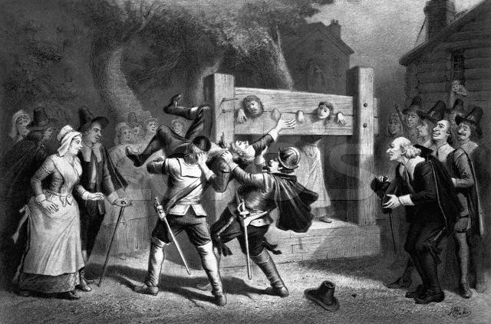
Religious leaders wielded powerful influence over the admission to church membership.
However, congregations could hire and fire their ministers at will.
Still, there were laws to limit Earthly pleasures, such as a fine of twenty shillings for couples caught kissing in public.

Slide 6
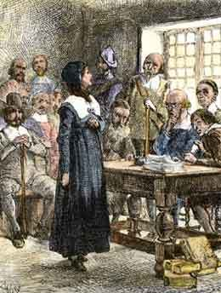
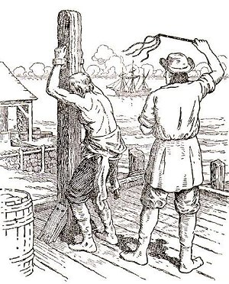
Quakers were fined, flogged, and/or banished.
Anne Hutchinson claimed that a holy life was no sure sign of salvation and that the truly saved need not bother to obey the law of either God or man. A notion known as “antinomianism”.

Slide 7
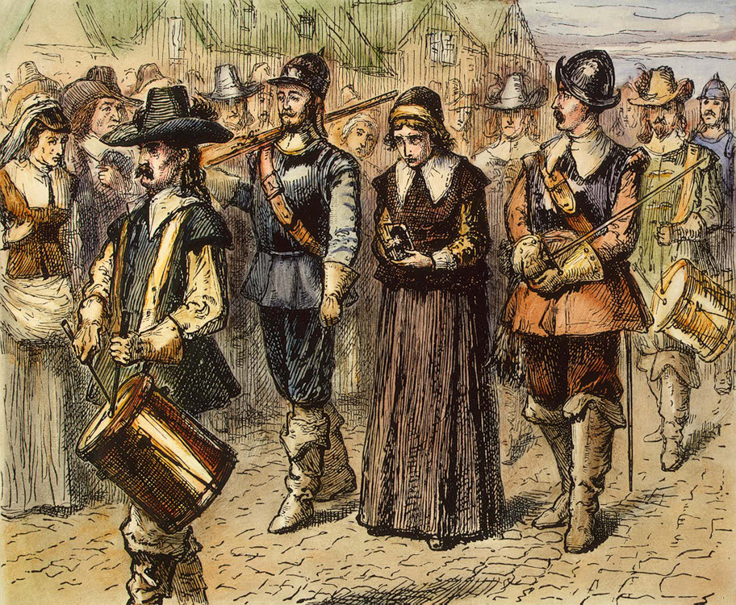

Slide 8
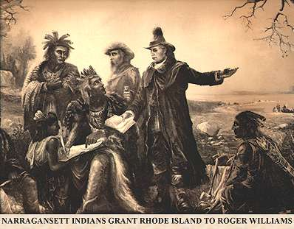
Roger Williams was a radical idealist hounded his fellow clergymen to make a clean and complete break with the Church of England.
He was banished in 1635, and led the way for the Rhode Island colony.

Slide 9
Puritan Family Law
Was the intent of the 1646 Massachusetts law merely to frighten children into behaving properly? In what ways might parents have been the primary targets of the law?
Was John Porter Jr. punishable under the terms of the 1646 law? In what ways was he a prime candidate for capital punishment?
How many children would you estimate were executed under the auspices of the 1646 law?

