Slide 1
Period 3 & 7
We will examine America’s preparation for World War II.
Go over homework
AP Review
Chapter 36 Notes
World War 2 Propaganda
Japanese Internment

Slide 2
American Colonization Society
Cult of Domesticity
Susan B. Anthony
Declaration of Sentiments
Compromise of 1850
Know Nothing Party
Manifest Destiny
Kansas Nebraska Act

Slide 3
Allies Trade Space for Time
FDR adopted the strategy of "getting Germany first“
US had to feed, clothe, and transport its forces to far away regions.
also had to send a vast amount of food and munitions to its allies
In the Supreme Court ruling in Korematsu v. U.S. (1944), the Supreme Court upheld the constitutionality of the concentration camps.

Slide 4
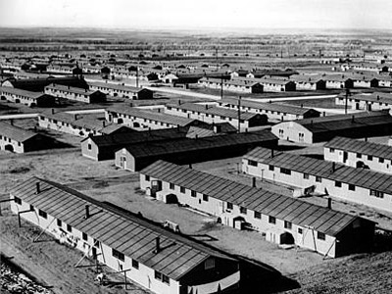
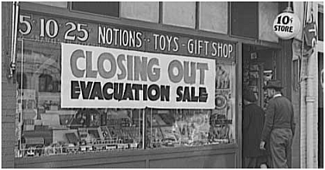
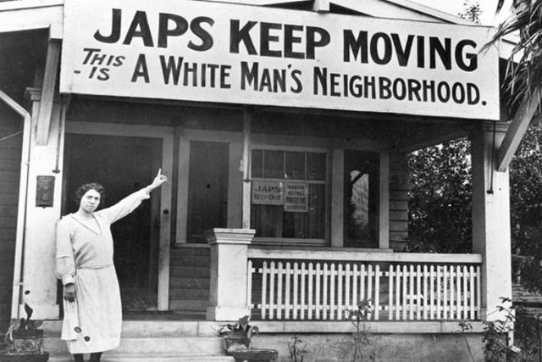
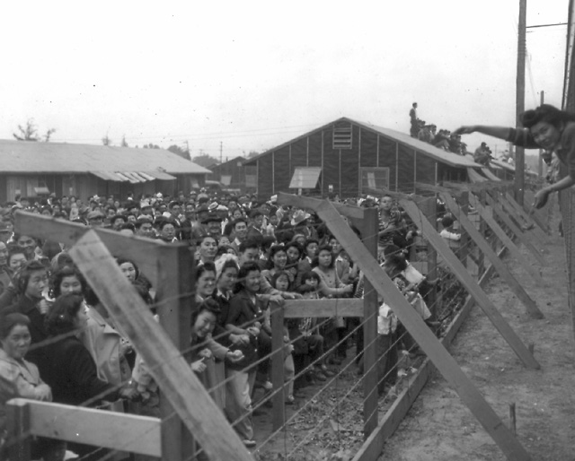

Slide 5
Building the War Machine
Orchestrated by the War Production Board (WPB), factories produced an enormous amount of weaponry, such as guns and planes.
WPB halted the manufacture of nonessential items such as cars.
government imposed a national speed limit and gasoline rationing as America's lifeline of rubber was broken.

Slide 6
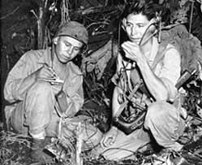
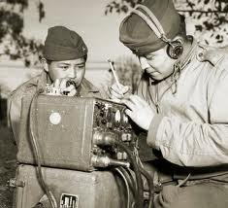
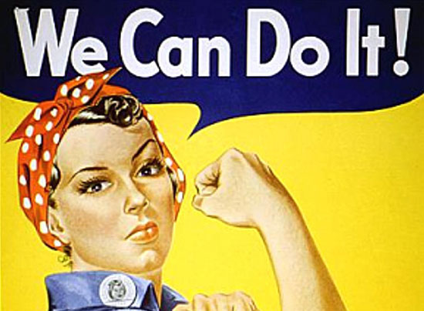

Slide 7
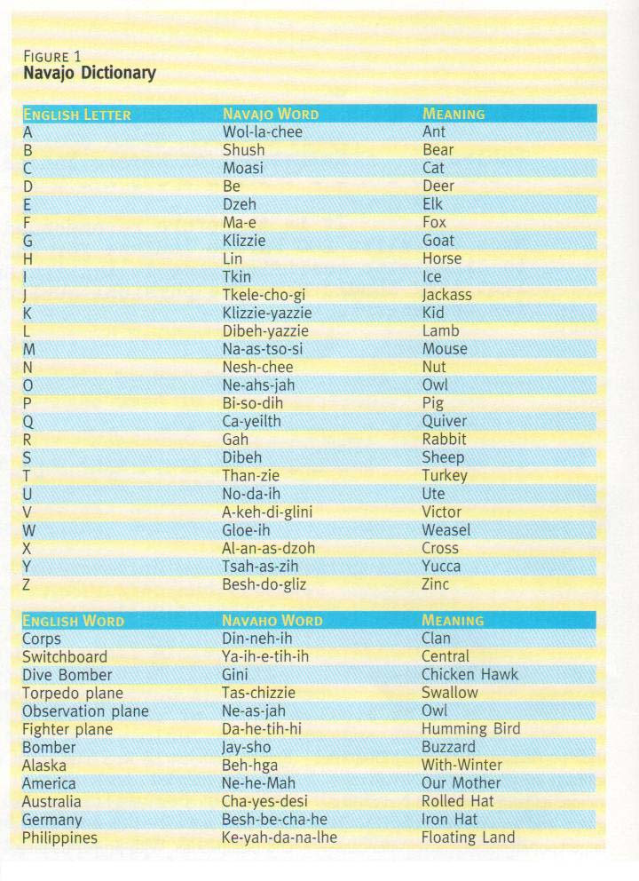

Slide 8
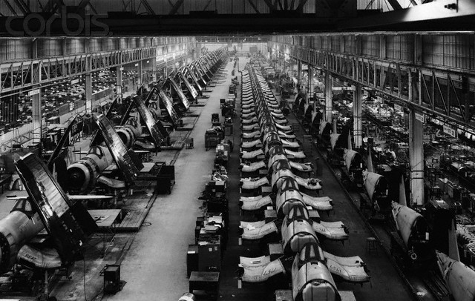
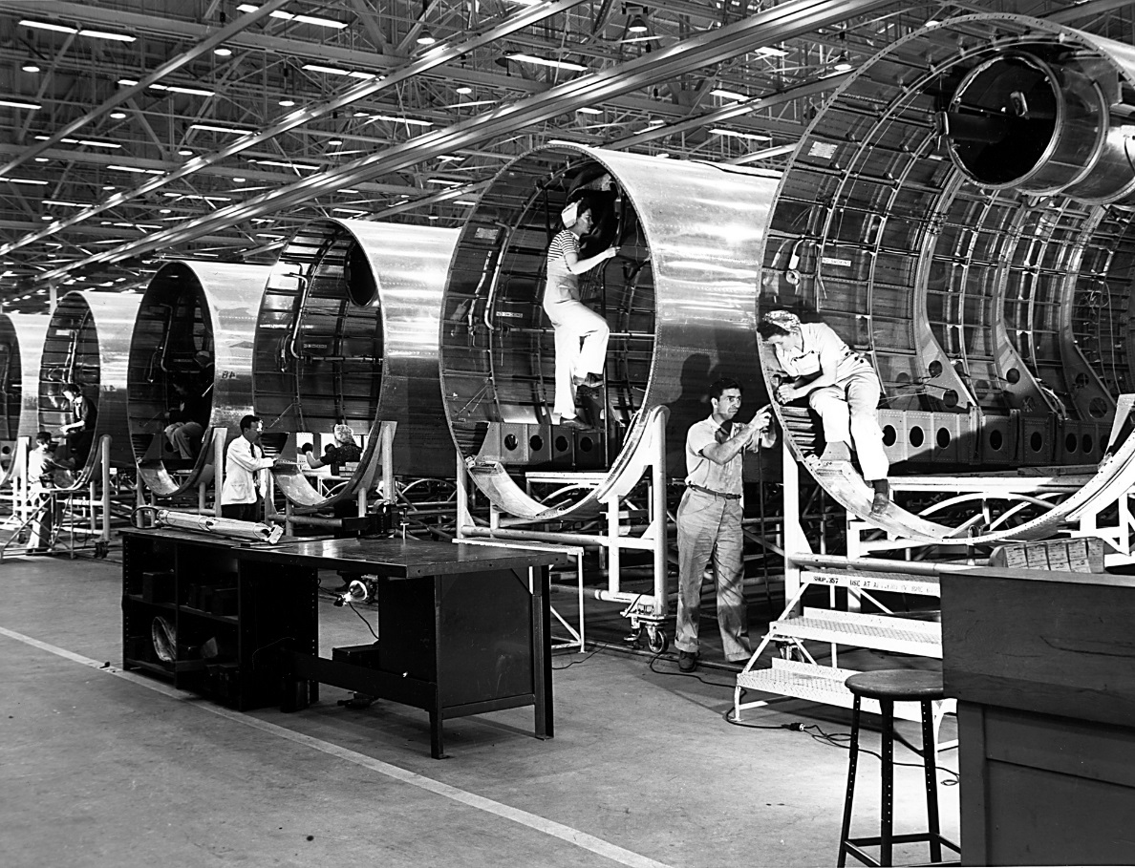
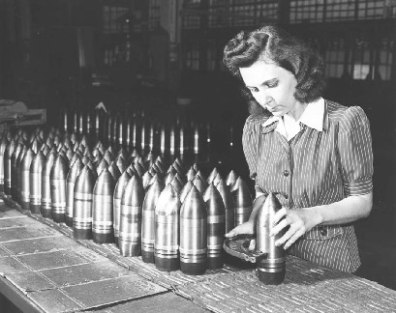

Slide 9
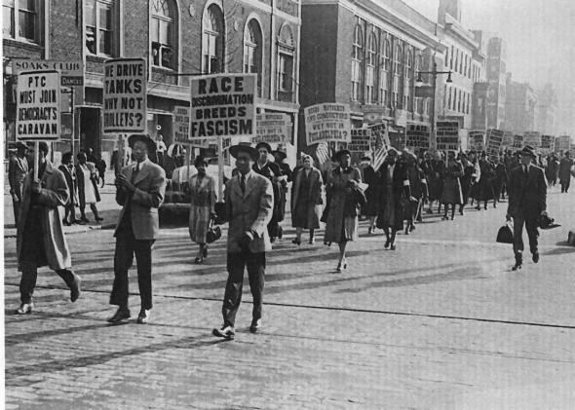
War Labor Board (WLB) imposed ceilings on wage increase
Smith-Connally Anti-Strike Act. It authorized the federal government to seize and operate businesses tied-up by strikes .
The national
debt rose from
$49 billion in
1941 to $259
billion in 1945.

Slide 10
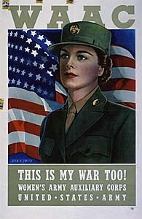
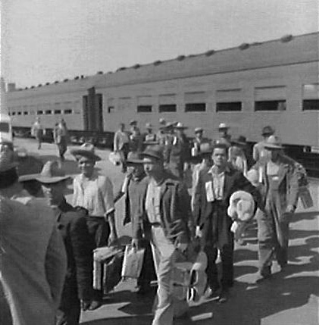
Manpower and Womanpower
Braceros: Mexican agricultural workers brought to America to harvest the fruit and grain crops of the West.
The armed services enlisted nearly 216,000 women in WWII. Millions of women also took jobs outside the house, working in the war industry

Slide 11
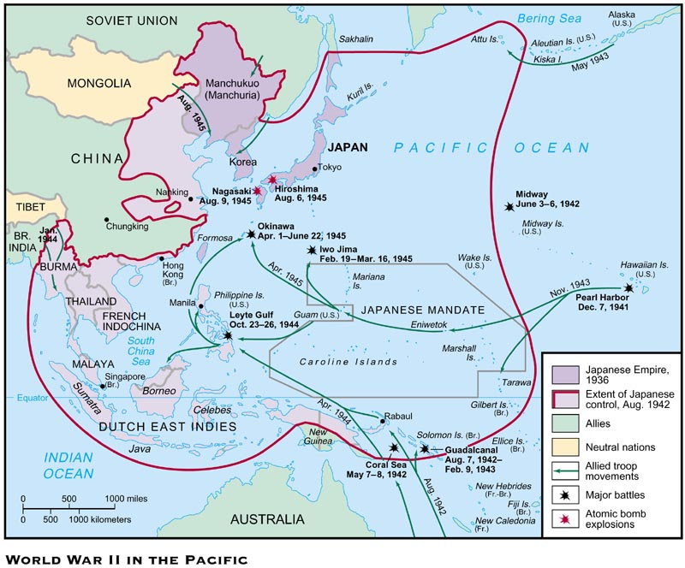

Slide 12
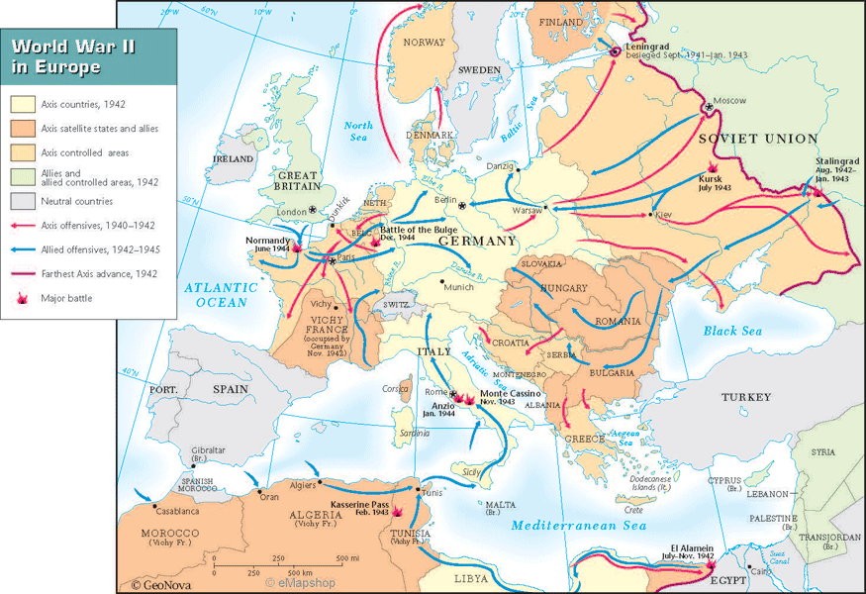

Slide 13
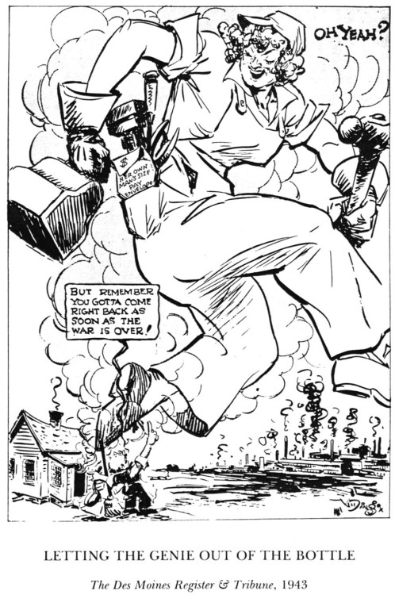

Slide 14
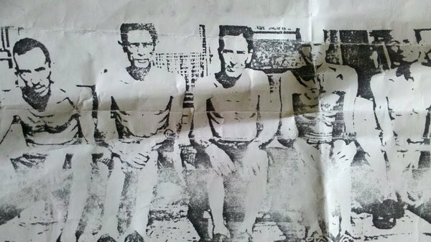
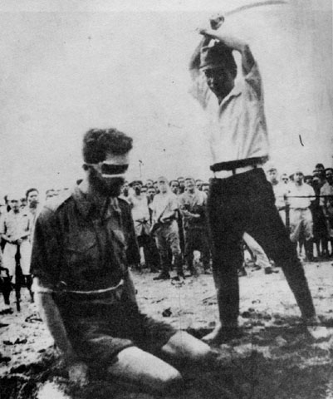
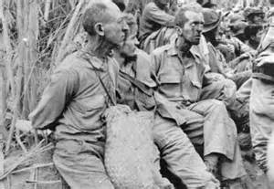

Slide 15
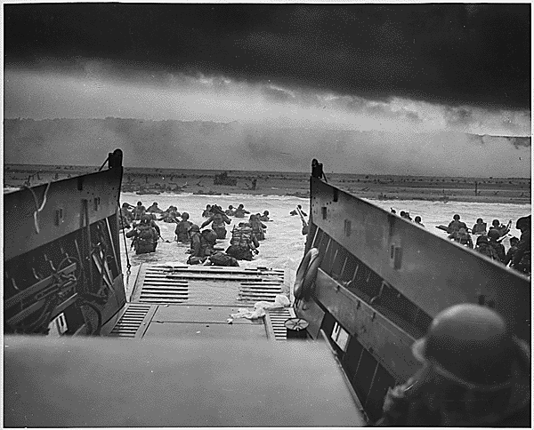
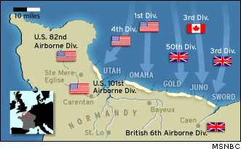
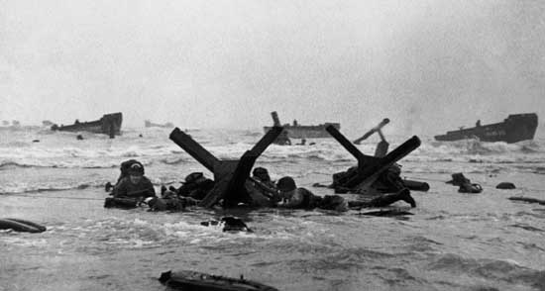

Slide 16
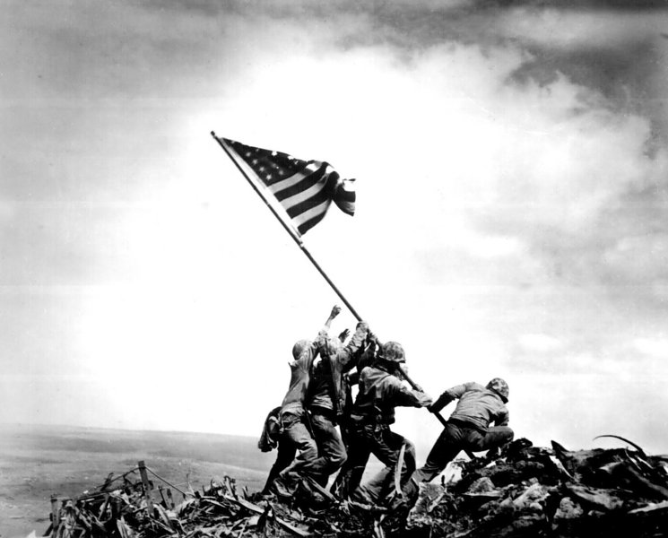

Slide 17
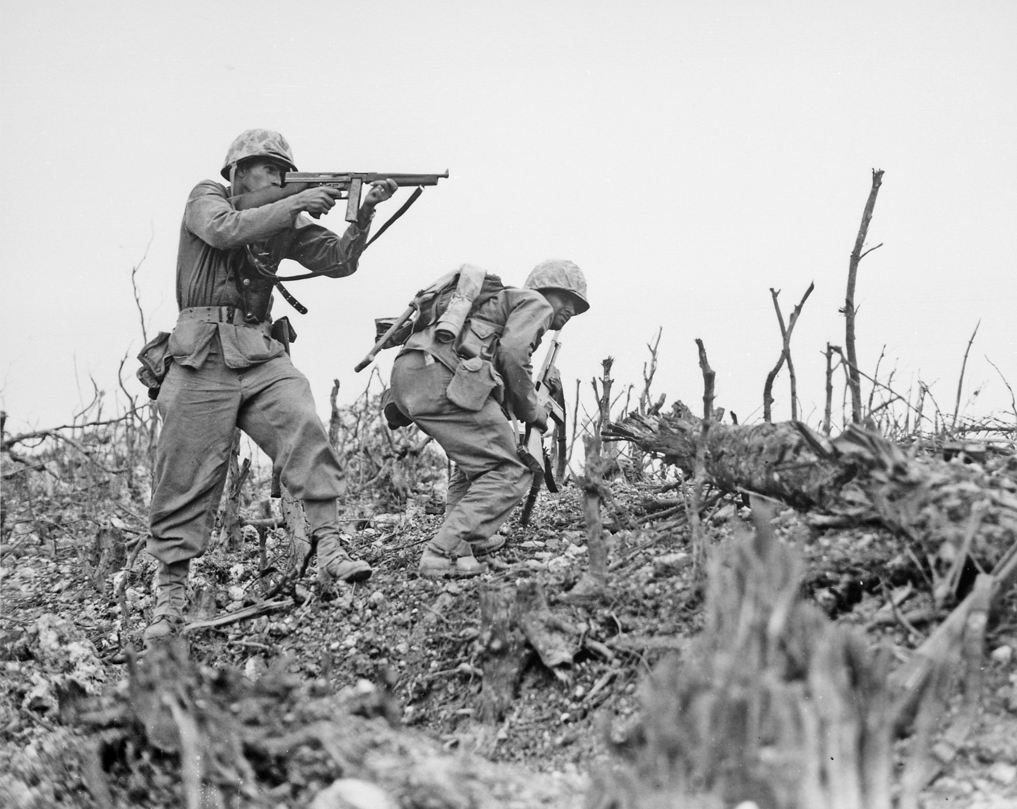

Slide 18
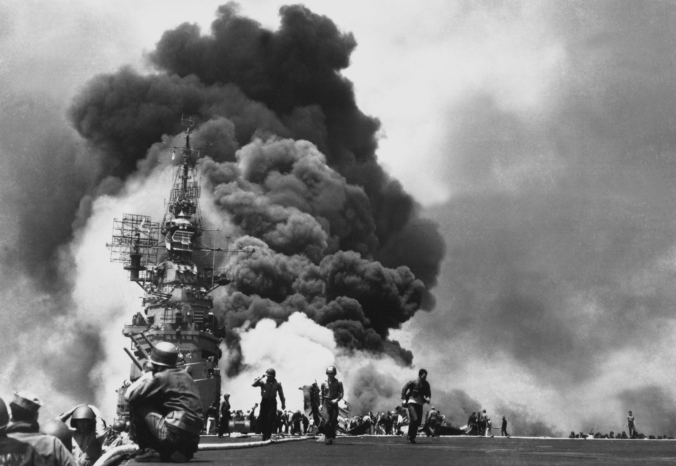

Slide 19
