Slide 1
Act of Toleration
Anglican Church
Indentured Servants
Mercantilism
John Smith
Pocahontas

Slide 2
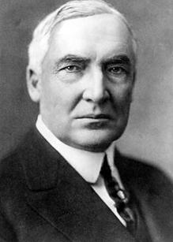
Warren G. Harding looked presidential
Not very intelligent
Didn’t like to hurt people’s feelings
Placed friends in key government positions

Slide 3
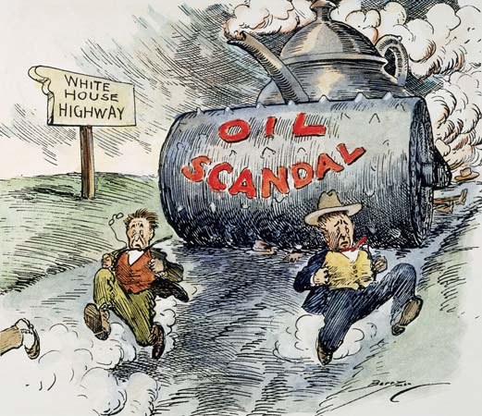
Teapot Dome – Secretary of the Interior leased lands to oil companies in exchange for $100,000 bribe

Slide 4
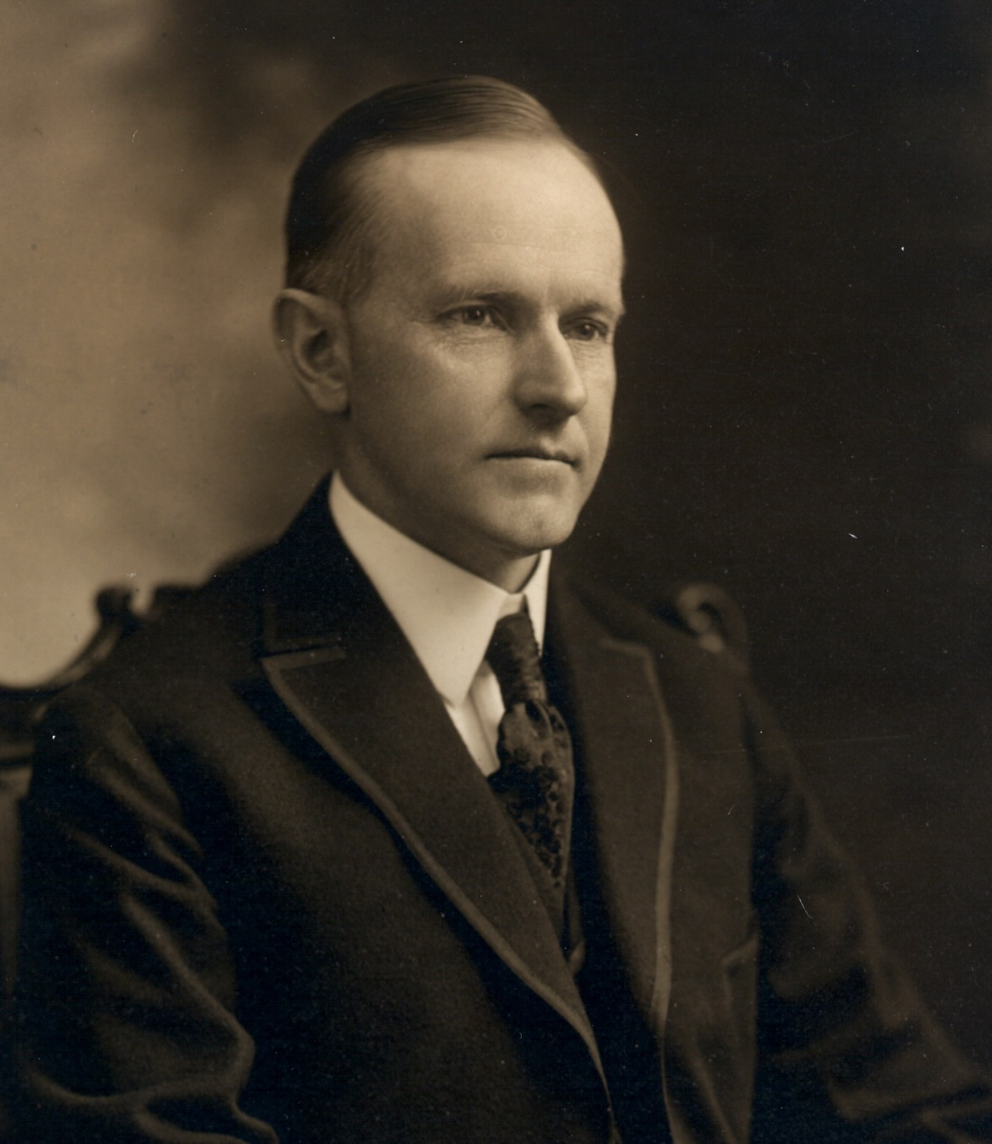
Calvin Coolidge
Known as Silent Cal takes over for Harding after his death
President during roaring twenties

Slide 5
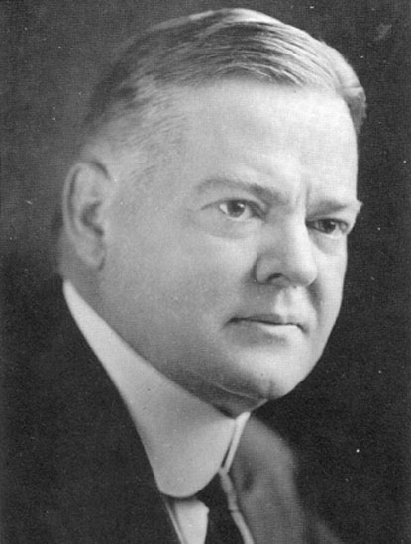
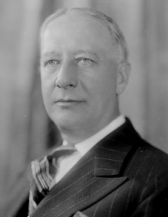
Chapter 33 Notes
Triumph of Hoover
Calvin Coolidge decided to not run for reelection in 1928.
Sec. of Commerce Herbert Hoover became the nominee for Republicans and ran on the prosperity the 20's enjoyed.
The Democrats nominated NY Gov. Alfred E. Smith. he was Catholic (which turned off many) and he was a drinker (still the days of prohibition).

Slide 6
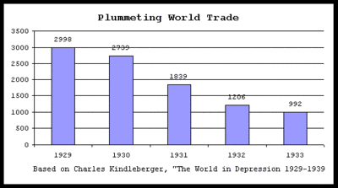
Hawley-Smoot Tariff
(1) it went against a trend toward lower tariffs,
(2) it would slow trade and thus deepen the depression when it hit, and
(3) it helped move the U.S. to full-fledged isolationism and thus help allow Hitler to rise to power.

Slide 7
Stock Market Crash
On "Black Tuesday," October 29, 1929, the bottom dropped out of the stock market on some bad economic news from Britain.
The sell-off had begun and prices plummeted: stockholders had lost $40 billion in value by the end of 1929.

Slide 8
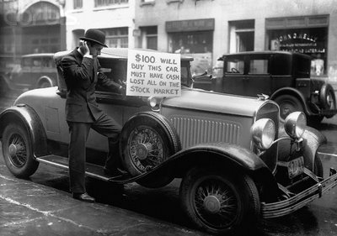
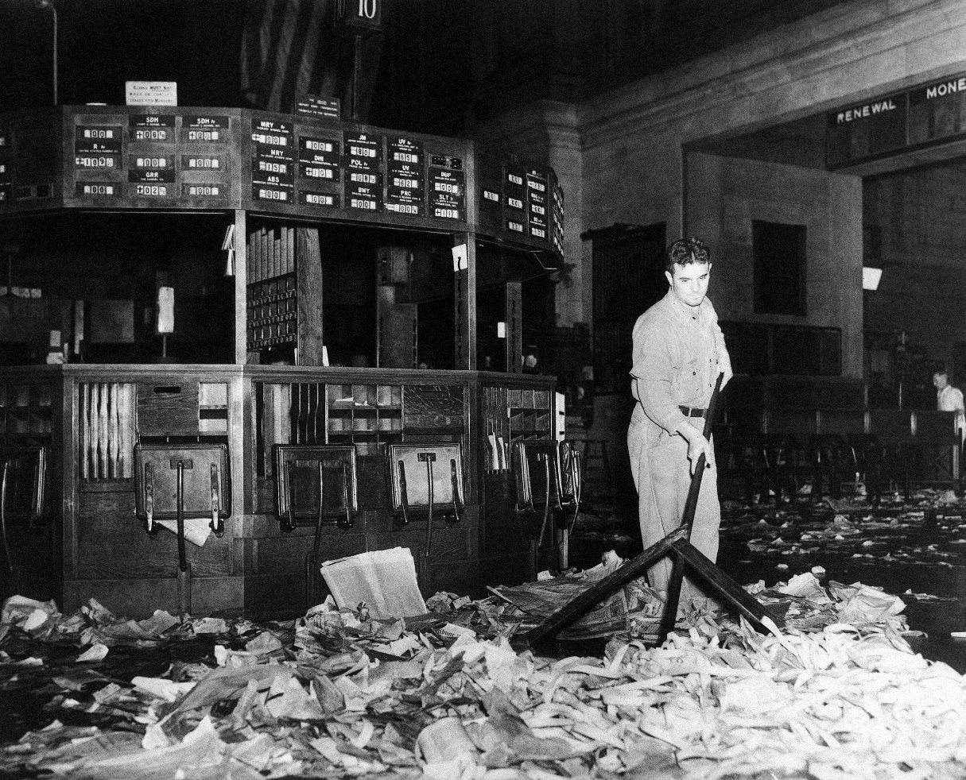

Slide 9
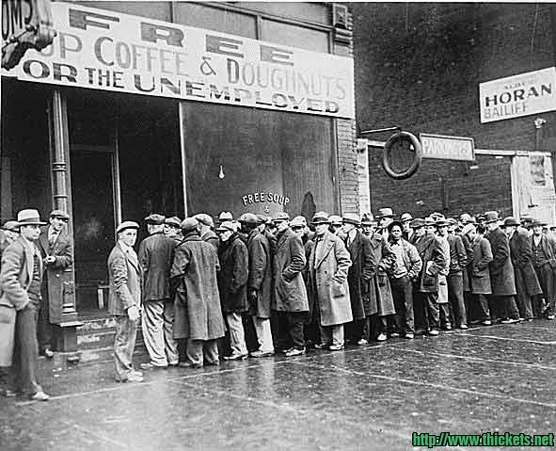
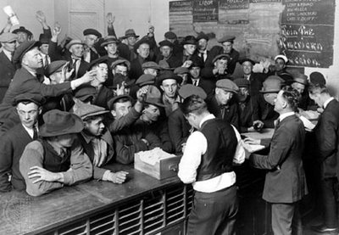
Onset of the Great Depression
Businesses began to go out of business (since people couldn't or wouldn't buy now).
Unemployment shot up.
Over 5,000, banks went bankrupt as people withdrew their money in fear of their bank going bankrupt (a self-fulfilling prophecy).
The only things growing were soup kitchens and homeless shelters.

Slide 10
Period 3 & 7
We will examine the events during the early days of the Great Depression.
Collect Homework
AP Review
Chapter 33 Notes
Bonus Army
Hoover Dam
FDR

Slide 11
Mayflower Compact
King Phillips War
New England Confederation
Bacon’s Rebellion
Half Way Covenant
Salem Witch Trials
Triangular Trade

Slide 12
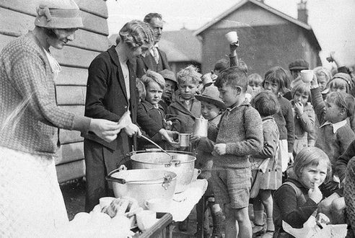
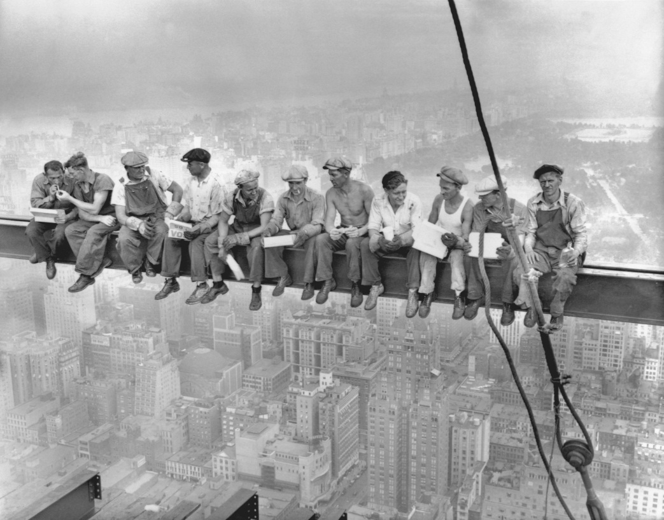
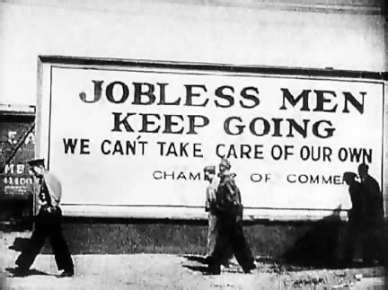
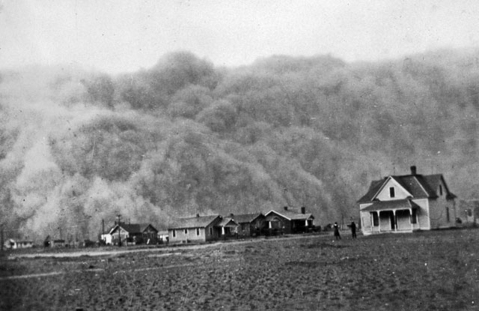

Slide 13
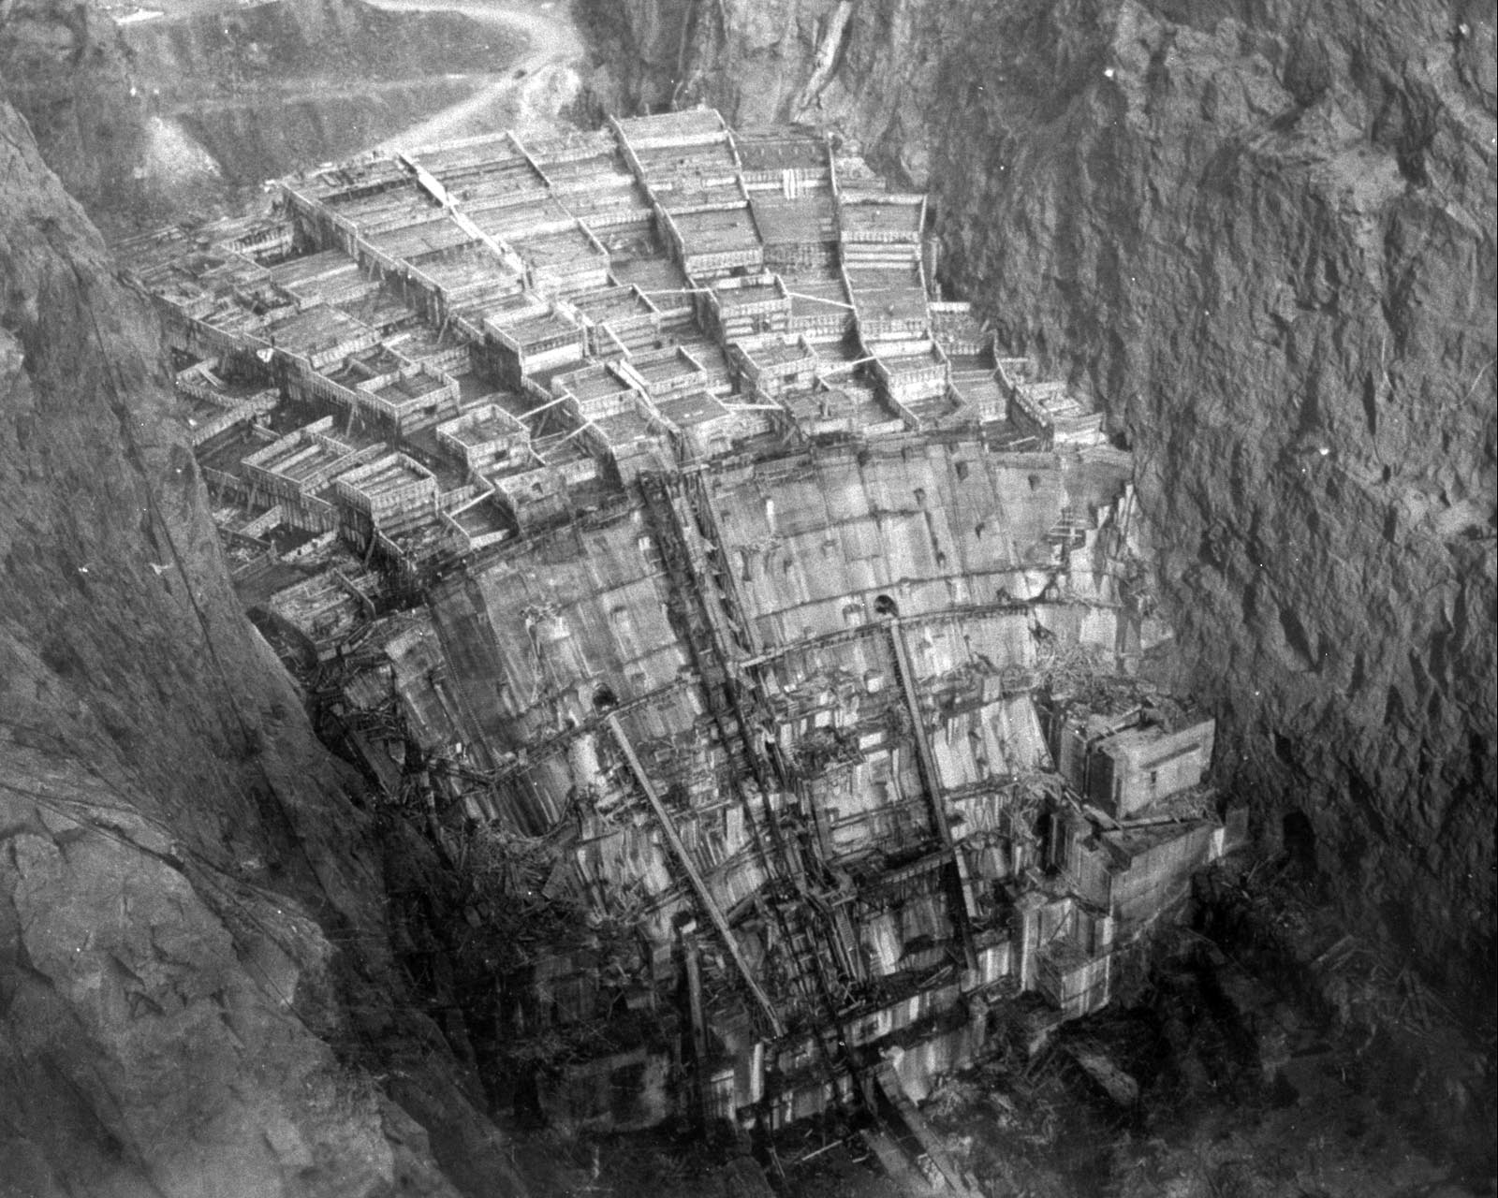
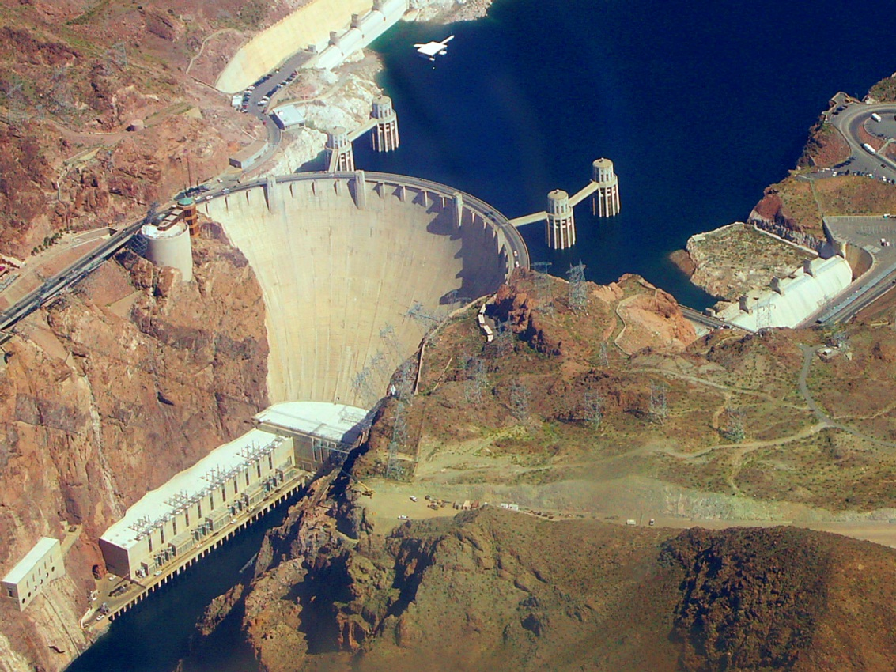
Hoover Battles the Great Depression
The massive Boulder Dam was begun in 1930, completed in 1936, and renamed to Hoover Dam.
The resulting Lake Mead served to generate electricity, irrigation, flood control, and recreation.

Slide 14
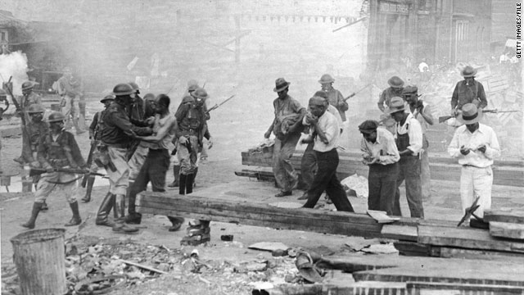
Routing the Bonus Army
Many WWI veterans were still clamoring for "bonuses" for saving the world for democracy.
It consisted of 20,000 people who marched to Washington, set up camp, and demanded their bonuses.
Pres. Hoover criticized the bonus army as being made up of riffraff and reds (communists). Hoover ordered them evicted.
The eviction was carried out using tear gas and bayonets.

Slide 15
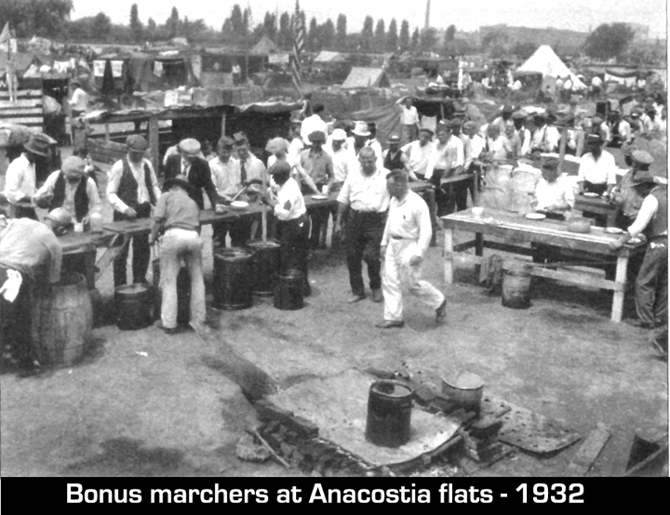

Slide 16
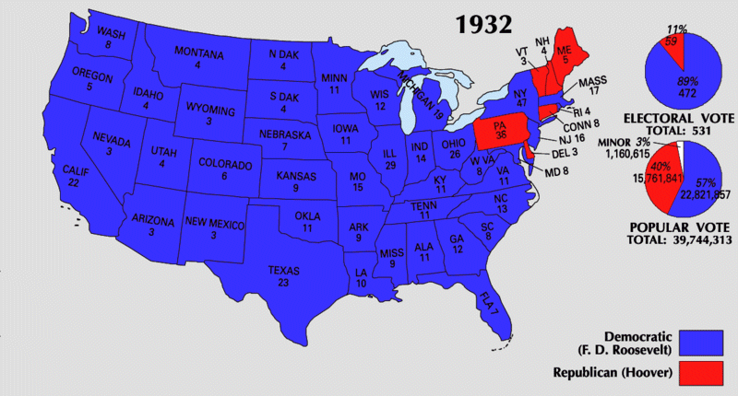

Slide 17
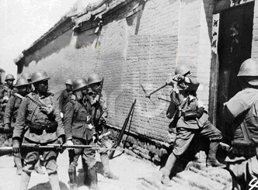
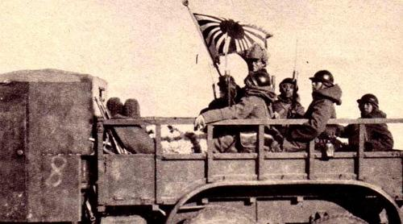
Japan attacks
In 1931, Japan invaded Manchuria (northern China).
Those who believed in the idealistic League of Nations and the Kellogg-Briand Pact which outlawed war on paper, were shocked
Since the Depression was foremost on their minds, most Americans didn't care to do much else toward Japan.

Slide 18
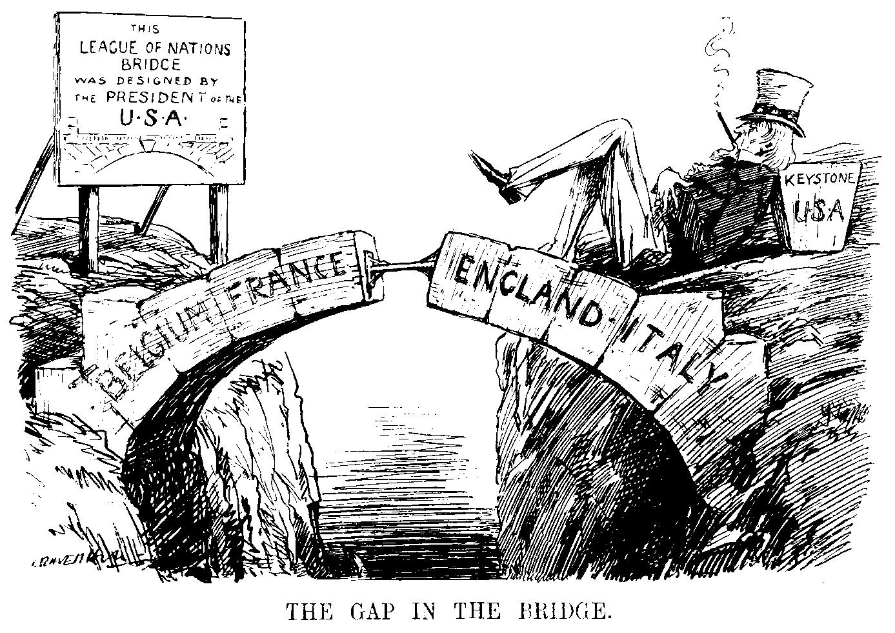
The Japanese invasion of Manchuria in 1931 taught a lesson: aggressive nations could take over weaker nations, the free nations would complain, but they would take no action..

