Slide 1
Period 3 & 7
We will examine the foreign policy decisions of the McKinley and Roosevelt administrations.
Warm Up: AP Review
First Sound Recorded
Presidential Chart
Chapter 28 Homework
Philippine Insurrection
Chapter 28 Notes

Slide 2
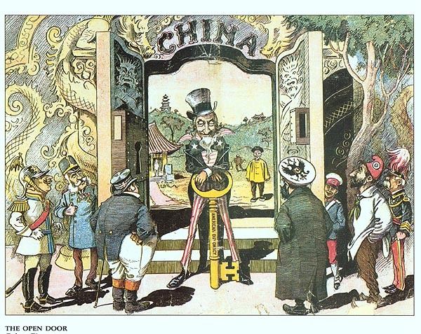
Chapter 28
Open Door Policy
US was afraid China was going to be divided up and access denied
Secretary of State John Hay issues Open Door Note
Note called on all powers to allow for equal trade in China

Slide 3
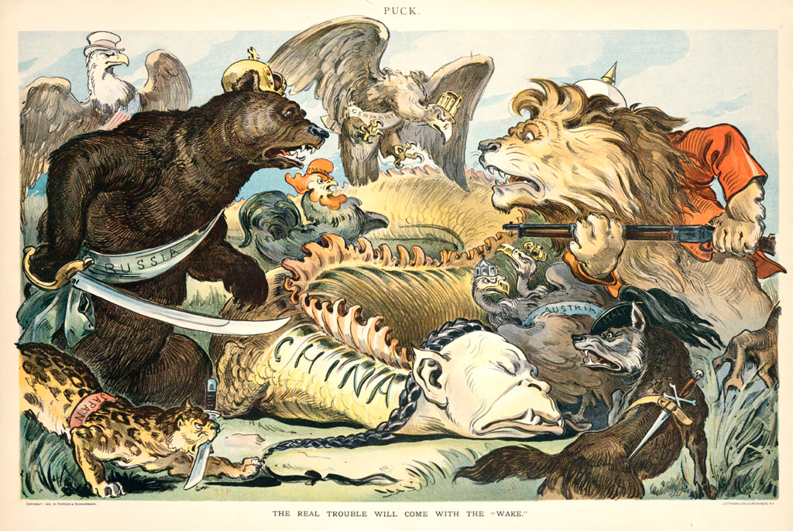

Slide 4
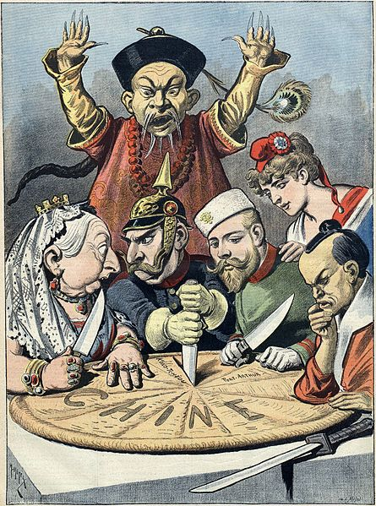

Slide 5
Election of 1900
William McKinley supported the gold standard and had led country though Spanish American War
William Jennings Bryan was anti-imperialist and supported the silver standard
Teddy Roosevelt was chosen as McKinley’s VP to keep him out of the way from New York political bosses

Slide 6
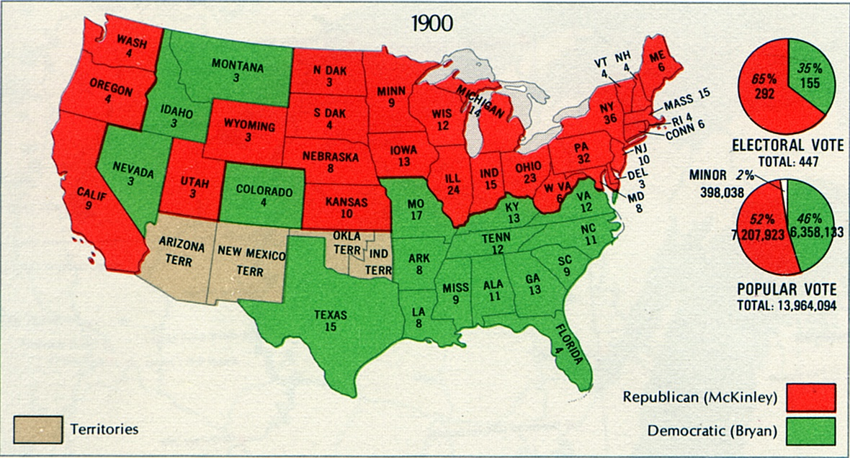

Slide 7
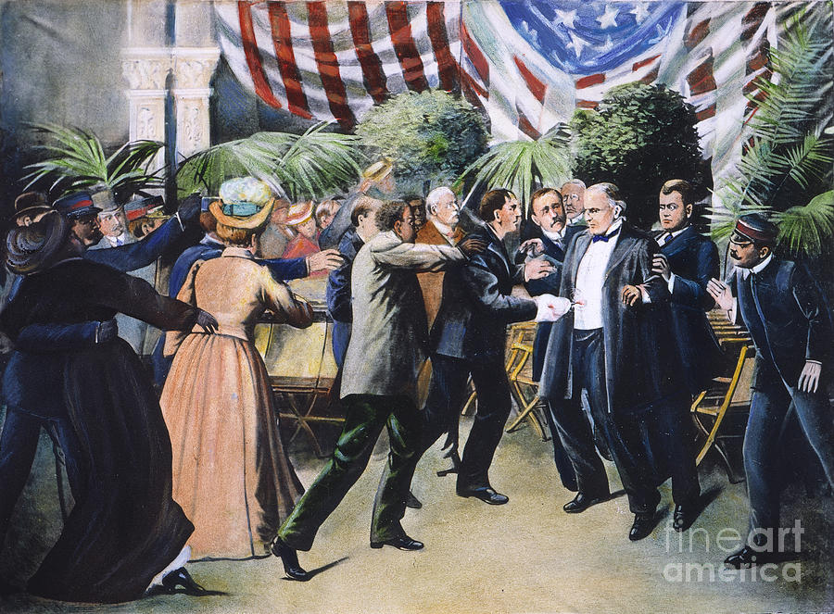
TR becomes President
In September 1901, McKinley is assassinated by anarchist Leon Czolgosz
Teddy Roosevelt becomes youngest president
Believes that as long as it is not forbidden by Constitution, it can be done.

Slide 8
Panama Canal
The war with Spain showed the need for a quick route between the Atlantic and Pacific Oceans
US desired a canal through Panama
Panama belonged to Colombia and did not want to allow US to build canal.
Panamanians revolted backed by the US and Panama became an independent country
Signed a treaty with US to allow canal to be built

Slide 9
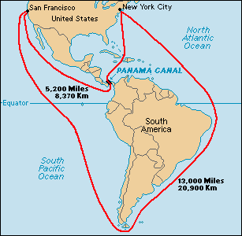
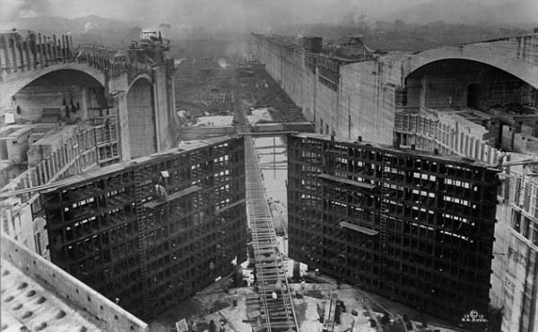
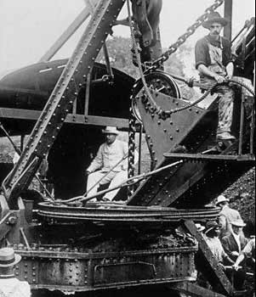

Slide 10
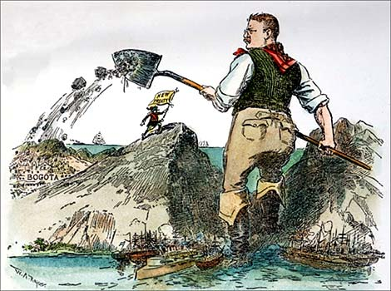

Slide 11
Roosevelt Corollary
Latin American countries were having a hard time paying off their debts to Europeans
Roosevelt Corollary says US will handle debt problems on behalf of Europeans
Preserves the Monroe Doctrine
As a result US intervenes in Latin America constantly

Slide 12
Period 3 & 7
We will examine the foreign affairs of the Roosevelt administration.
Warm Up: AP Review
The Philippine Insurrection
Chapter 28 notes
Crash Course

Slide 13
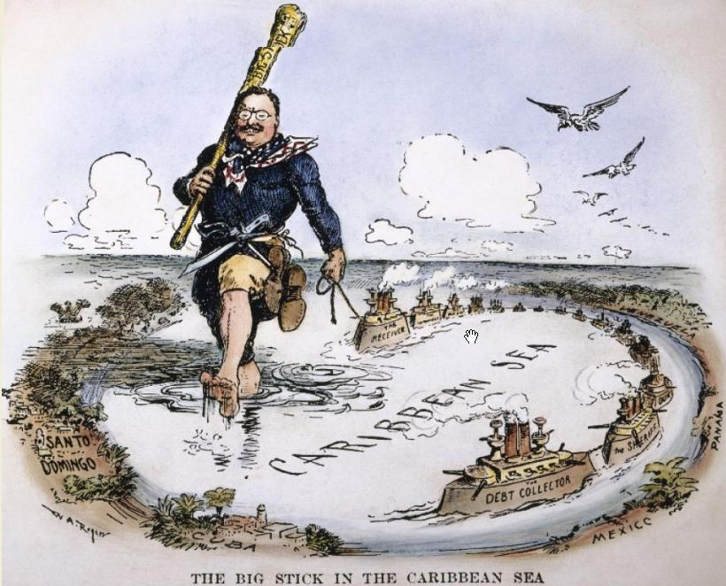
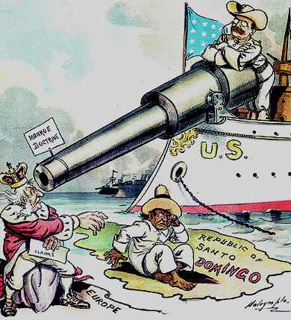

Slide 14
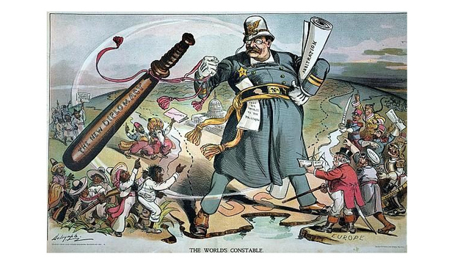

Slide 15
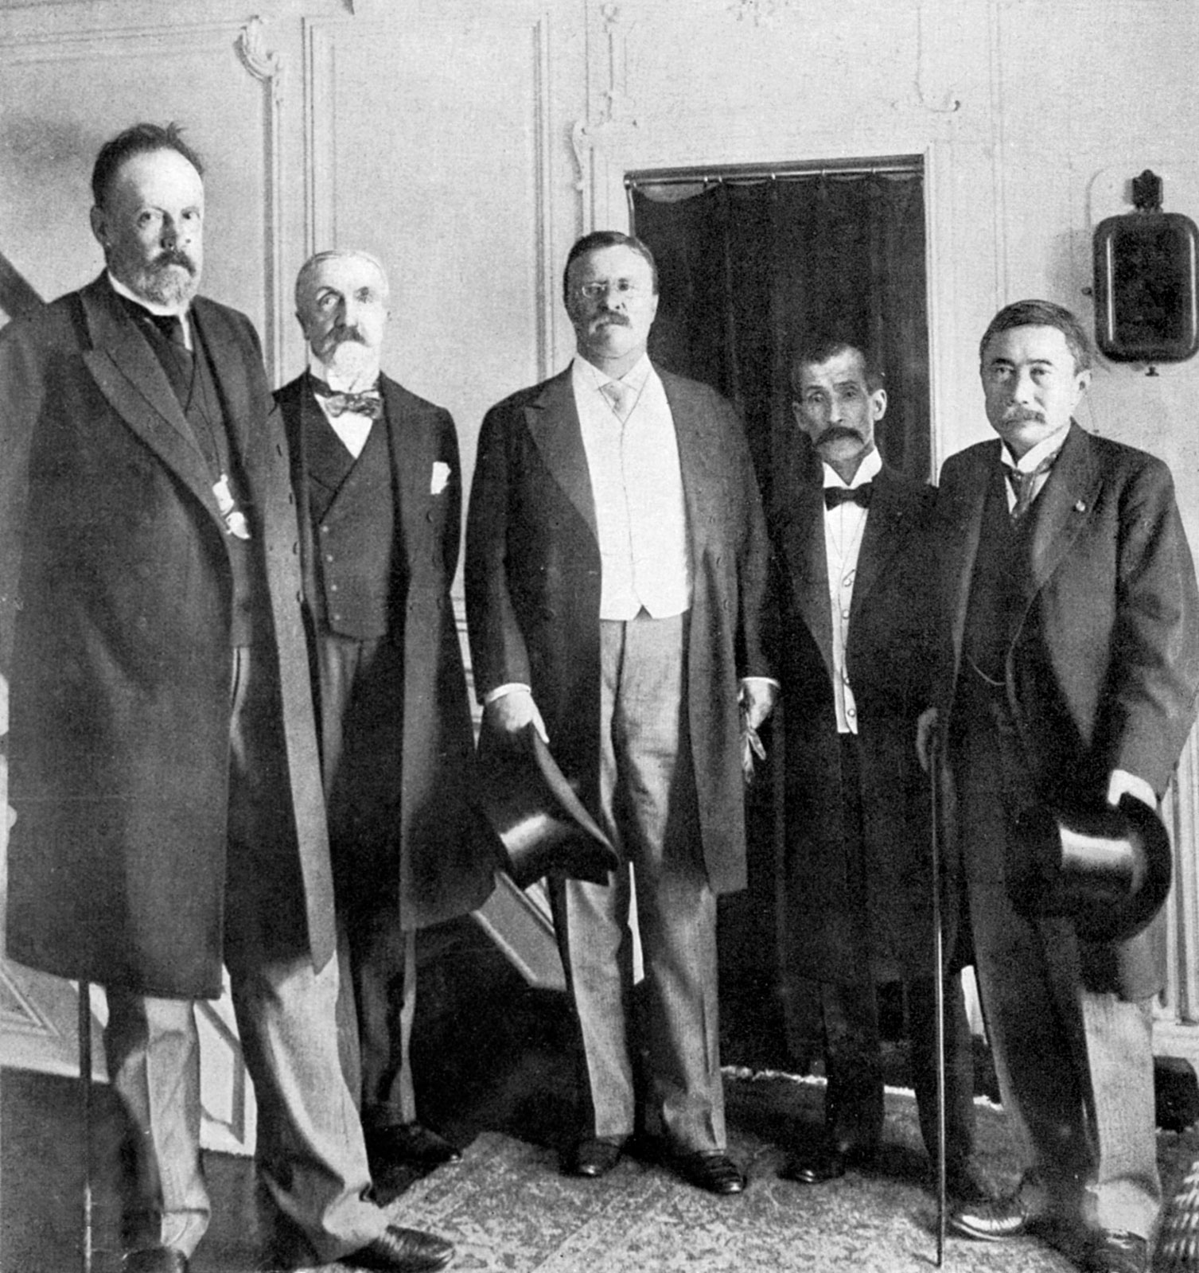
Russo-Japanese War
Russia and Japan go to war in 1904
Teddy Roosevelt intervenes and negotiates a peace treaty
Roosevelt earns a Nobel Peace Prize for his work

Slide 16
Gentlemen’s Agreement
After Russo-Japanese War many Japanese laborers begin to enter US.
After San Francisco earthquake Japanese students are segregated into special schools due to lack of space
TR negotiates an agreement. No special schools for Japanese but no more immigrants from Japan

