Slide 1
Period 3 & 7
We will examine the increase in immigration to the United States during the late 1800s as well as, how those immigrants were treated upon arrival to America.
Warm Up: Old vs. New Immigrants
Go over homework
Chapter 25 Notes
Immigration Chart

Slide 2
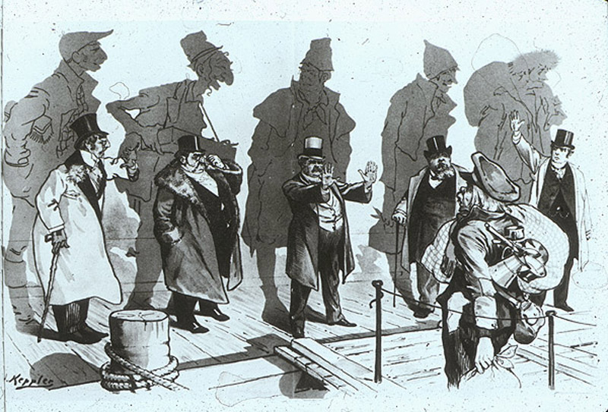
Immigrants
Old Immigrants: Northern and Western Europe
New Immigrants: Southern and Eastern Europe

Slide 3
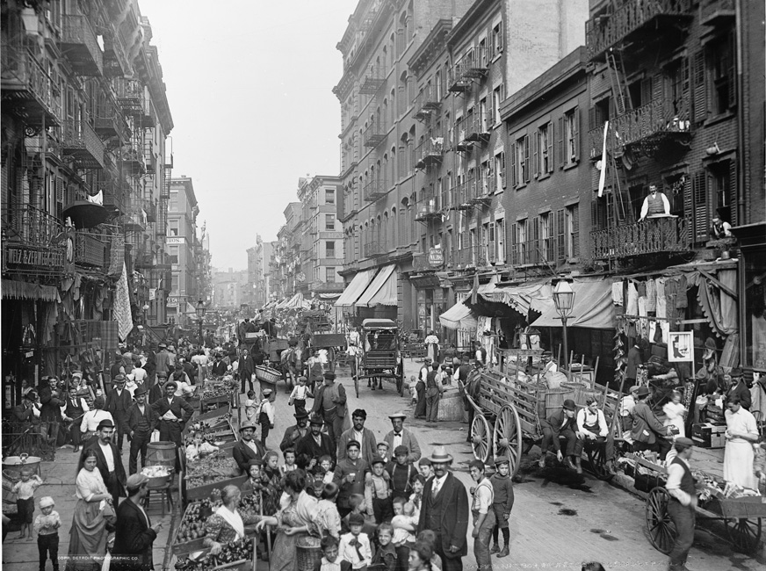

Slide 4
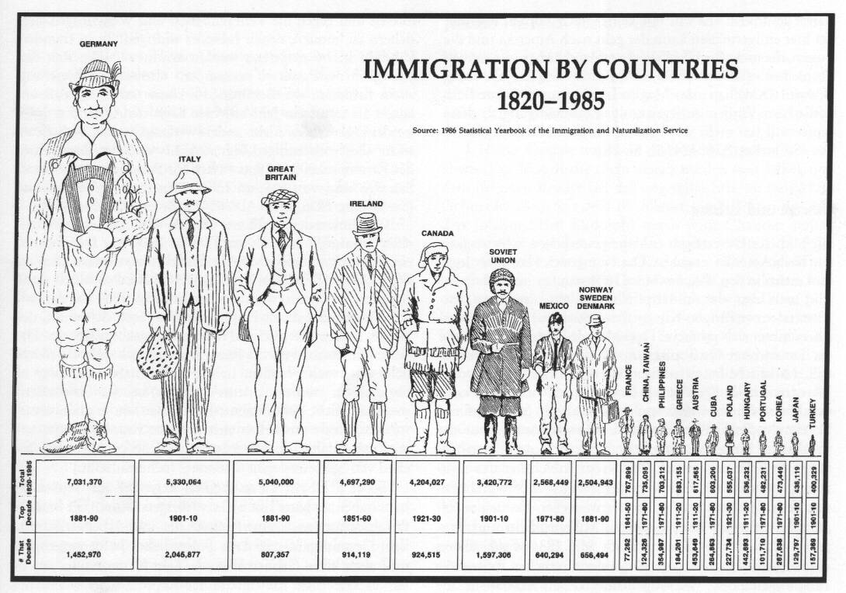

Slide 5
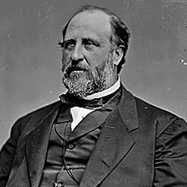
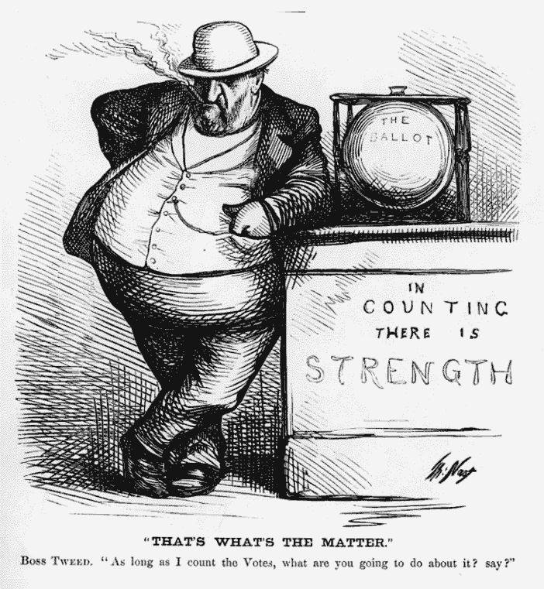
Many immigrants stayed for a short time and returned home
Many children of new immigrants became Americanized quickly and gave up the European ways of their parents.
Immigrants were often controlled by “party bosses” like Boss Tweed

Slide 6
People began to be concerned about the plight of immigrants and started organizations to assimilate them and keep them away from party bosses.
The Social Gospel – Churches should take on important social issues of the day.
Jane Addams – Establishes Hull House to teach immigrants skills they will need to succeed in US. Wins Nobel Peace Prize in 1931.

Slide 7
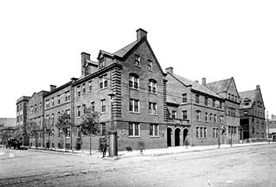
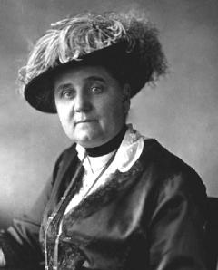
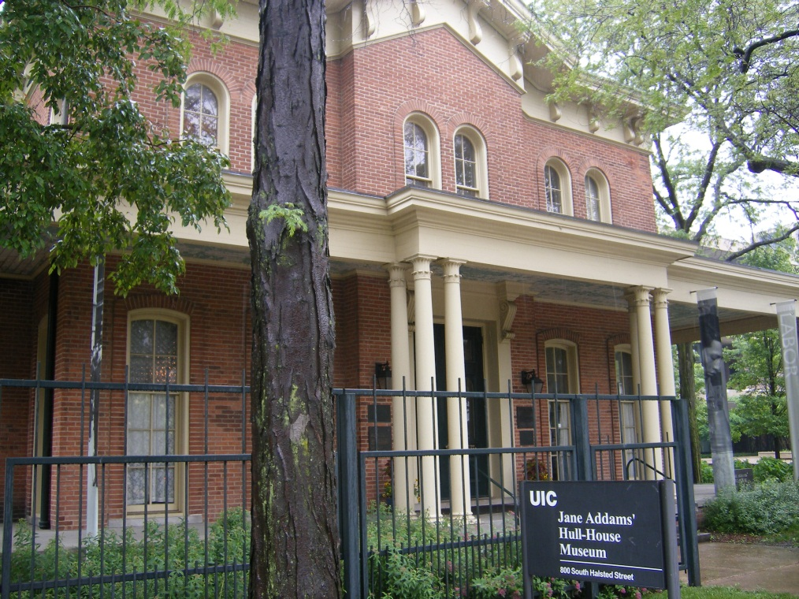

Slide 8
Nativism
Anti-immigrant settlement returned to the country.
1882- Chinese Exclusion Act
Literacy Tests for immigrants were established in 1917
At the same time Statue of Liberty is built in New York Harbor.

Slide 9
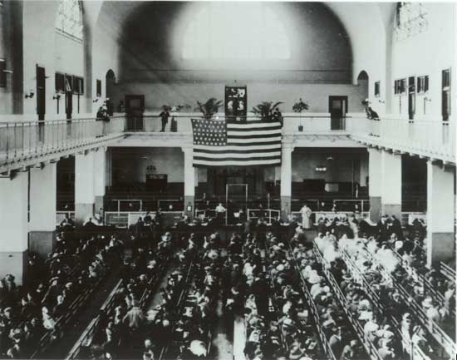
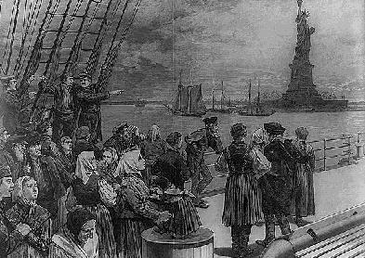
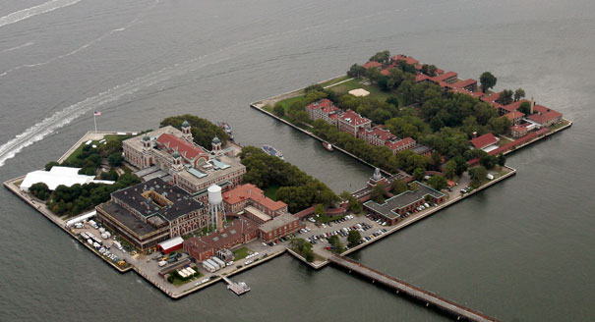

Slide 10
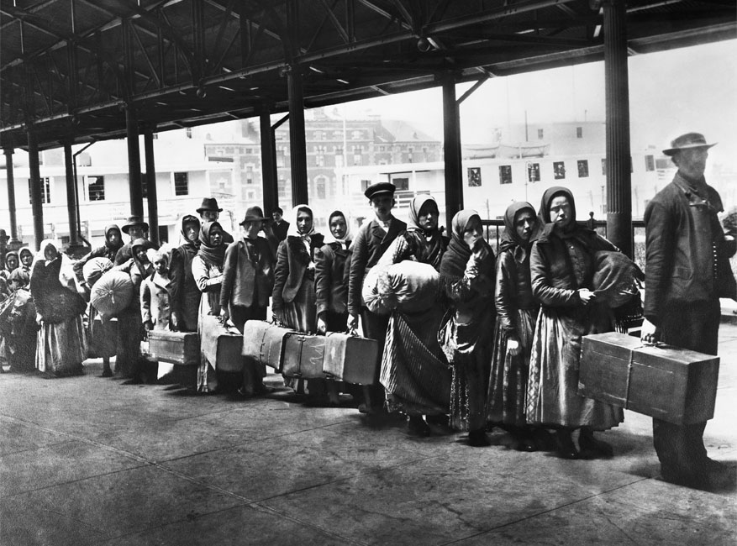
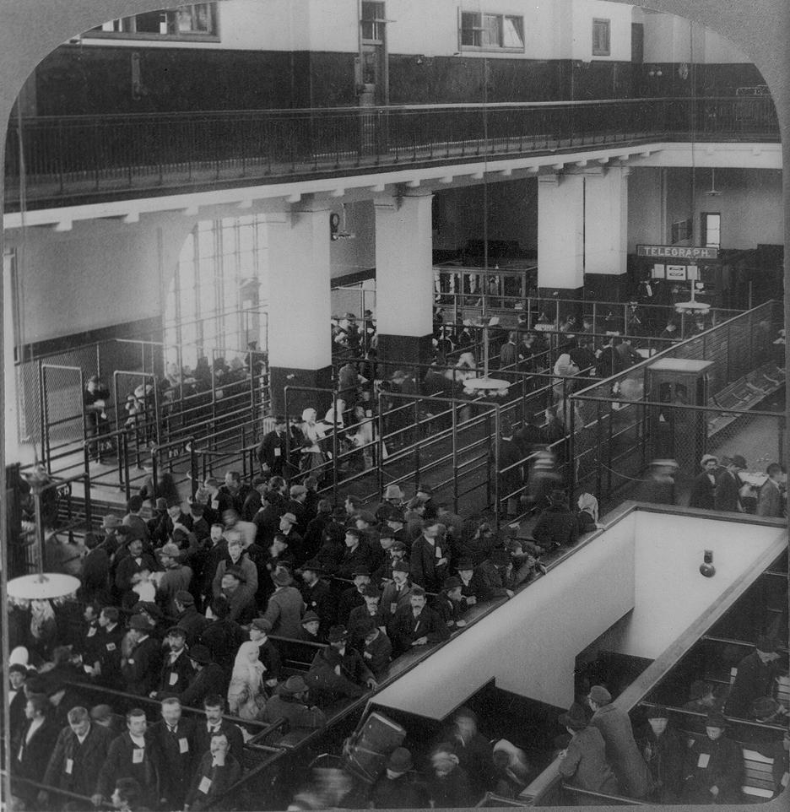
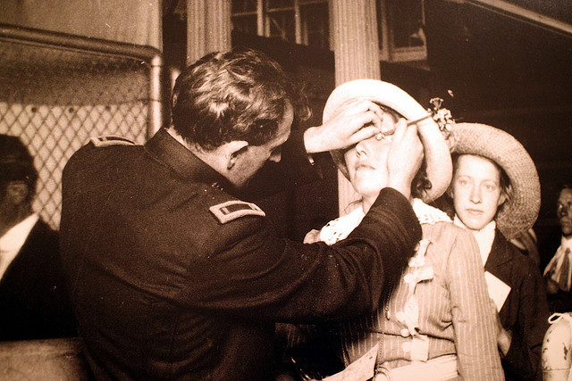

Slide 11
Chapter 25 – Immigration Graph (p. 561)
There are 5 major “peaks” of immigration and 4 major “valleys.” What factors led to increases in immigration? What factors might have slowed immigration?
What 5 year period saw the biggest increase? Decrease?
Find the Immigration Reform Act of 1986 in your text, what did it do?

Slide 14
Life of a Sweatshop Girl
What did Sadie’s parents do for a living?
When did things begin to get tough for Sadie’s family?
What did Sadie’s mother think of doing with her daughter and traveling to America?
How was the families journey to America? What class did they travel?
How did Sadie and her mother make a living?
What religion is Sadie? How many days per week does she work?
How much money did Sadie spend each week on food?
How much money did Sadie spend on clothing and fun? How much did she save?
Are women paid the same as men?
What is Sadie seem to focus on when it comes to Henry?
What piece of technology does Sadie have a hard time believing exists?
Why do the women work fast?
How are the machines powered?
How is Sadie learning English?
What union does she belong to? What does the Union want?

Slide 15
Period 3 & 7
We will examine the growth of cities and the influx of new immigrants and the role they both played in the development of the US.
Warm Up: Nelson Mandela
Go over homework
Notes
Clips of Early Sports
Booker T. Washington v. W.E.B. DuBois

Slide 16
Churches face problems
Emphasis on material gain worried many in the church
Over 150 religions to choose from in the United States.
Salvation Army and YMCA established
Charles Darwin’s Theory of Evolution challenges accepted religious doctrine
General Lewis Wallace writes the novel Ben-Hur to challenge Darwin

Slide 17
Booker T. Washington and WEB DuBois
Booker T. Washington:
Ex-Slave who started a school in Tuskegee Alabama
Taught African Americans useful skills and trades
Did not push for social equality. Blacks should help themselves before gaining more rights
W.E.B. Du Bois:
First African American to get a PHD from Harvard
Helped establish the NAACP
Demand equality for Black Americans immediately

Slide 18
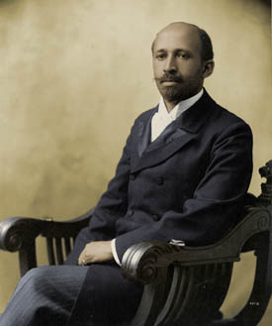
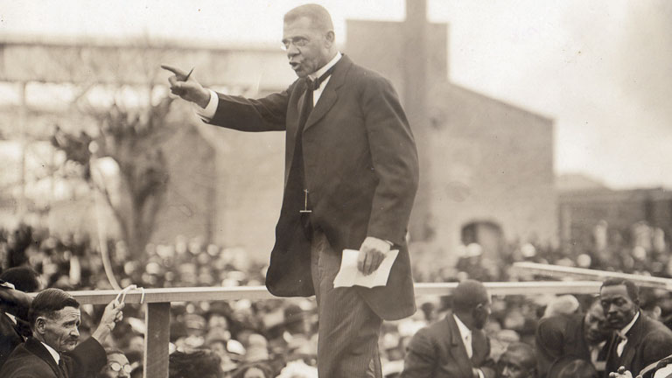

Slide 19
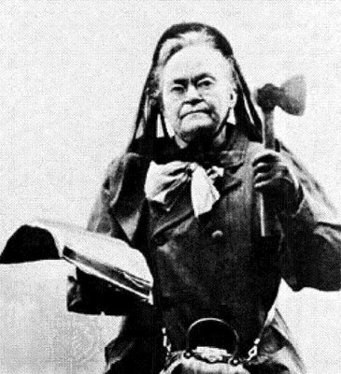
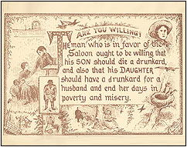
Prohibition
National Prohibition Party founded in 1869
Women’s Christian Temperance Union demanded a national ban on alcohol
Anti-Saloon League was formed in 1893
Carrie Nation used a hatchet to break liquor
bottles and chop up bars

Slide 20
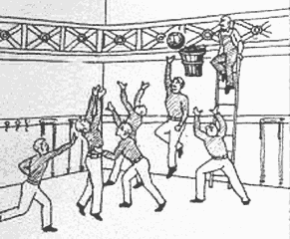
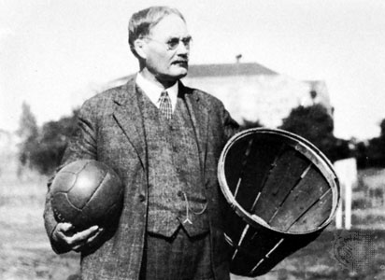
Amusements
People begin to have more money and more time
PT Barnum’s circus
Buffalo Bill Cody’s Wild Show
Baseball becomes the National Pastime
Basketball is invented in 1891 by James Naismith

Slide 21
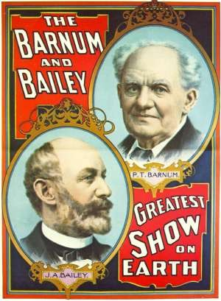
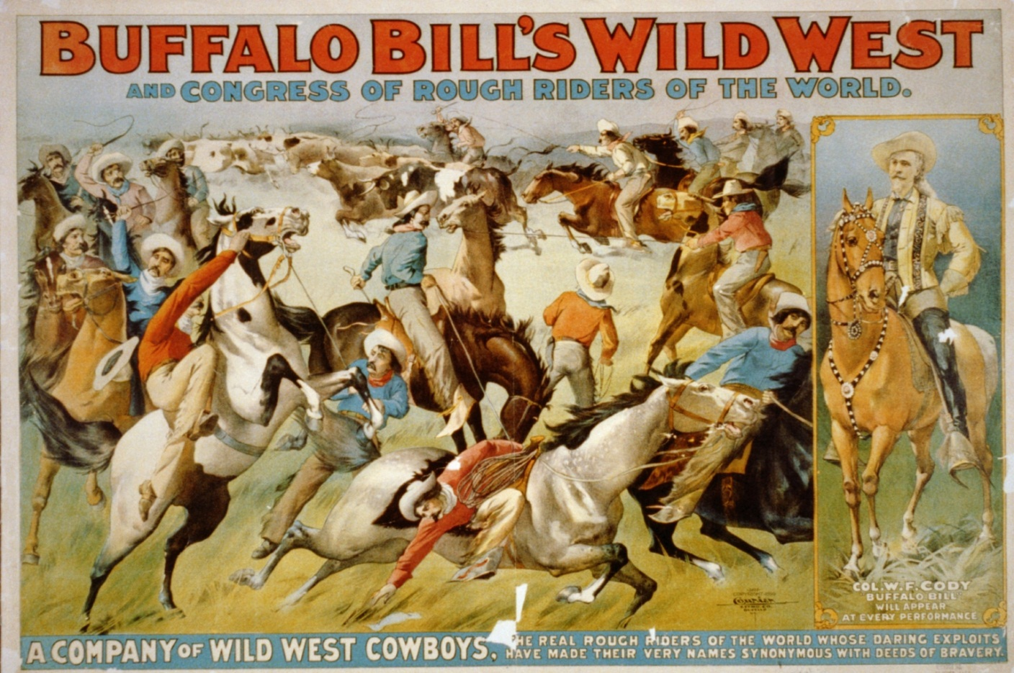

Slide 22
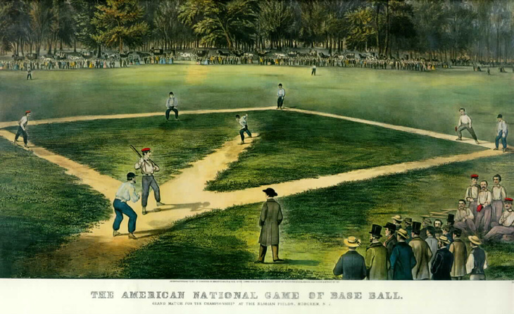

Slide 23
Primary Reading
Cleaning Up New York
Why are the streets dirty? Three examples
What problems result from unharnessed wagons being left on the street?
How has cleaning up the streets helped life in the city?
Jacob Riis Goes Slumming
What are some of the problems faced by people living in the tenements?

