Slide 1
Little Rock
How many black students were supposed to go to Little Rock High School?
What orders did the national guard have?
What was each of the black students assigned?
Who was the lone African American graduate in 1958?
What did the governor do to stop integration the next year?

Slide 2
The NAACP Legal Strategy
Professor Charles Hamilton Houston leads NAACP legal campaign
Focuses on most glaring inequalities of segregated public education
Places team of law students under Thurgood Marshall
Brown v. Board of Education
Marshall’s greatest victory is Brown v. Board of Education of Topeka
In 1954 case, Court unanimously strikes down school segregation

Slide 3
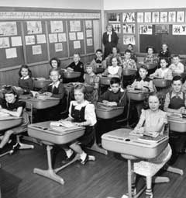
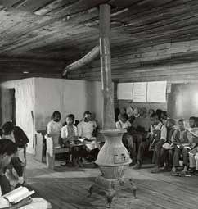

Slide 4
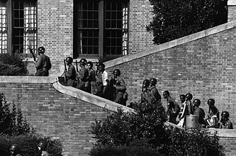
Crisis in Little Rock
Gov. Orval Faubus has National Guard turn away black students
Eisenhower has paratroopers supervise school attendance
1957 Civil Rights Act—federal government power over schools, voting

Slide 5
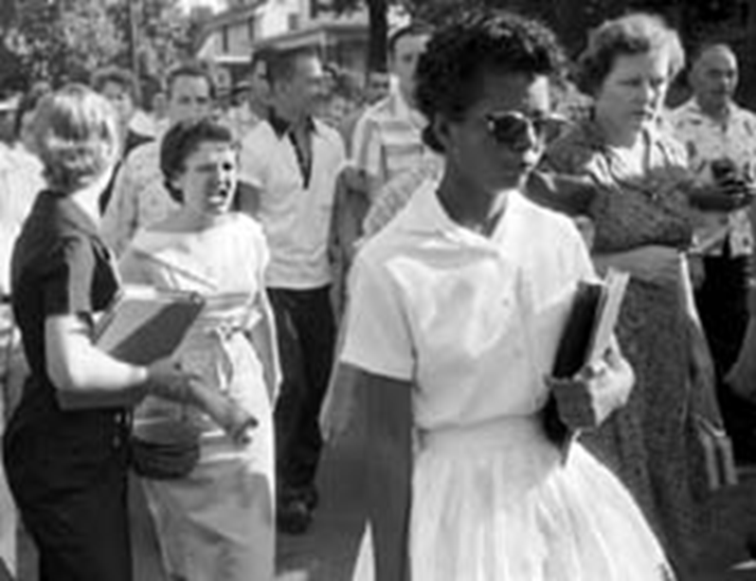
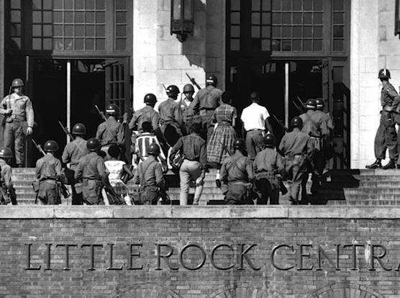

Slide 6
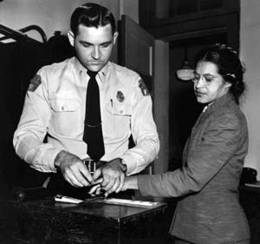
Boycotting Segregation
1955 NAACP officer Rosa Parks arrested for not giving up seat on bus
Montgomery Improvement Association formed, organizes bus boycott
Elect 26-year-old Baptist pastor Martin Luther King, Jr. leader

Slide 7
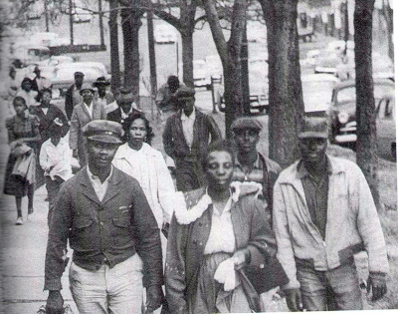
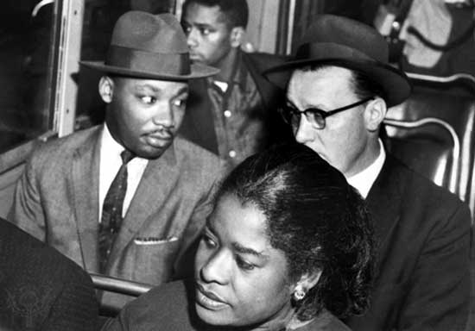

Slide 8
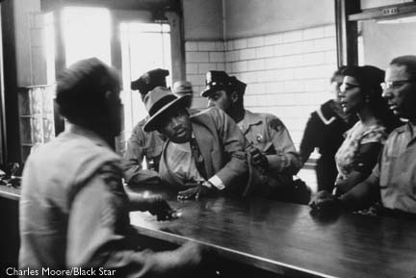
Changing the World with Soul Force
King calls his brand of nonviolent resistance “soul force”
- civil disobedience, massive demonstrations
King remains nonviolent in face of violence after Brown decision

Slide 9
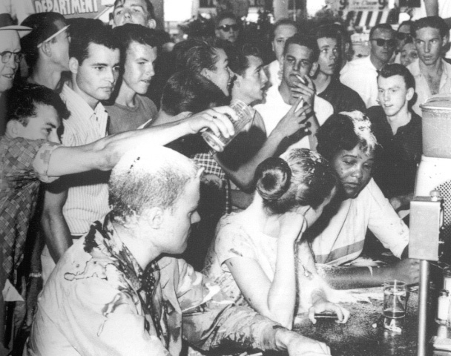

Slide 10
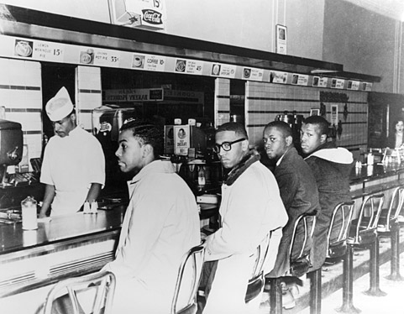
Demonstrating for Freedom
SNCC adopts nonviolence, but calls for more confrontational strategy
Influenced by Congress of Racial Equality (CORE) to use sit-ins:
- refuse to leave segregated lunch counter until served
First sit-in at Greensboro, NC Woolworth’s shown nationwide on TV

Slide 11
Period 2, 5, & 6
We will examine the strategies of the Civil Rights movement to bring about change.
Go over homework
Birmingham
Chapter 21.2 Notes
I Have a Dream
Crossword

Slide 12
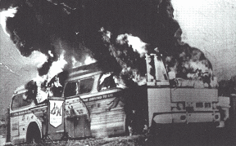
CORE’s Freedom Rides
• 1961, CORE tests Court decision banning interstate bus segregation
• Freedom riders—blacks, whites sit, use station facilities together
• Riders brutally beaten by Alabama mobs; one bus firebombed

Slide 13
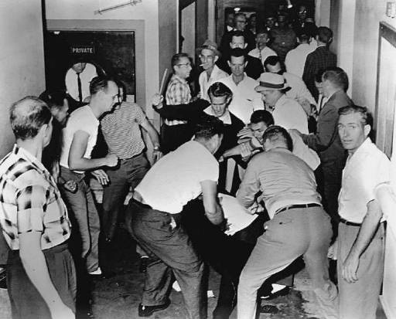
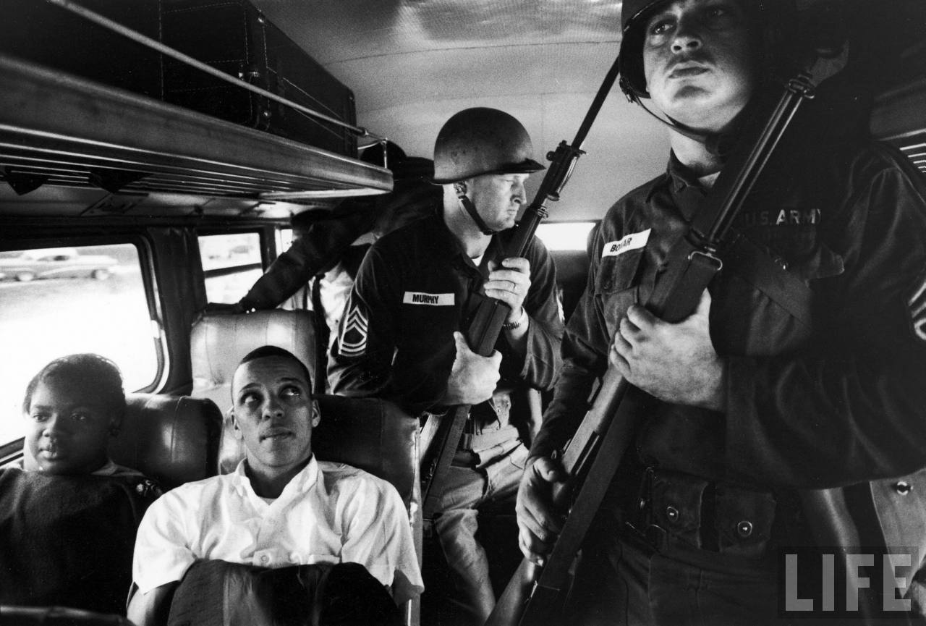

Slide 14
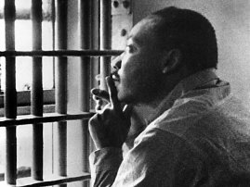
Heading into Birmingham
April 1963, SCLC demonstrate to desegregate Birmingham
King arrested, writes “Letter from Birmingham Jail”
TV news show police attacking child marchers—fire hoses, dogs, clubs
Continued protests, economic boycott, bad press end segregation

Slide 15
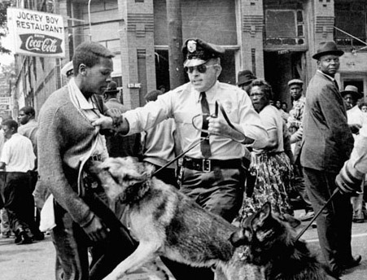

Slide 16
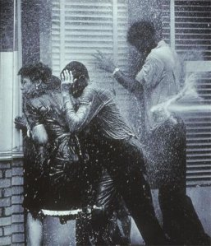
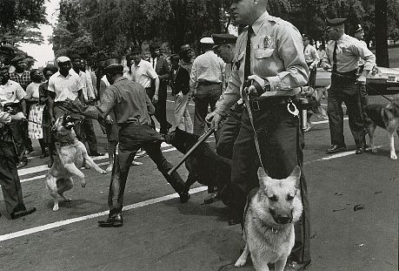
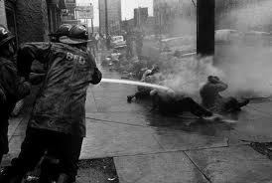

Slide 17
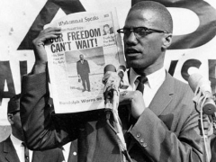
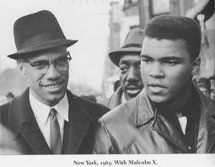
African-American Solidarity
• Nation of Islam, Black Muslims, advocate blacks separate from whites
- believe whites source of black problems
• Malcolm X—controversial Muslim leader, speaker; gets much publicity
• Frightens whites, moderate blacks; resented by other Black Muslims

Slide 18
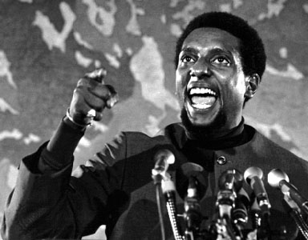
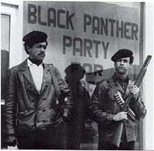
Black Panthers
• Black Panthers fight police brutality, want black self-sufficiency
• Preach ideas of Mao Zedong; have violent confrontations with police
• Provide social services in ghettos, win popular support

