Slide 1
Period 2, 5, & 6
We will examine the effects of the Cold War on US History
Chapter 18 Notes
Go over test
Cold War Map
Homework

Slide 2
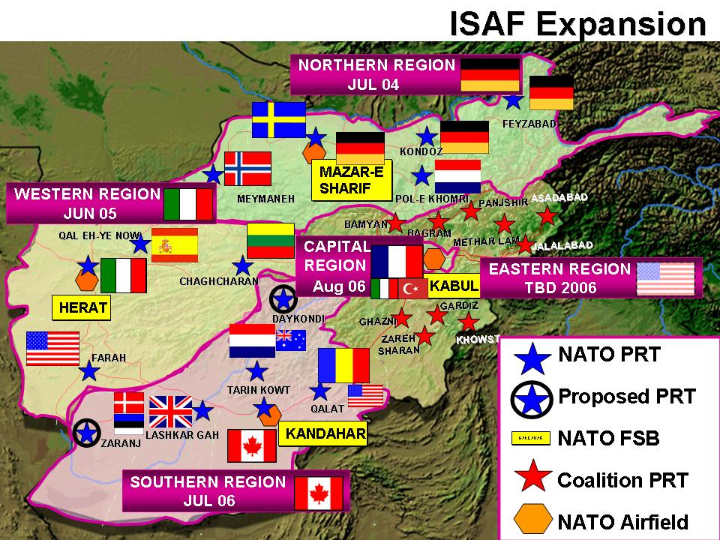
CHAPTER 18 NOTES
The NATO Alliance
Fear of Soviets leads to North Atlantic Treaty Organization (NATO)
European nations, U.S., Canada pledge mutual military support

Slide 3
North Korea Attacks South Korea
1950, North Korea invades South, begins Korean War
South Korea calls on UN to stop invasion; Security Council approves
MacArthur put in command of South Korean, U.S., other forces

Slide 4
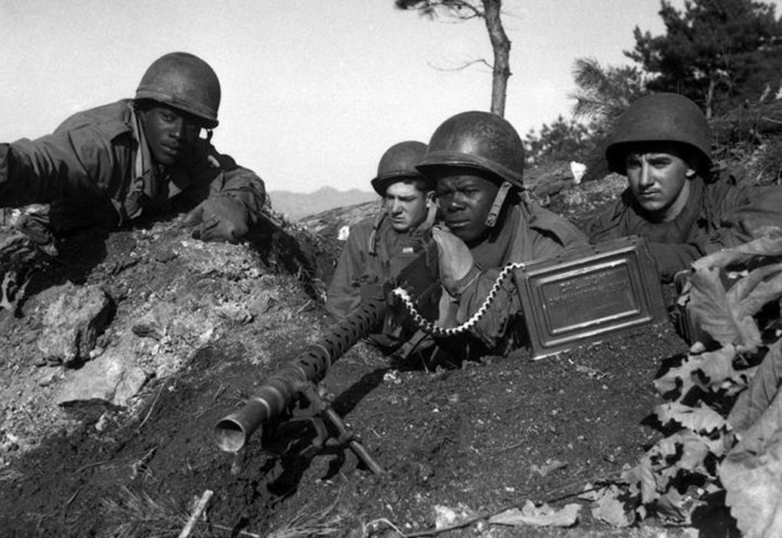
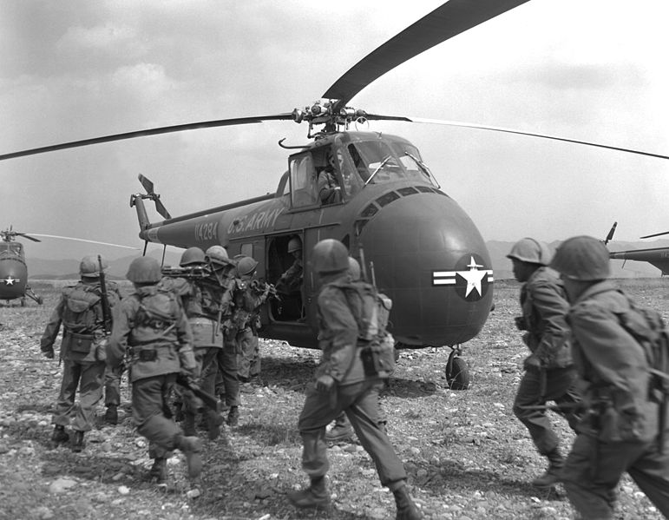

Slide 5
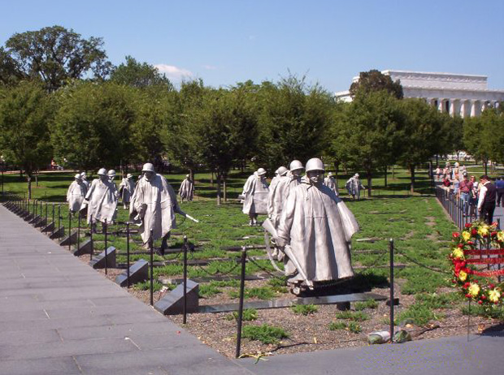

Slide 6
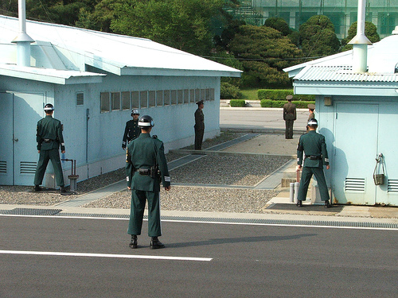
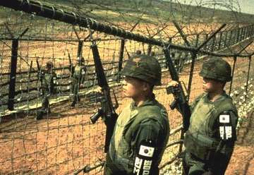
``
Settling for Stalemate
1951, Soviet Union suggests cease-fire
1953 armistice: Korea still divided; demilitarized zone established
Lack of success, high human, financial costs help elect Eisenhower

Slide 7
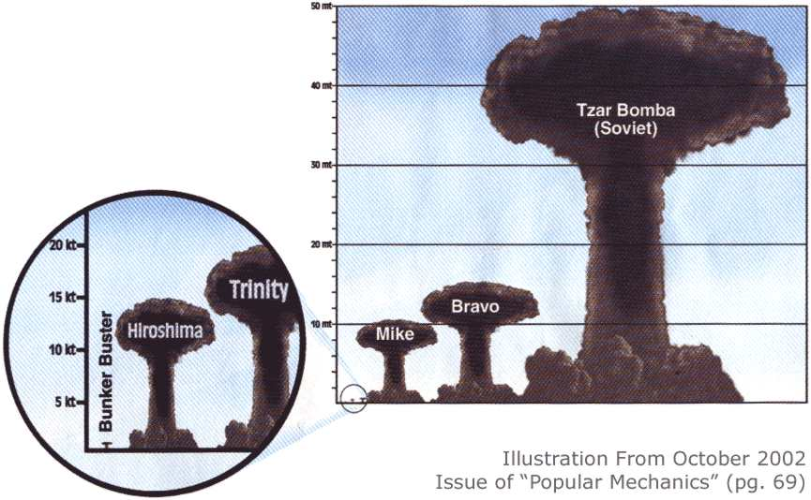
Nuclear Arms Race
• H-bomb—hydrogen bomb—nuclear weapon more powerful than atom bomb
• 1952, U.S. explodes first H-bomb; 1953, Soviets explode one

Slide 8
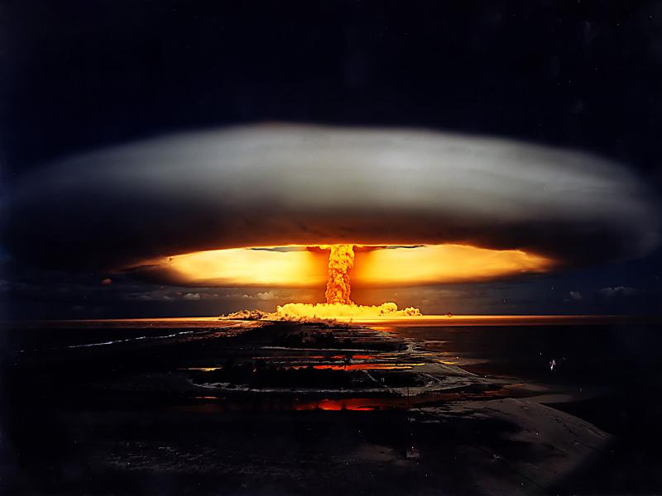

Slide 9
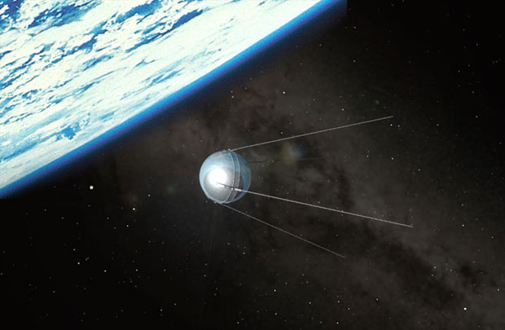
The Space Race
October 1957, Soviets launch Sputnik, first artificial satellite
Shocked Americans pour money into own space program

