Slide 1
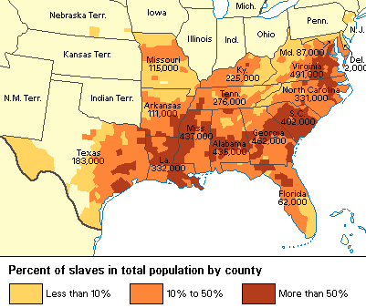

Slide 2
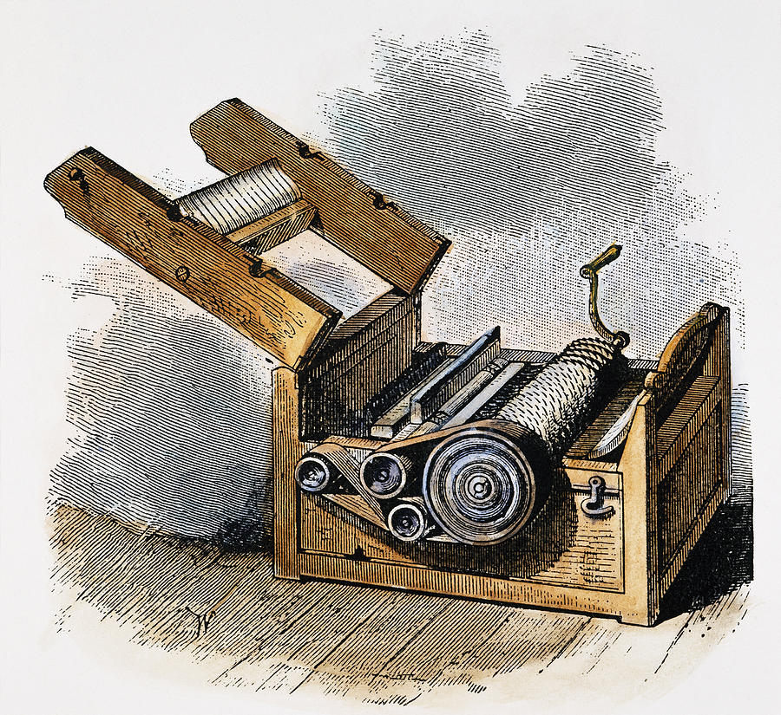
King Cotton
The North transported the cotton to England and the rest of Europe.
The South produced more than half the world’s cotton, and held an advantage over countries like England, needed cotton to make cloth
The South believed that since England was so dependent on them that, England would support the South

Slide 3
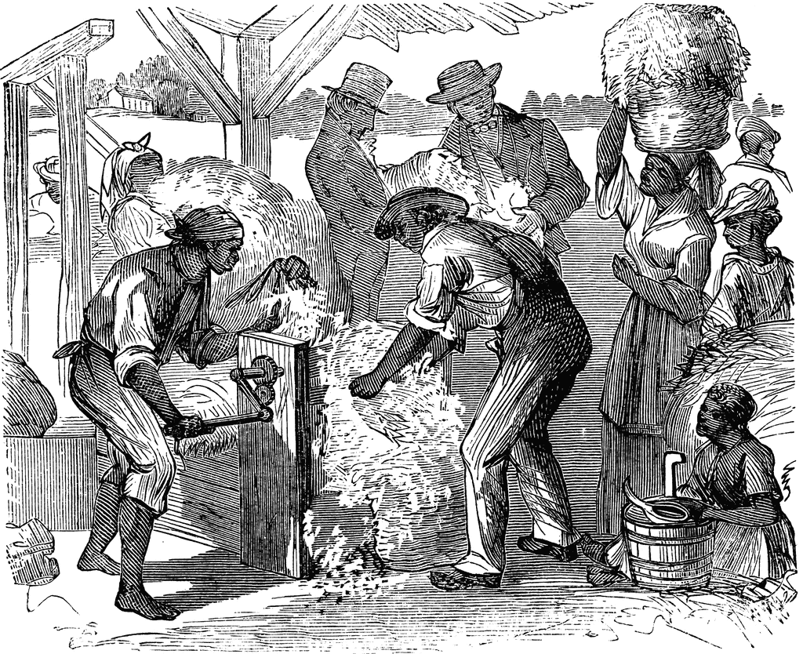

Slide 4
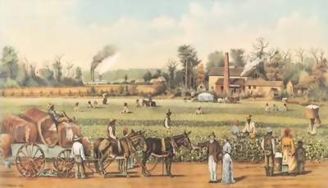
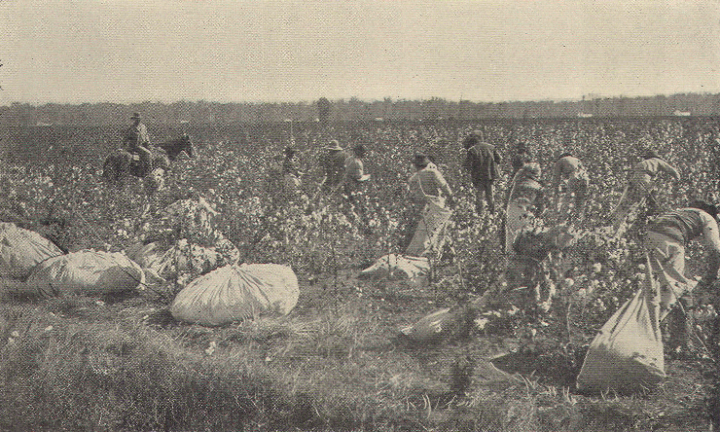
The Southern aristocrats widened the gap between the rich and the poor and hampered public-funded education by sending their children to private schools.

Slide 5
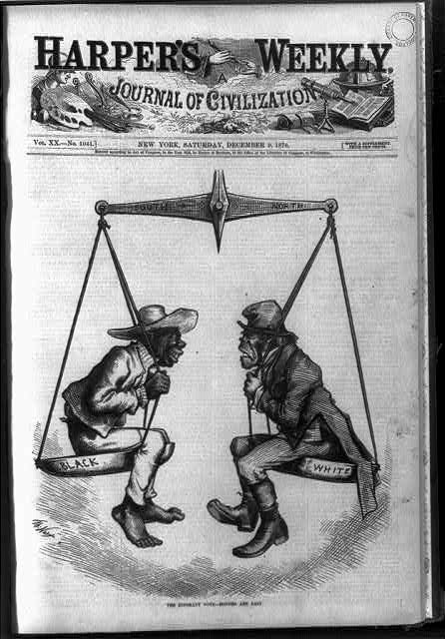
The economic structure of the South became increasingly monopolistic smaller farmers sold their land to the large estate owners.
The dominance of King Cotton likewise led to a one-crop economy
Southerners resented the Northerners who got rich at their expense
South was dependent on the North for clothing, food, and manufactured goods.
The South repelled immigrants from Europe, who went to the North, making it richer.

Slide 6
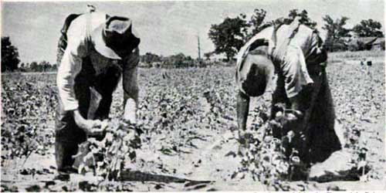
White Majority
Beneath the aristocracy were the whites that owned one or two, or a small family of slaves; they worked hard on the land with their slaves
Beneath these people were the slaveless whites (a full 3/4 of the white population) that raised corn and hogs

Slide 7
Free Blacks
In the upper South, free Blacks were descended from those freed by the idealism of the Revolutionary War
In the deep South, they were usually mulattoes (Black mother, White father who was usually a master) freed when their masters died.
Many owned property; a few owned slaves themselves.

Slide 8
Free Blacks were prohibited from working in certain occupations and forbidden from testifying against whites in court
In the North, free Blacks were also unpopular, as several states denied their entrance, most denied them the right to vote and most barred them from public schools.
Northern Blacks were especially hated by the Irish, with whom they competed for jobs.

Slide 9
Period 3 & 7
We will examine the growth of the abolitionist movement and some of its important leaders.
Warm Up: What was expected of men and women during the mid 1800s
Go over homework
Presidential Chart
Chapter 16 Notes
America the Story of US: Division

Slide 10
Questions to Consider
What are some of the rules for Men and Women that would be considered out of date today?
What are some of the rules for Men and Women that would still fit with today’s society?

Slide 11
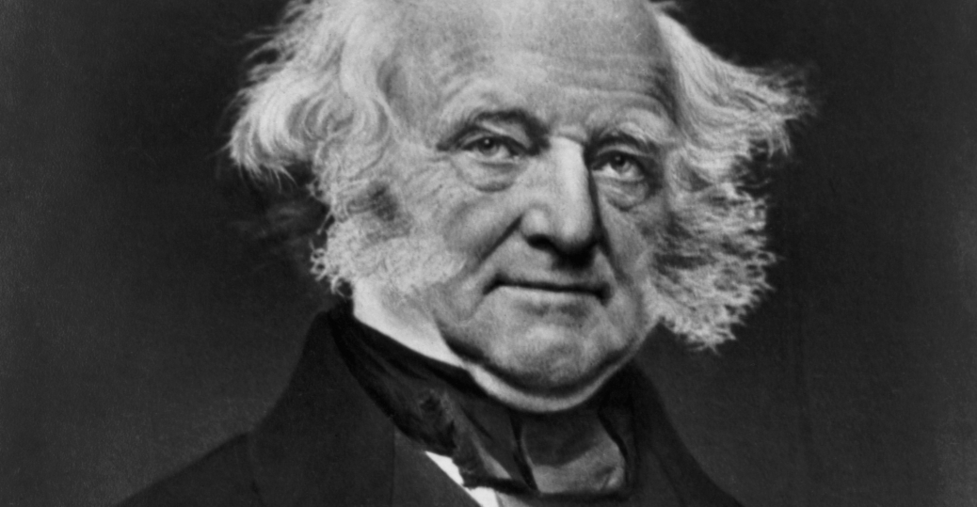

Slide 12
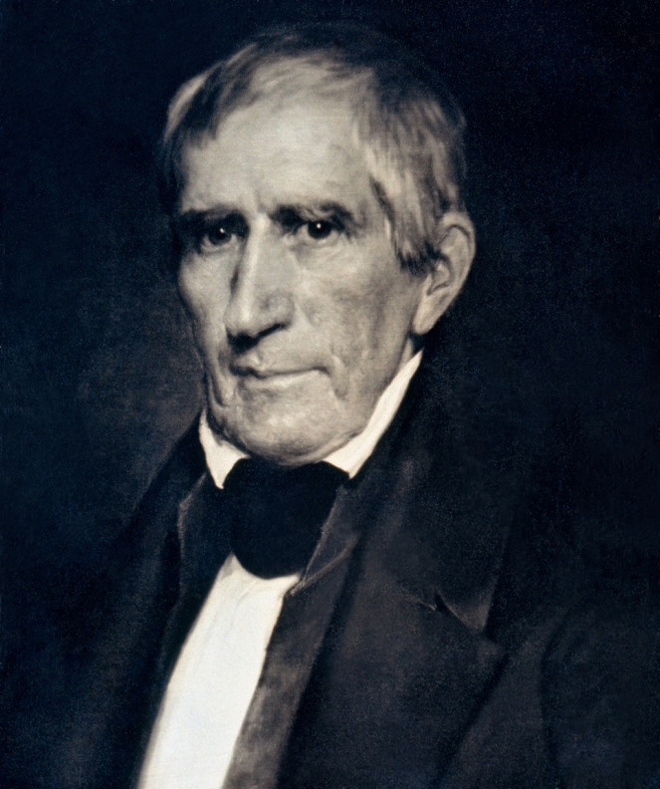

Slide 13
Life Under the Lash
Slave life varied from place to place, but for slaves everywhere, life meant hard work, no civil or political rights, and whipping if orders weren’t followed.
Lash beatings weren’t that common, since a master would lower the value of his slave
Forced separation of spouses, parents and children seem to have been more common in the upper South.
Still, most slaves were raised in stable two-parent households and continuity of family identity across generations was evidenced in the widespread practice of naming children

Slide 14
Slaves had no dignity, were illiterate, and had no chance of achieving the “American dream.”
They also devised countless ways to make trouble
They worked as slowly as they could without getting lashed.
They stole food and sabotaged expensive equipment.
Occasionally, they poisoned their masters’ food.
Rebellions, such as the 1822 Charleston rebellion led by Denmark Vesey, and the 1831 revolt by preacher Nat Turner, were not successful.

Slide 15
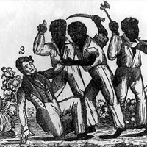
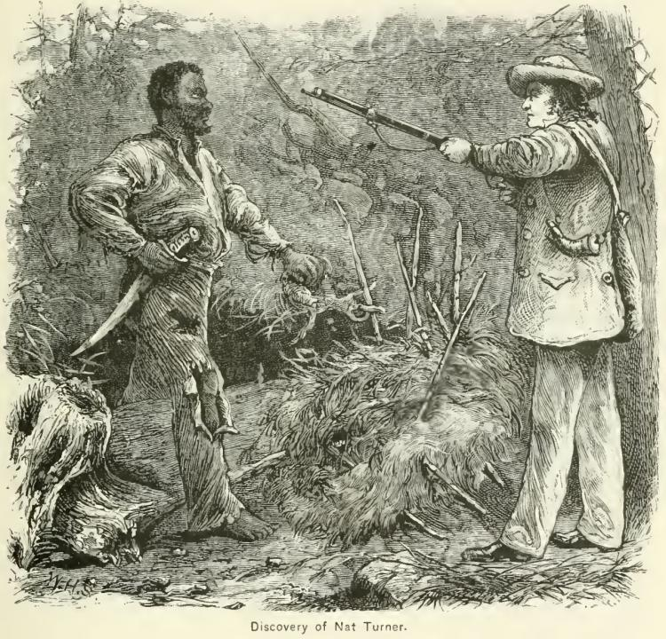

Slide 16
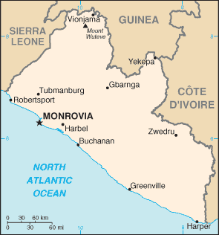
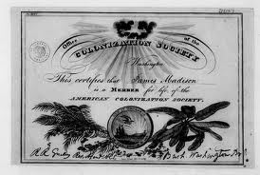
Abolitionism
In 1817, the American Colonization Society was founded to transport Blacks back to Africa, and in 1822, the Republic of Liberia was founded.

Slide 17
William Lloyd Garrison published The Liberator triggering a 30-year war of words
Sojourner Truth, a freed Black woman who fought for black emancipation and women’s rights,
The greatest Black abolitionist was an escaped slave, Frederick Douglass, who was a great speaker and fought for the Black cause despite being beaten and harassed.
His autobiography, Narrative of the Life of Frederick Douglass, depicted his remarkable struggle.
Douglass increasingly looked to politics to solve the slavery problem.
He and others backed the Liberty Party in 1840, the Free Soil Party in 1848, and the Republican Party in the 1850s.

Slide 18
Period 3 & 7
We will examine how the growth of industry impacted both the North and South.
Irish immigrants
Go over homework
Chapter 16 Notes continued
America the Story of US
Chapter 16 Guidebook

Slide 19
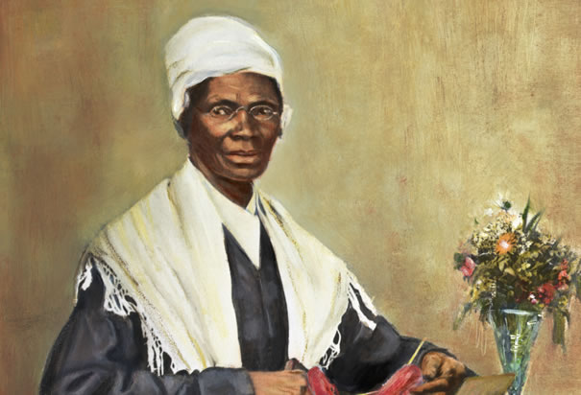
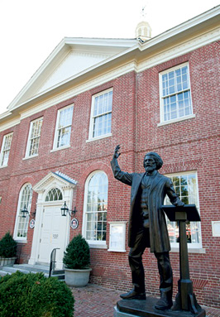
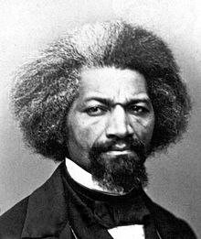

Slide 20
For a long time, abolitionists were unpopular
The South owed the North $300 million by the late 1850s, and northern factories depended on southern cotton to make goods.
Many abolitionists’ speeches provoked violence and mob outbursts in the North
Reverend Elijah P. Lovejoy was killed by a mob in 1837; he became an abolitionist martyr.
Yet by the 1850s, abolitionist outcries had been an impact on northern minds and were beginning to sway more and more toward their side

