Slide 1
Period 2, 5, & 6
We will examine the attempts by FDR to deal with the Great Depression.
Election Map
Go over Homework Questions
Chapter 15 Notes
Chapter 15 Crossword

Slide 2
The New Deal
Glass-Steagall Act establishes Federal Deposit Insurance Corporation
- insures individual bank accounts
• Federal Securities Act —companies must give all information on stocks
• Securities and Exchange Commission created to regulate stock market
• 21st Amendment repeals prohibition by end of 1933

Slide 3
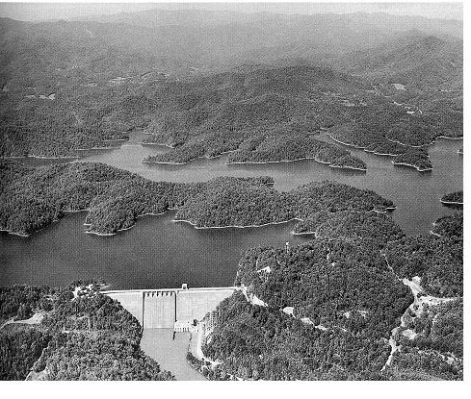
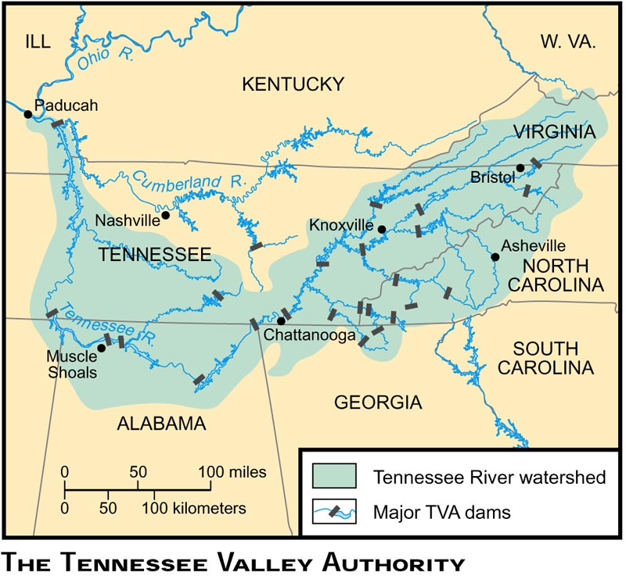
Rural Assistance
Agricultural Adjustment Act (AAA) raises food prices, lowers supply
Tennessee Valley Authority creates jobs renovating, building dams

Slide 4
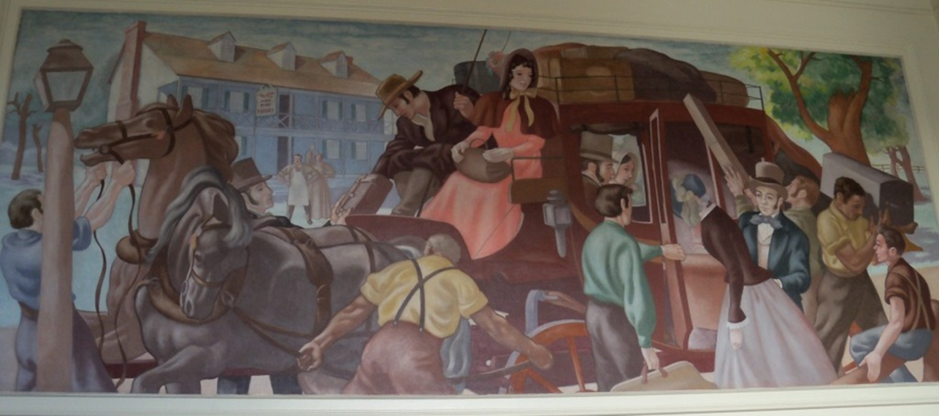
Providing Work Projects
Civilian Conservation Corps —public works jobs for young men
Public Works Administration —money to states to create jobs
Civil Works Administration builds rural schools, pays teachers

Slide 5
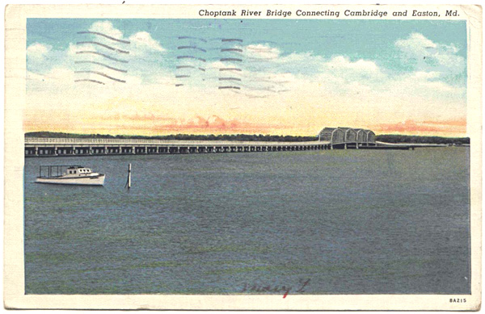
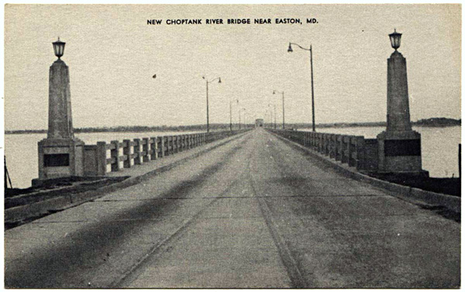

Slide 6
Culture During the Depression
John Steinbeck writes The Grapes of Wrath about Dust Bowl migrants

Slide 7
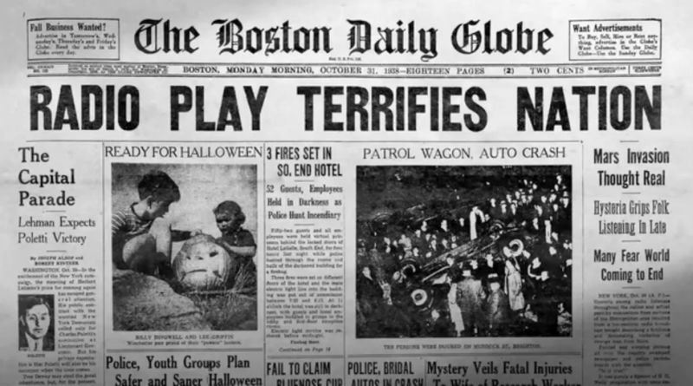
90% of households have a radio; families listen together every day
Dramas, variety shows play in evening
War of the Worlds convinces Americans the US is under attack from aliens
Immediate news coverage becomes customary

Slide 8
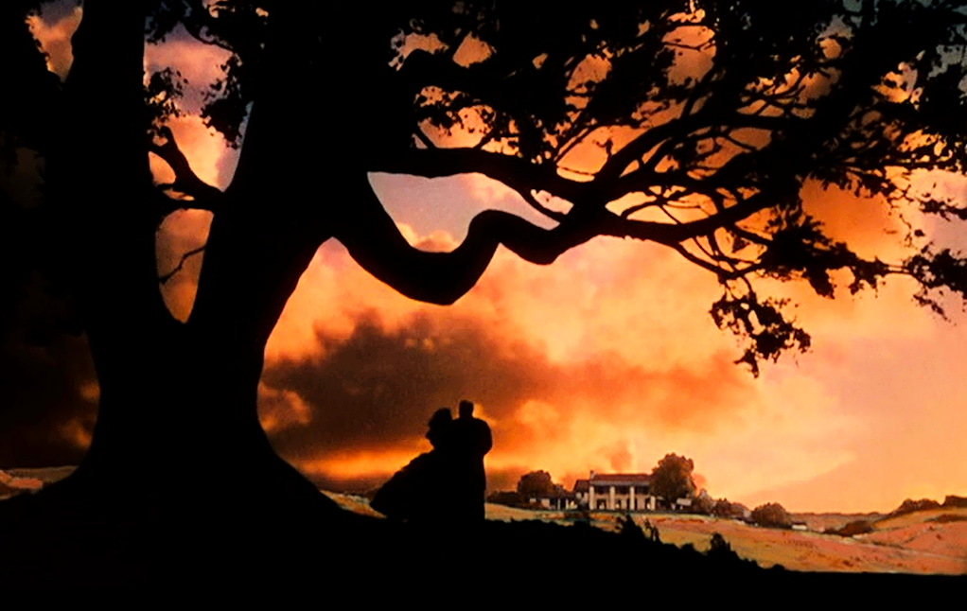
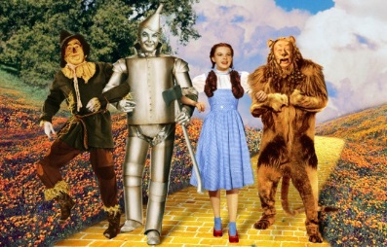
Movies are a Hit
About 65% of population goes to movies once a week
Films offer escape from reality; show wealth, romance, fun
Gone With the Wind, Wizard of Oz

