Slide 1
Chapter 12. 1 War Breaks Out
• 1839, Opium War erupts—fight caused because Britain refused to stop selling opium to the Chinese.
• China loses the war to more modern British navy.
• China signs the Treaty of Nanjing (1842) gives British control of Hong Kong
• In 1844, other nations win extraterritorial rights this means foreigners are exempt from laws in certain ports

Slide 2
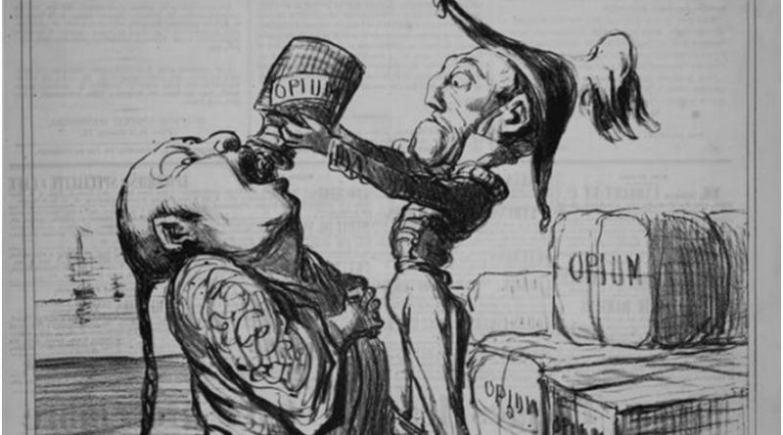
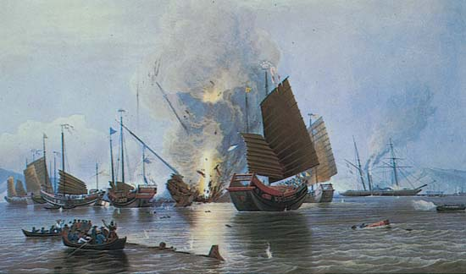

Slide 3
The Taiping Rebellion
• In late 1830s, Hong Xiuquan recruits followers to build new China where everyone would share in China’s wealth.
• Taiping Rebellion—name given Hong’s movement; taiping—“great peace”
• In 1850s, Hong’s army grows large, captures large areas in southeast
• By 1864, rebellion defeated by internal fighting

Slide 4
Period 2,5,6,& 7
We will examine how imperialism impacted China.
Warm Up: Get a laptop
Go over homework
Imperialism in China Notes
Crash Course and practice Asia Map
Critical Thinking Questions

Slide 5
Open Door Policy
• China suffers attacks from other nations; this forced China to grant more rights to these countries through many treaties.
• Europeans and Japan gain spheres of influence—areas of economic control
• U.S. declares Open Door Policy (1899)
- Chinese trade open to all nations. Other nations agree.

Slide 6
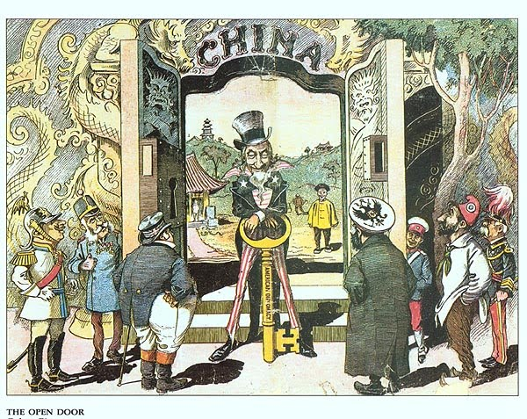

Slide 7
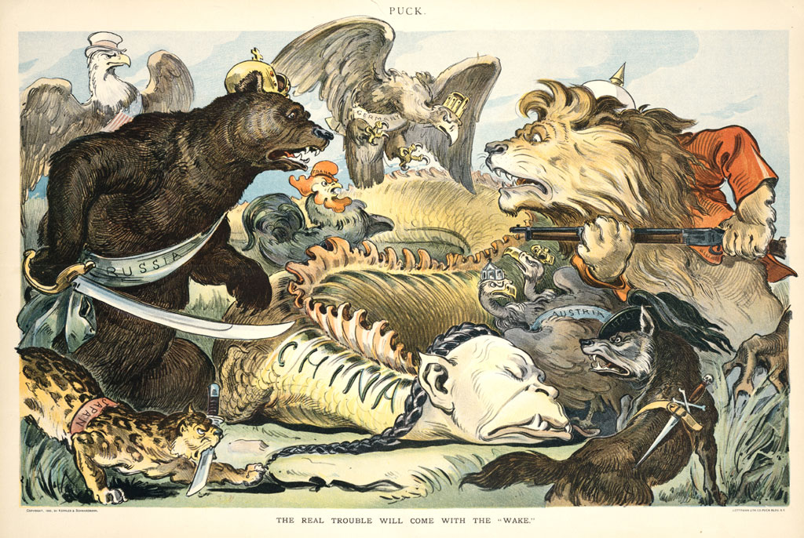

Slide 8
The Boxer Rebellion
• Anti-Foreign peasants form secret organization- Secret Society of the Harmonious Fists they became known as the Boxers
• In 1900, they launch Boxer Rebellion
• Rebels take Beijing, but foreign army defeats them, ending rebellion
• Though rebellion fails, Chinese nationalism surges

