Slide 1
Chapter 9.1 Notes
The 4 goals of the Progressive Era
Protecting social welfare
Promoting moral improvement
Creating economic reform
Fostering efficiency

Slide 2
Protecting Social Welfare:
YMCA opened libraries, sponsored classes, and built swimming pools
Salvation Army fed the poor in soup kitchens. Taught immigrants value of hard work and temperance

Slide 3
Promoting Moral Improvements
Immigrants should improve their own moral behavior
Prohibition was seen as solution to problems
Prohibition movement helped the women’s voting movement

Slide 4
Period 2, 5, & 6
We will examine the political, economic, and social changes of the Progressive Era.
Today:
Review assembly Line
Henry Ford Reading
Chapter 9 Notes
Car Challenge

Slide 5
Assembly Line
How does an assembly line work?
Why does it decrease the cost of a car?
What is something built using an assembly line today other than a car?
Would you want to work on an assembly line? Why or why not?

Slide 6
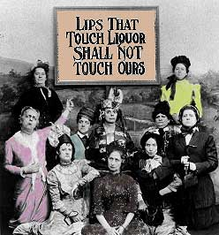

Slide 7
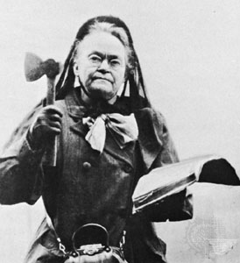
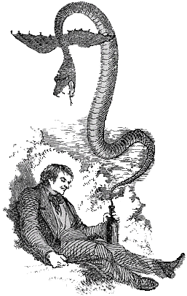
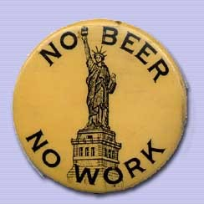

Slide 8
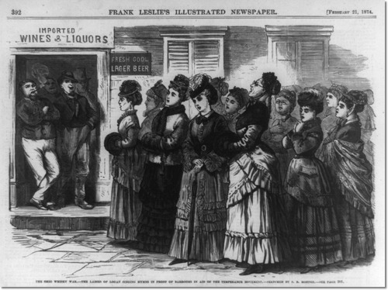

Slide 9
Anti-Saloon League had problems with immigrant groups
Alcohol was part of immigrant’s culture
Saloons were important for cashing checks and serving meals
Creating Economic Reform
Muckrakers: Journalists who wrote about corruption

Slide 10
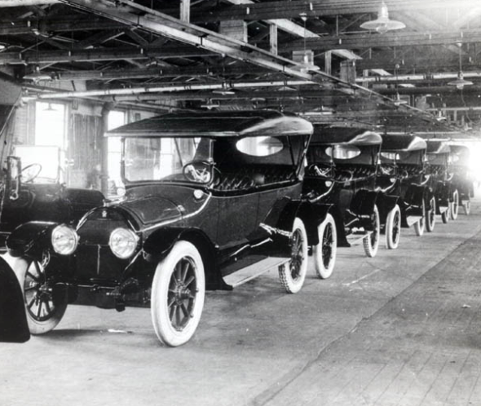
Fostering Efficiency
High worker turnover because they could not keep up
Henry Ford reduced work day to 8 hours to keep workers happy

Slide 11
Businesses hired children
Children perform unskilled work for little pay
Children’s small hands were good for working on small parts or with small tools
Children had to work because their parents didn’t make enough
Protecting Working Children
Children suffered from accidents, health problems, stunted growth

Slide 12
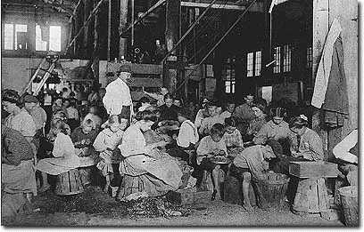
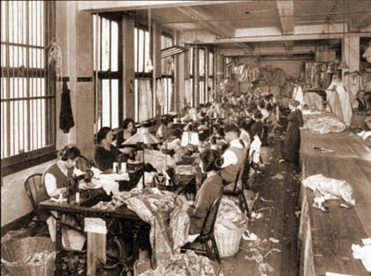

Slide 13
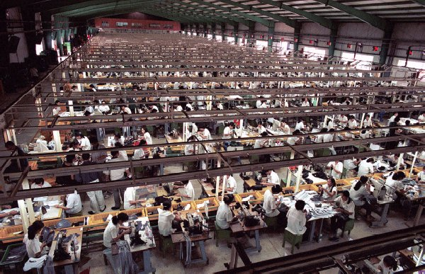
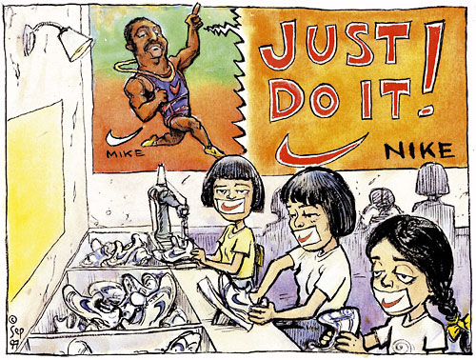

Slide 14
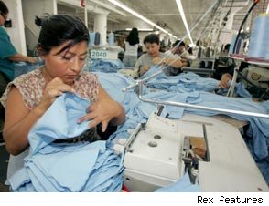
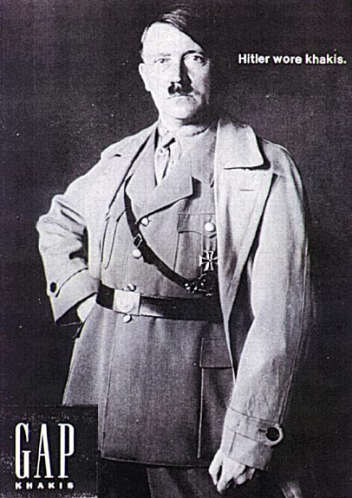

Slide 15
Keating-Owen Act (1916) – Can’t transport goods across state lines that are produced by child labor
Supreme Court declared the act unconstitutional

Slide 16
Limiting Working Hours
Supreme Court allowed laws that limited the work day to 10 hours
A worker’s family was also compensated if he or she was killed on the job

Slide 17
17th Amendment
Before senators were chosen by the state legislature
The amendment allows for the direct election of senators
Who are our two senators from Maryland?

