Slide 1
Chapter 34
FDR and the Three R’s:
Relief, Recovery, and Reform
• New Deal’s goals
– Short-range: relief and immediate
recovery
– Long-range: permanent recovery and
reform of abuses that had produced the
boom and bust cycle

Slide 3
• March 12, 1933 –
first of 30 “fireside
chats”
– Assured public that
it was now safer to
keep money in the
bank then under the
mattress

Slide 4
• The problem of unemployment
– 1 of every 4 workers unemployed in 1933
– FDR used federal money to assist
unemployed and “prime the pump” (start
the flow) of industrial recovery

Slide 5
Why US went off the gold standard
– Goal was inflation to relieve debts and stimulate
production
– Government bought up gold at increasing prices
• Price per ounce went up from $21 (1933) to $35 (early
1934)
– Attacked by “sound money” conservatives
– 1934 – 1971 – limited gold standard
• For international trade, US would pay debts in gold if
requested at 1 ounce for every $35 owed
• Domestic circulation of gold (as money) prohibited
– 1971 – Nixon took US completely off gold
standard

Slide 6
Period 3 & 7
We will examine the Roosevelt’s administrations attempt to deal with the Great Depression.
  AP Review
  Achievement Quiz
  Collect Homework
  Chapter 34 & 35 Notes
  Depression Graph

Slide 7
Period 3 & 7
Jays Treaty
Shay’s Rebellion
3/5 Compromise
Embargo Act
Non-Intercourse Act
John Marshall
Marbury v. Madison
McCulloch v. Maryland

Slide 8
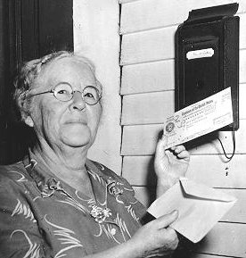

Slide 10
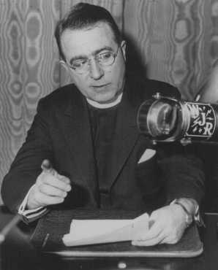
Father Charles Coughlin
– From Michigan
– Demanded “Social Justice”
• Inflated currency
• Nationalization of all banks
– Anti-Semitic and Fascistic attacks led to superiors in Catholic church silencing
him

Slide 11
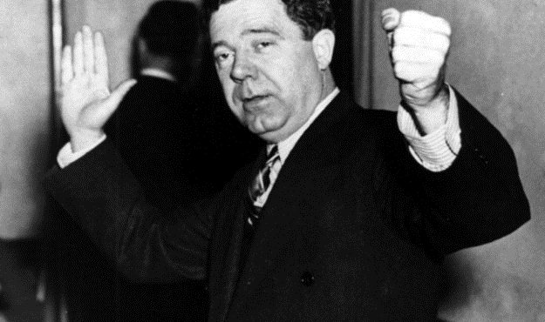
Senator Huey P. “Kingfish” Long
– From Louisiana
– “Share Our Wealth” program
• Promised to make “Every Man a King”
• Every family would receive $5,000 yearly by
taxing the rich
– Killed by assassin in 1935

Slide 12
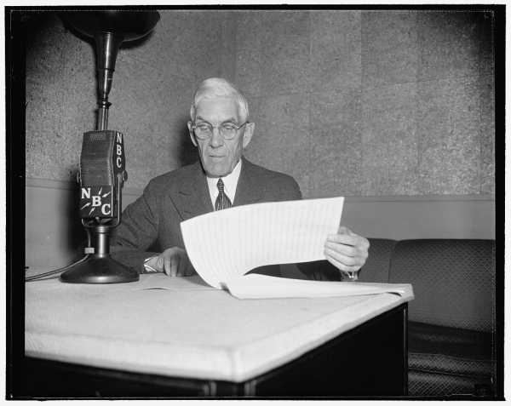
Dr. Francis E. Townsend
– From California
– Retired doctor who had lost his savings in crash
– Every senior (over 60) would receive $200 a month
• To stimulate the economy, they would be
required to spend the money that month

Slide 14
Roosevelt’s court reform
(“court packing”) plan
– 1937 – Roosevelt asked
Congress to allow him to
appoint 1 new justice for
every member over 70 who
would not retire
• Maximum membership
would be 15
• Falsely accused Court of
being behind in its work

Slide 15
Battle of New Orleans
Gibbons v. Ogden
War Hawks
Adams Onis Treaty
Missouri Compromise
Corrupt Bargain
Spoils System

