Slide 1
Period 3 & 7
We will examine the attempts to change society through government action.
Chapter 29 Notes
Upton Sinclair’s The Jungle
US Food Production Today

Slide 2
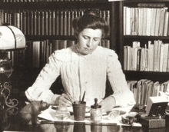
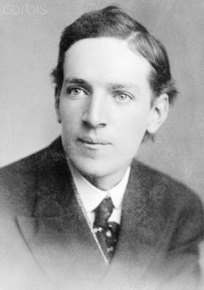
Chapter 29
Muckrakers: Writers who exposed corruption and scandal
Ida Tarbell writes a book about the Standard Oil Company. Pioneers investigative journalism. Her story leads Supreme Court to break up Standard Oil in 1911.
Upton Sinclair writes The Jungle leads US government to pass the Meat Inspection Act in 1906

Slide 3
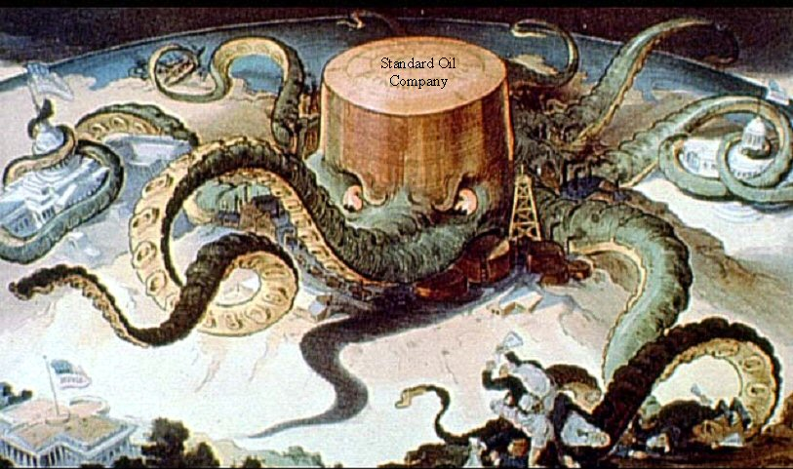

Slide 4
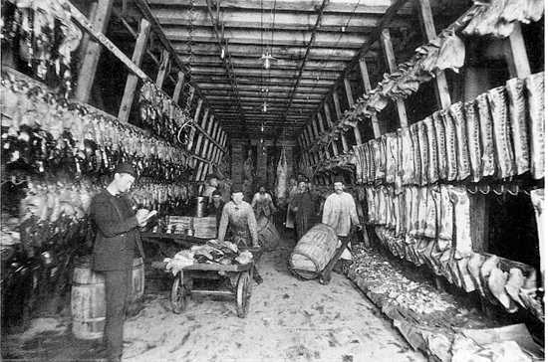
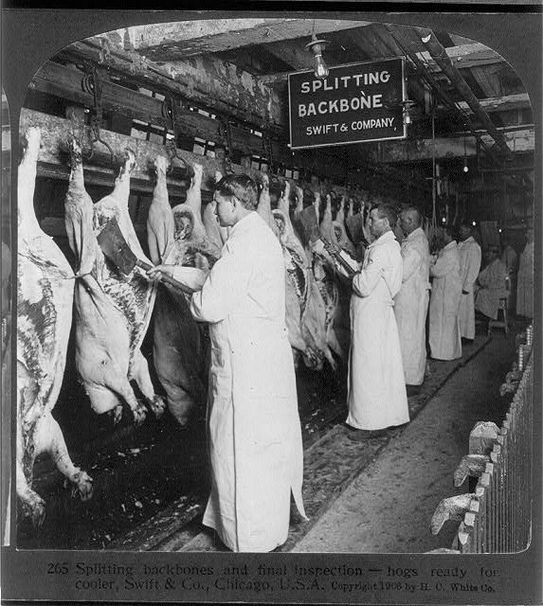
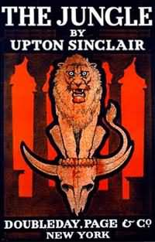

Slide 5
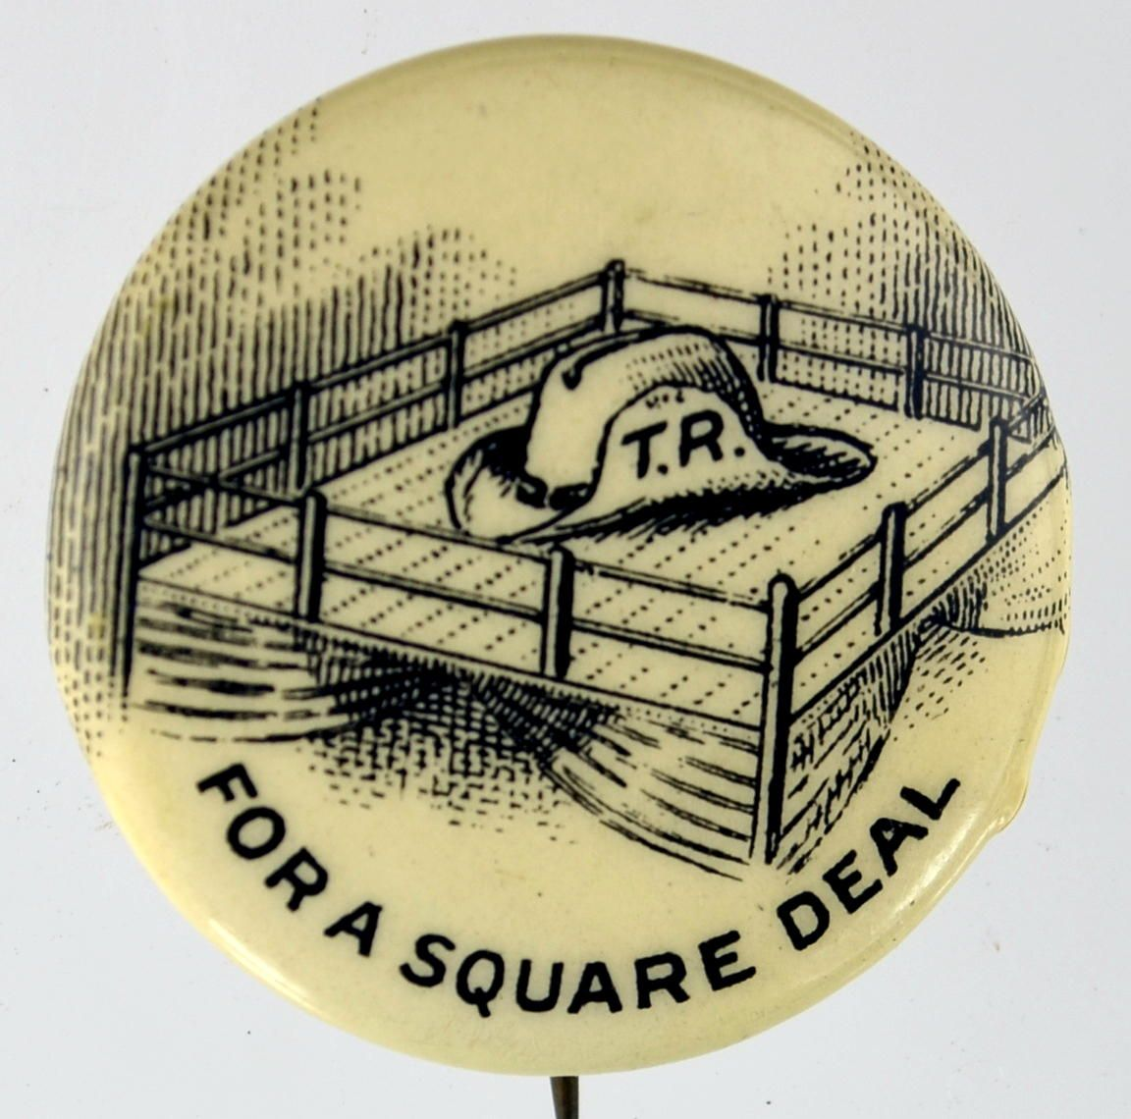
Teddy Roosevelt’s Square Deal
Program Consisted of 4 Parts
Control of Corporations
Consumer Protections
Negotiate with Labor
Conservation of Natural Resources
Roosevelt intervened in a coal strike.
Threatened to have government take over the mines.
Both sides reached a compromise
1st time government didn’t take side of business

Slide 6
After election of 1904, Teddy Roosevelt promises not to run again. A promise he quickly regrets
TR chooses William Howard Taft as his Republican Successor in the 1908 election

Slide 7
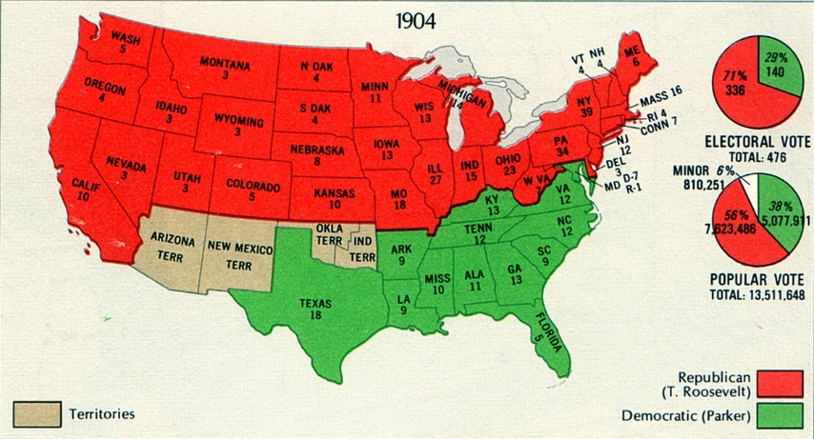

Slide 8
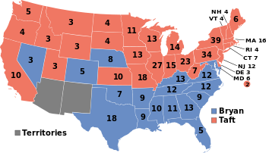

Slide 9
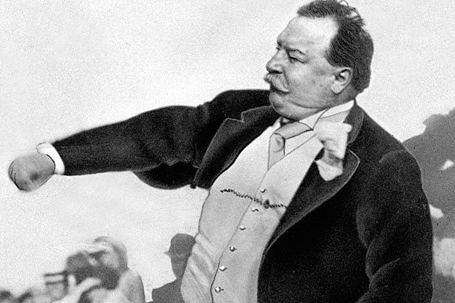
Taft the Trustbuster
A trust was a monopoly of a particular business
Ex. Standard Oil and US Steel
Taft brought 90 lawsuits against trusts during his presidency. Twice as many as TR.
TR didn’t like how Taft was handling the country. Tried to take nomination back from Taft in 1912.

