Slide 1
Period 3 & 7
We will examine the reasons why the United States went to war with Spain.
Why go to war?
Go over homework
Chapter 27 Notes
Spain Regrets the Maine
McKinley War Address

Slide 2
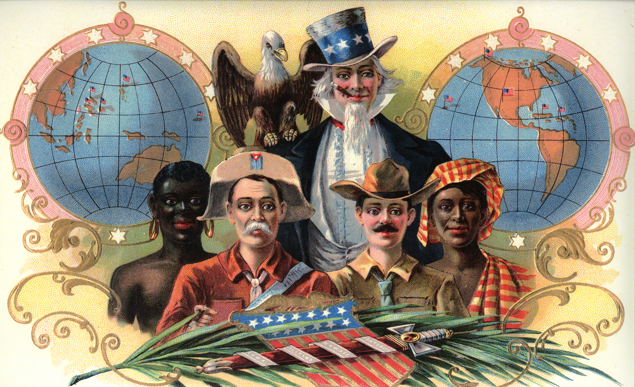

Slide 3
Chapter 27 – The Path of Empire
Alfred T. Mahan writes book Influence of Sea Power on History, convinces many countries to build up their navy
Navy is key to world dominance
US and Britain argue over Venezuela. Britain backs off wants friend in US in case it goes to war with Germany

Slide 4
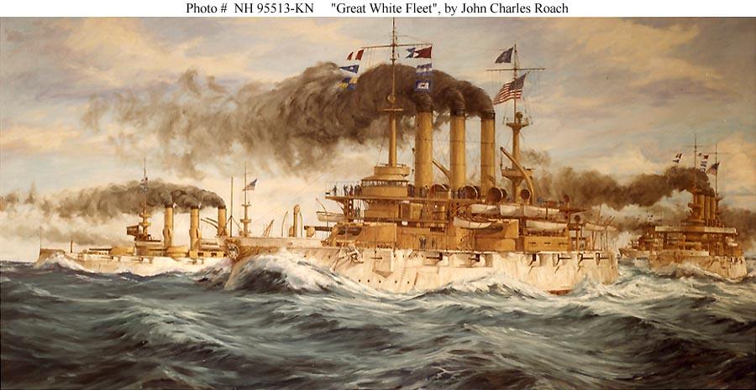

Slide 5
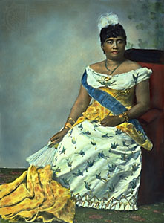
Hawaii
US makes a deal with Hawaiians to allow naval base at Pearl Harbor
With passage of McKinley tariff, American sugar planters in Hawaii were making less money
No tariff if Hawaii became part of US
Overthrow Queen Lilioukalani and demand to be annexed by the US

Slide 7
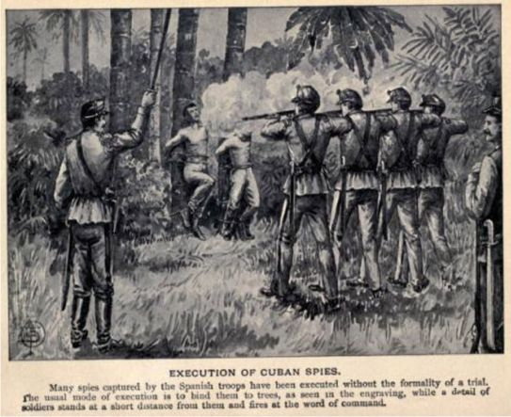
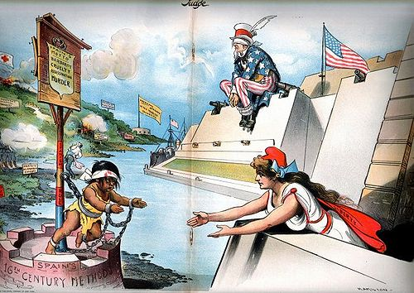
Cuba
Cubans began to revolt against the Spanish
Spanish soldiers rounded rebels into re-concentration camps
Rebels believed that if revolution continued in Cuba, US would intervene in order to protect investment in sugar plantations

Slide 8
Yellow Journalism and the USS Maine
William R. Hearst and Joseph Pulitzer led the fabricated atrocities of Cuba apart of the new "yellow journalism."
The two men caused the American people to believe that conditions in Cuba were worse than they actually were
The USS Maine was sent to Havana Harbor to protect American interests in Cuba
In February of 1898 it blew up killing 260 of 400 crew
US blamed Spain for the explosion. Spain claimed it was an accident.

Slide 9
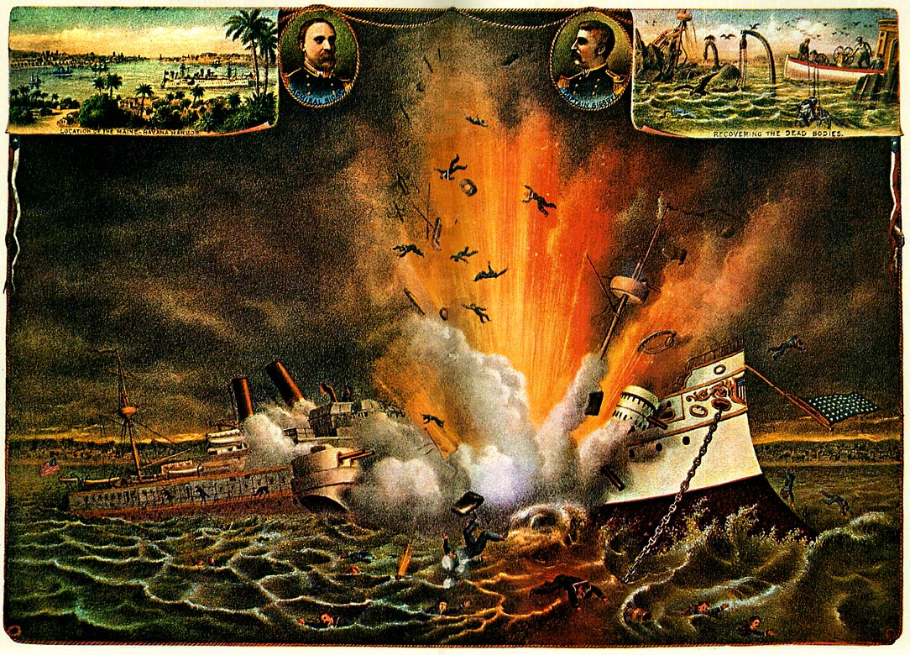
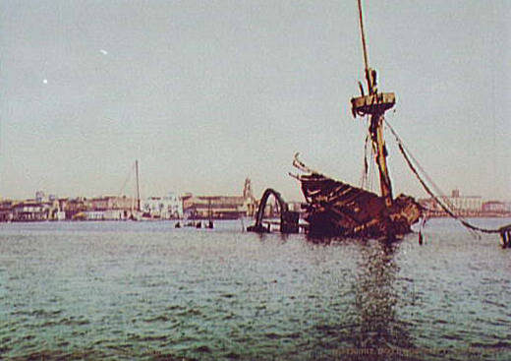

Slide 10
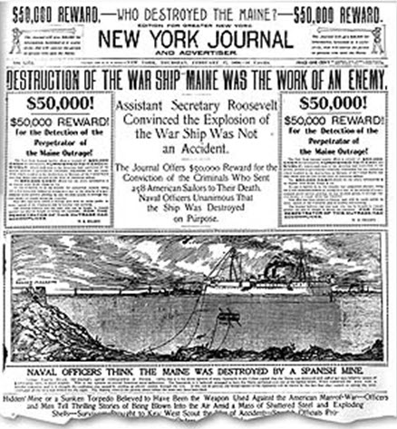
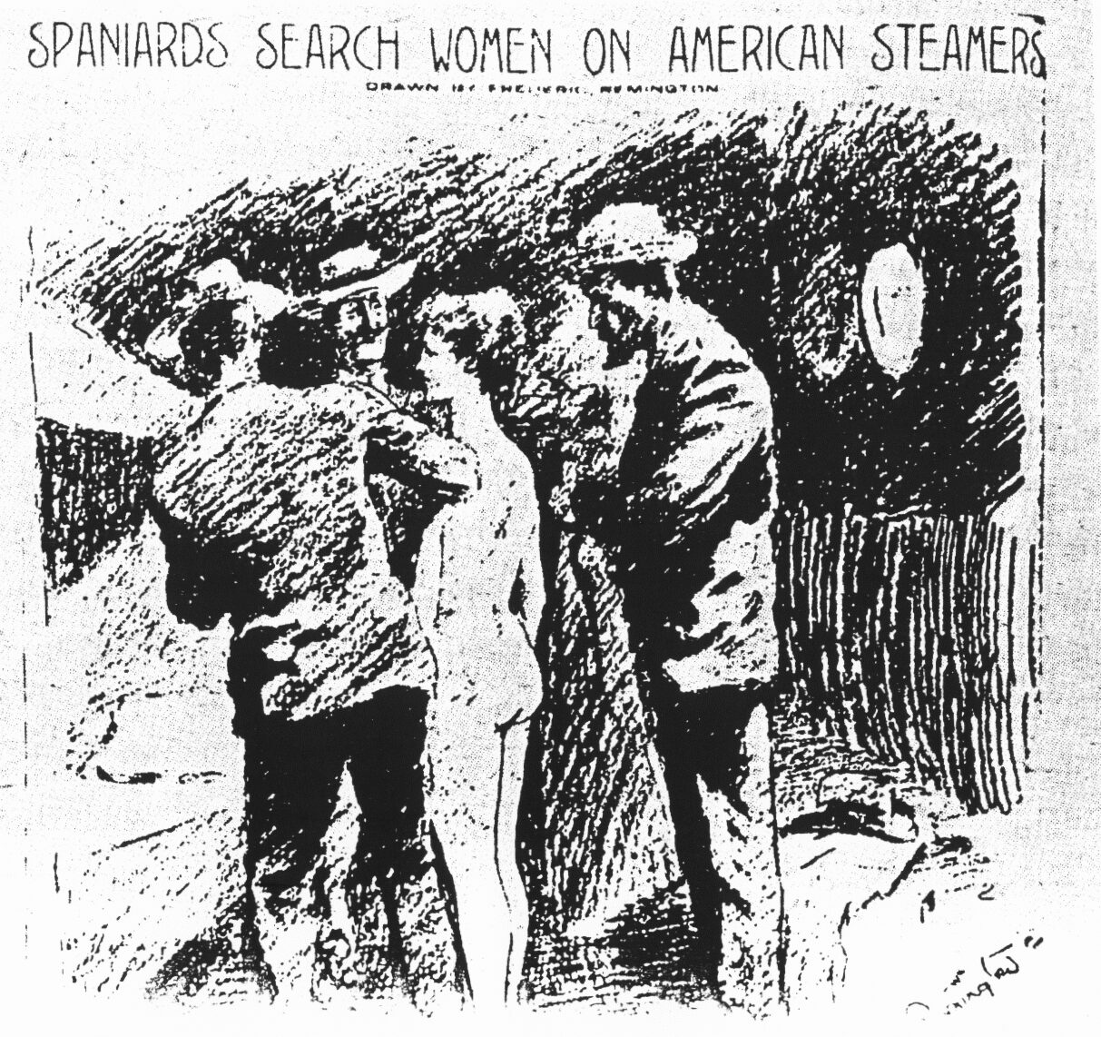
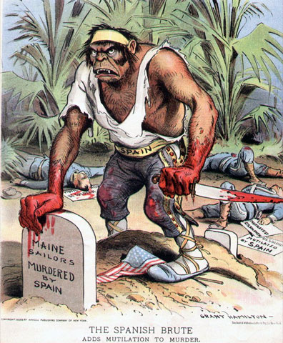

Slide 11
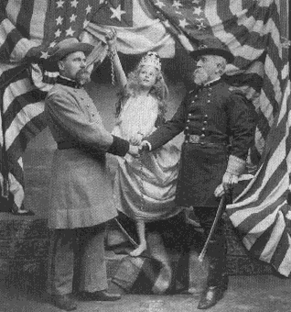

Slide 12
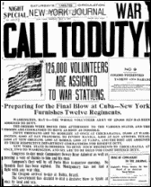
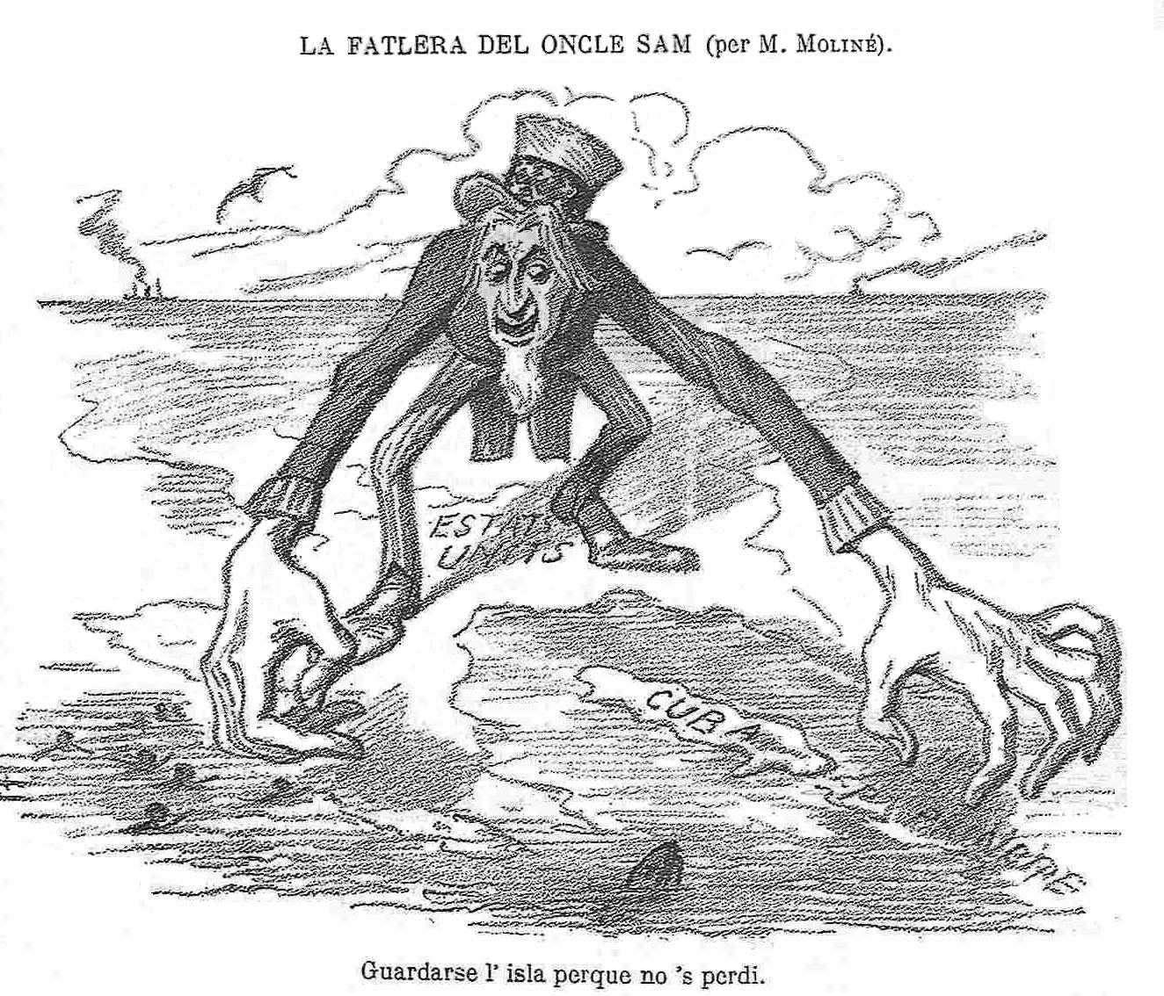
McKinley was reluctant to go to war with Spain. Civil War veteran.
American People were demanding war with Spain.
Congress Declared war and issued the Teller Amendment
Teller Amendment guaranteed Cuba’s freedom upon defeat of Spain

Slide 13
The War with Spain
US had a small army of only 28,000 men compared to 200,000 Spanish troops in Cuba
Commodore Dewey’s fleet defeat the Spanish in the Philippines.
In order to supply Philippines the US annexed Hawaii
The US invasion of Cuba was disorganized and nearly met with disaster because of disease

Slide 14
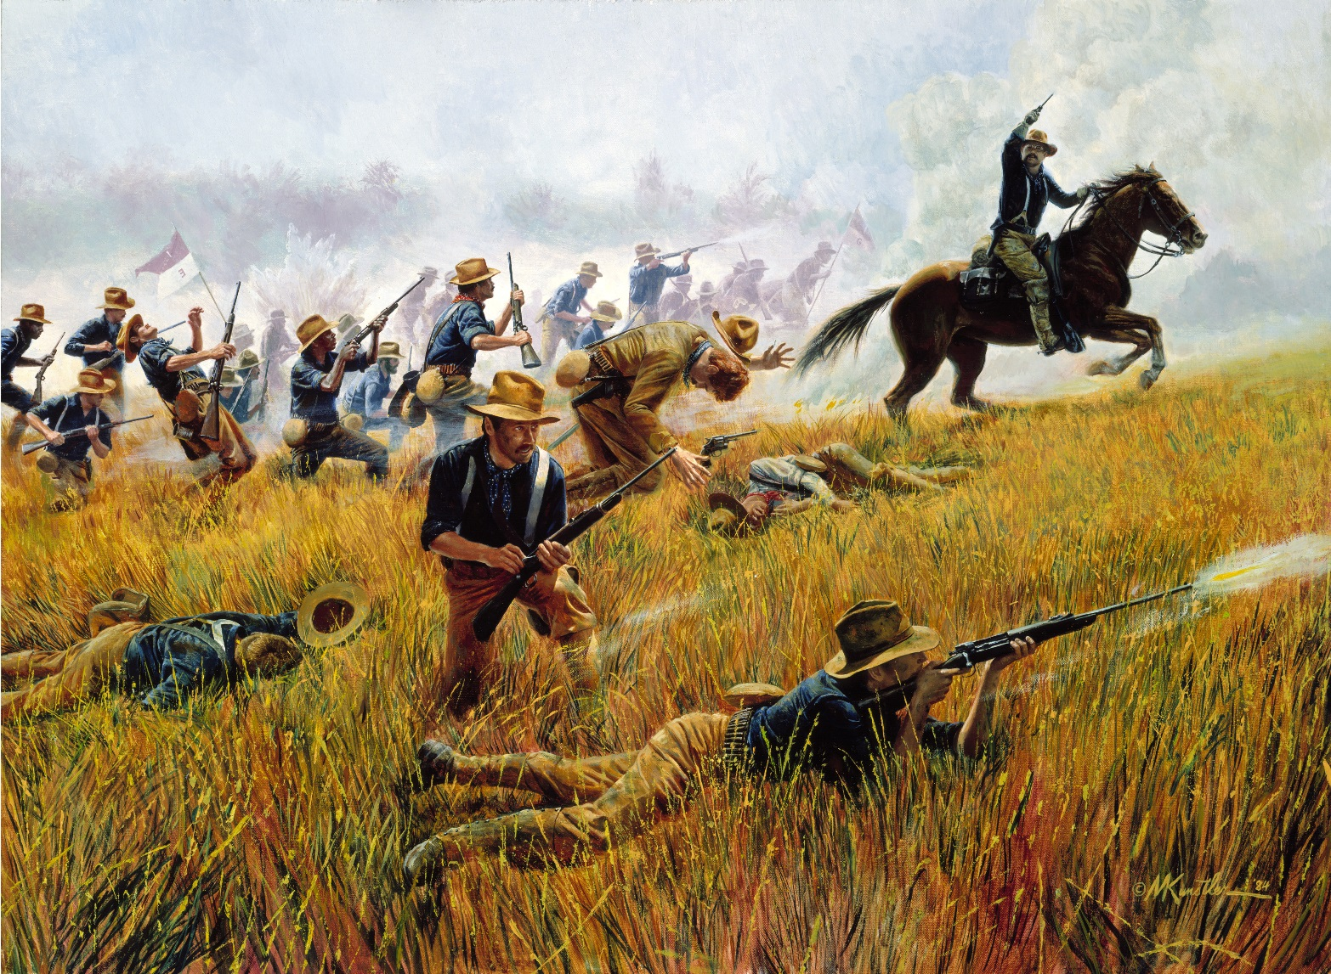
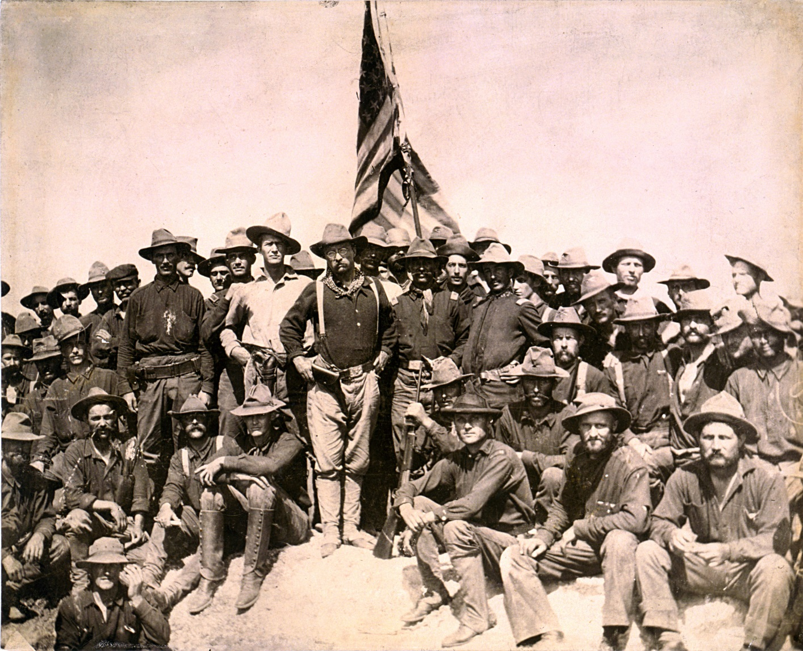
Teddy Roosevelt and the Rough Riders along with the 9th and 10th US Cavalry defeated the Spanish at San Juan Hill and Kettle Hill
The US captured Puerto Rico
After just 5 months of fighting Spain and US sign an armistice

Slide 16
Period 3 & 7
We will examine the events of the Spanish American War as well as its long term effects.
AP Review
Chapter 27 Notes
Spanish American War Documents
Imperialism DBQ

Slide 17
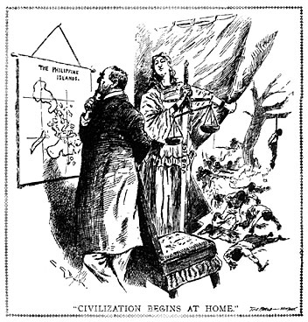
Anti-Imperialist League
Many in the US opposed the treaty because it made the US an imperial power
US becomes involved in the Philippine Insurrection where it uses some of the same tactics Spanish used
Insular Cases state that the Constitution does not apply to Philippines
Platt Amendment- US can intervene in Cuba whenever it wishes

Slide 19
Results
US gains prestige as a world power
War helps heal wounds from the Civil War and unite North and South
US gains Guam, Puerto Rico, Philippines and oversees Cuba

Slide 20
