Slide 1
Problems of Peace
After the war there were many questions
1. What to do with the free Blacks?
2. How to reintegrate the Southern states into the Union?
3. What to do with Jefferson Davis?
4. Who would be in charge of Reconstruction?

Slide 2
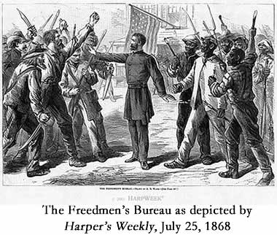
Freedmen’s Bureau
Some freed slaves took vengeance on former owners
Some freed slaves stayed to work on plantation
Many slaves took to roads looking for family and work
The church became the focal point of the black community
Freedmen’s Bureau taught 200,000 freed blacks how to read

Slide 3
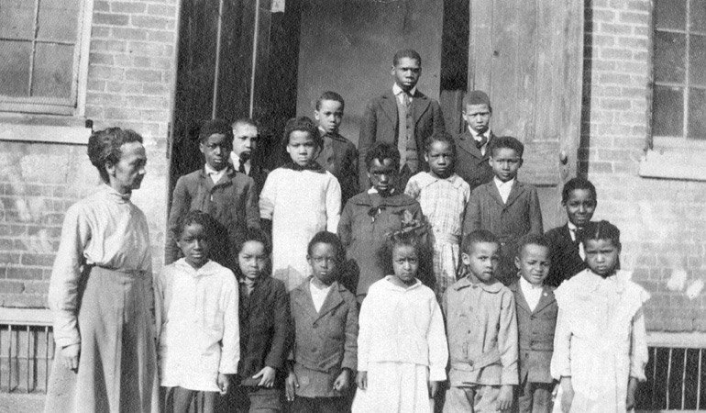
Presidential Reconstruction
Since Lincoln believed that the South had never legally withdrawn from the Union, restoration was to be simple.
In his 10% plan, the southern states could be reintegrated into the Union if and when they had only 10% of its voters pledge and take an oath to the Union, also acknowledge the emancipation of the slaves;

Slide 4
Radical Republicans felt punishment was due the South.
They feared that the leniency of the 10 % Plan would allow the Southerners to re-enslave Blacks
Wade-Davis Bill through was pushed through Congress. It required 50% of the states’ voters to take oaths of allegiance

Slide 5
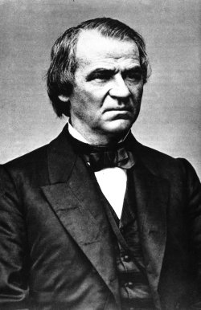
Johnson took Lincoln’s policy and added his own Reconstruction proclamation:
Certain leading Confederates were disfranchised (right to vote removed)
Confederate debt was repudiated
States had to ratify the 13th Amendment.

Slide 6
Test Topics
Election of 1860
Advantages of North and South
Battle of Antietam
Ironclads
Emancipation Proclamation
Gettysburg
Copperheads
Election of 1864
End of the war
Freedmen’s Bureau
Presidential Reconstruction
Congressional Reconstruction
Black Codes
Reconstruction Act
Ex Parte Milligan
Johnson Impeachment
Purchase of Alaska
Carpetbaggers and Scalawags
Compromise of 1877
Amendments 13, 14, 15

Slide 7
Period 3 & 7
We will examine the attempts by the President and the Congress to reconstruct the South after the Civil War.
Go over homework
Chapter 22 Notes
Test Exemption
Black Codes

Slide 8
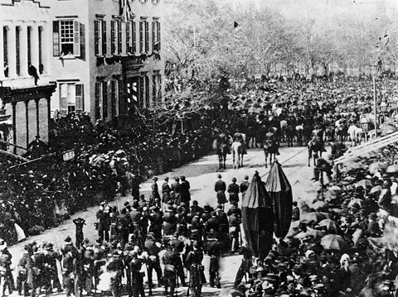

Slide 9
Black Codes
In order to control the freed Blacks, Black Codes were passed, aimed at keeping the Black population in submission and workers in the fields.
The codes forbade Blacks from serving on a jury and some even barred Blacks from renting or leasing land, and Blacks could be punished for “idleness” by being subjected to working on a chain gang.

Slide 10
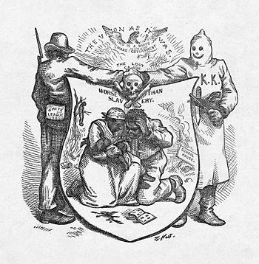

Slide 11
Northerners now realized that the South would be stronger politically than before, since now, Blacks counted for a whole person instead of just 3/5 of one
On December 6, 1865, President Johnson declared that the South had satisfied all of the conditions needed, and that the Union was now restored.

Slide 12
Reconstruction Act
The Reconstruction Act of March 2, 1867 divided the South into five military zones.
All states had to approve the 14th Amendment, making all Blacks citizens.
All states had to guarantee full suffrage of all male former slaves.
In the case Ex parte Milligan (1866), the Supreme Court ruled that military tribunals could not try civilians, even during wartime, if there were civil courts available.

Slide 13
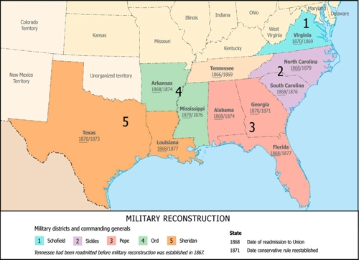
The end of Reconstruction was part of the Compromise of 1877—the two presidential candidates were at a stalemate and the only way to break the stalemate was with a deal.
In the deal, the North got their president (Rutherford B. Hayes) and the South got the military to pull-out (abandon?) the South and the former slaves, thus ending Reconstruction.

Slide 14
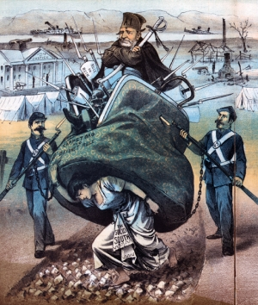

Slide 15
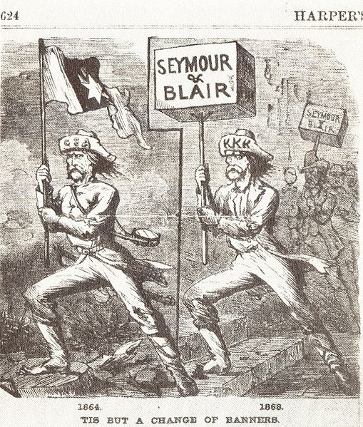
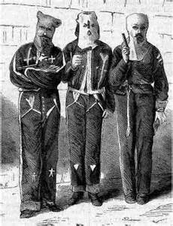
The Ku Klux Klan was formed in 1866—an organization that scared Blacks into not voting or not seeking jobs, etc… and often resorted to violence against Blacks in addition to terror.

Slide 16
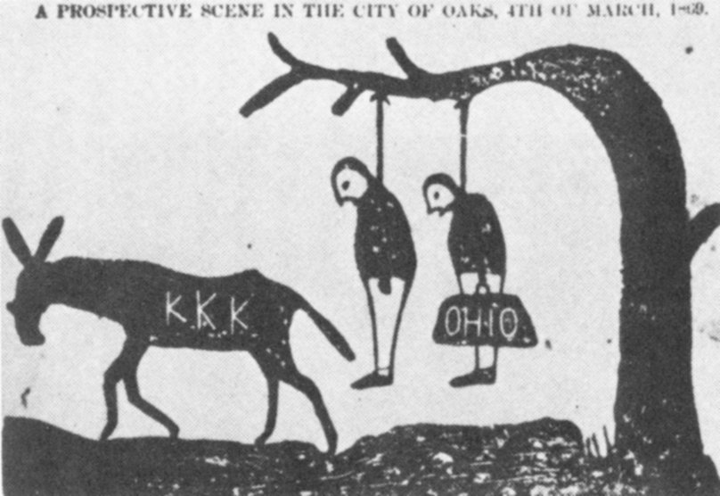

Slide 17
Johnson Impeached
In 1867, Congress passed the Tenure of Office Act, which provided that the president had to have the consent of the Senate before removing his appointees once they had been approved by the Senate
Johnson dismissed Stanton early in 1868 and the Republicans impeached him.

Slide 18
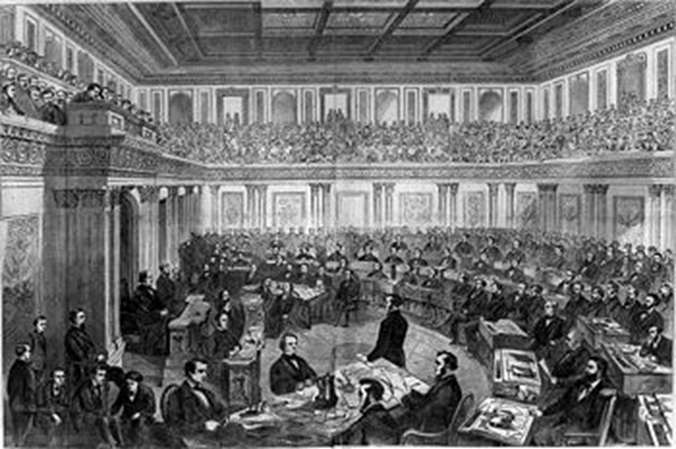
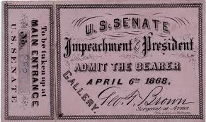
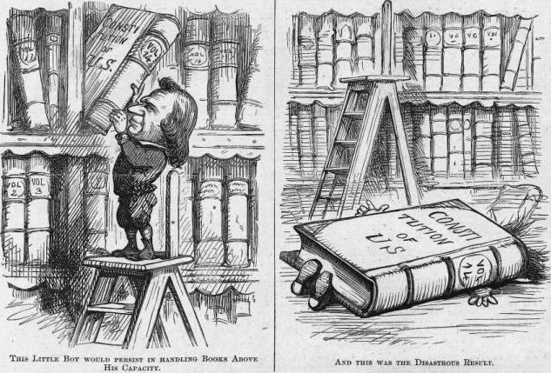

Slide 19
In 1867, Secretary of State William H. Seward bought Alaska from Russia to the United States for $7.2 million, but most of the public jeered his act as “Seward’s Folly” or “Seward’s Ice-box.”

Slide 20
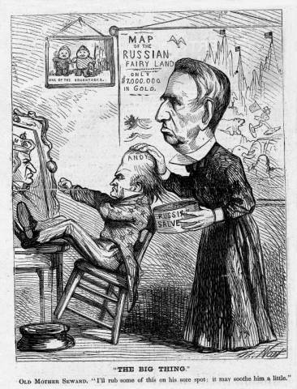

Slide 21
Black Codes
What happened to black children who had no parents or had parents who couldn’t care for them? Who was given preference when it came to this?
What was the master or given permission to do?
What punishment awaited convicted vagrants?
What punishment was given to whites who assembled with free blacks?
What type of tax was levied on free blacks? How much per year?
What was it against the law to own if you were a free black not in the military?
What were some of the non-violent acts that could get a freedman fined or imprisoned?
What were whites allowed to do to a freed black who quit their job?

Slide 22
Johnson was not allowed to testify by his lawyers, who argued that the Tenure of Office Act was unconstitutional and Johnson was acting under the Constitution, not the law.
On May 16, 1868, Johnson was acquitted of all charges by a single vote, as seven Republican senators with consciences voted “not-guilty”

Slide 23
Johnson v. Congress
Johnson repeatedly vetoed Republican-passed bills, such as a bill extending the life of the Freedman’s Bureau, and the Civil Rights Bill, which conferred on blacks the privilege of citizenship
As Republicans gained control of Congress, they passed the bills into laws with a 2/3 vote.
In the 14th Amendment, the Republicans sought to instill the same ideas of the Civil Rights Bill

