Slide 1
Truman Supports Civil Rights
African Americans, especially veterans, demand rights as citizens
Congress rejects civil rights laws; Truman issues executive orders:
- integrates armed forces; ends discrimination in government hiring
The 1948 Election
Southern Democrats—Dixiecrats—protest civil rights, form own party
Truman calls special session; asks Congress for social legislation

Slide 2
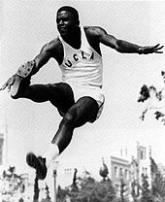
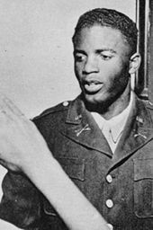
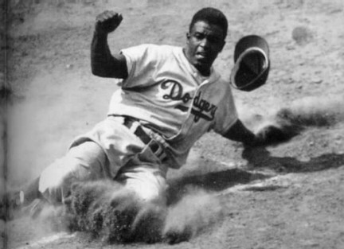

Slide 3
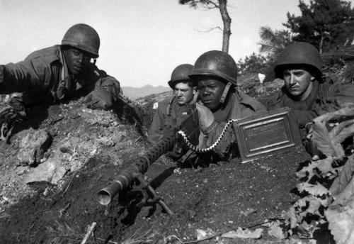

Slide 4
Chapter 19 Section 1: Readjustment and Recovery
The Impact of the GI Bill
1944 GI Bill of Rights eases veterans’ return to civilian life
Pays partial tuition, unemployment benefits; provides loans
Housing Crisis
10 million returning veterans face housing shortage
Developers use assembly-line methods to mass-produce houses
Build suburbs—small residential communities around cities

Slide 5
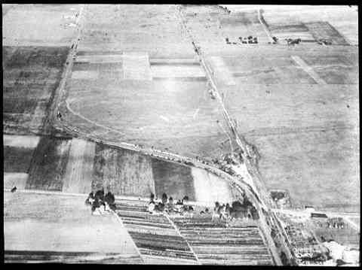

Slide 6
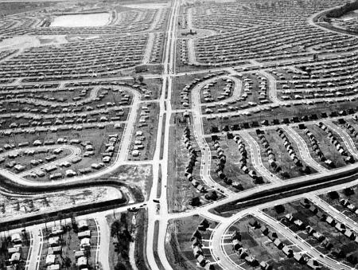

Slide 7
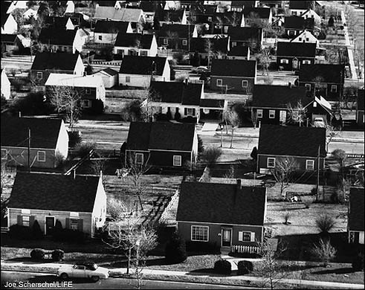

Slide 8
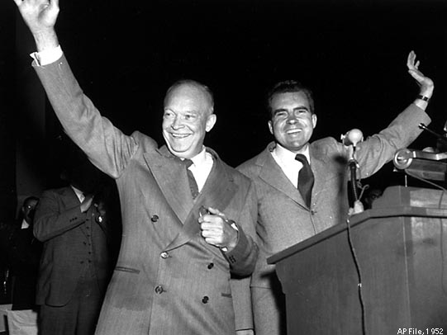
I Like Ike!
Truman’s approval rating drops over Korean War, McCarthyism
- decides not to run for reelection
Gen. Dwight D. Eisenhower runs against IL governor Adlai Stevenson
Newspapers accuse VP candidate Richard M. Nixon of corruption
- defends self in televised “Checkers speech”
Eisenhower wins; Republicans narrowly take Congress

Slide 10
Period 2, 5, & 6
We will examine the growth of the suburbs and its impact on life in the 1950s.
NBA Historic Night
Chapter 19 Notes
Ike commercial
Chapter 19.2 reading
McDonalds around the world

Slide 11
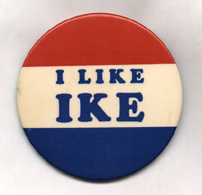
Walking the Middle of the Road
Eisenhower conservative about money, liberal on social issues
Ike tries to avoid civil rights movement, which is gaining strength
On economy, works for balanced budget, tax cut
Popularity soars; is reelected in 1956

Slide 12
Redefining the Family
Tensions from changed gender roles during war increase divorce rate
Economic Readjustment
Over 1 million defense workers laid off; wages drop for many workers
Price controls end; 25% increase in cost of scarce consumer goods
Congress reestablishes price, wage, rent controls
Remarkable Recovery
People have savings, service pay, war bonds; buy goods long missed
Cold War keeps defense spending up; foreign aid creates markets

Slide 13
