Slide 1
Jews Targeted
Europe has long history of anti-Semitism
Germans believe Hitler’s claims, blame Jews for problems
Nazis take away citizenship, jobs, property; require Star of David
• Holocaust—murder of 11 million people, more than half are Jews
Kristallnacht
• Kristallnacht—Nazis attack Jewish homes, businesses, synagogues
About 100 Jews killed, hundreds injured, 30,000 arrested

Slide 2
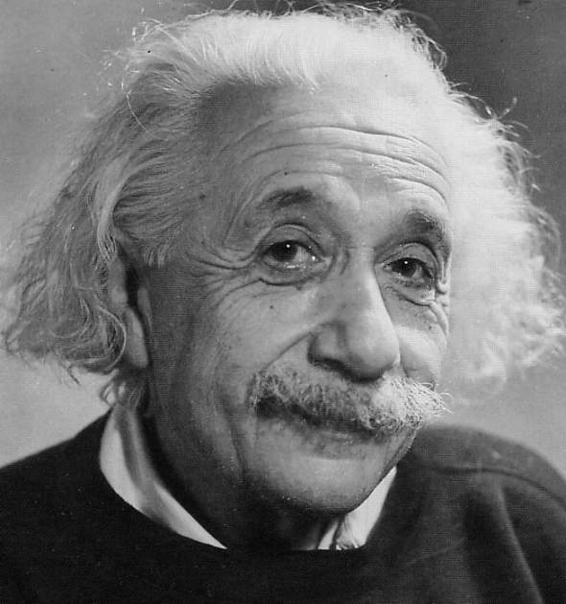
A Flood of Jewish Refugees
1938, Nazis try to speed up Jewish emigration
France has 40,000 refugees, Britain 80,000; both refuse more
U.S. takes 100,000, many “persons of exceptional merit”
Americans fear strain on economy, enemy agents; much anti-Semitism

Slide 3
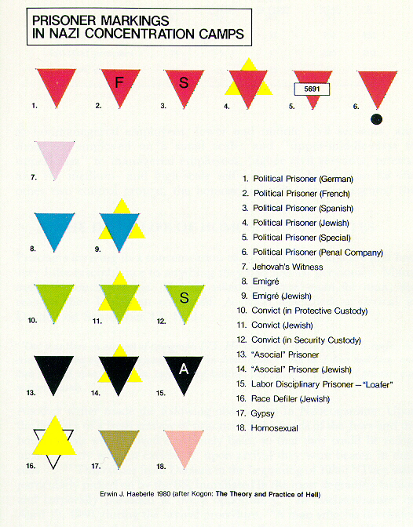

Slide 4
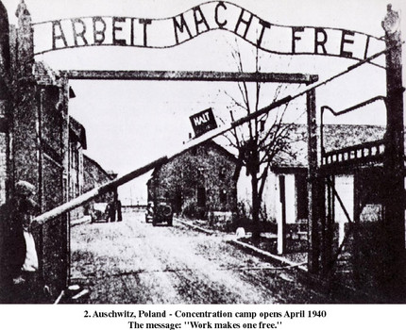
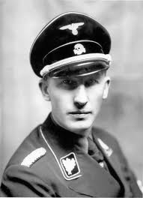
Hitler’s “Final Solution”
The Condemned
• Hitler’s Final Solution—slavery, genocide of “inferior” groups
• Genocide—deliberate, systematic killing of an entire population
• Target Jews, gypsies, freemasons, Jehovah’s Witnesses, unfit Germans
• Nazi death squads round up Jews, shoot them

Slide 5
Forced Relocation
Jews forced into ghettos, segregated areas in Polish cities
Some form resistance movements; others maintain Jewish culture

Slide 6
Period 2, 5, & 6
We will examine the Holocaust and the Nazi implementation of the Final Solution.
Chapter 16.3 Notes
Inside a Nazi Death Camp
Liberating a Concentration Camp
Quiz

Slide 7
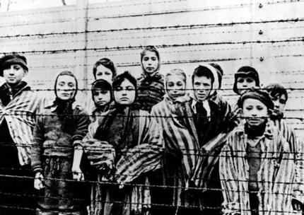
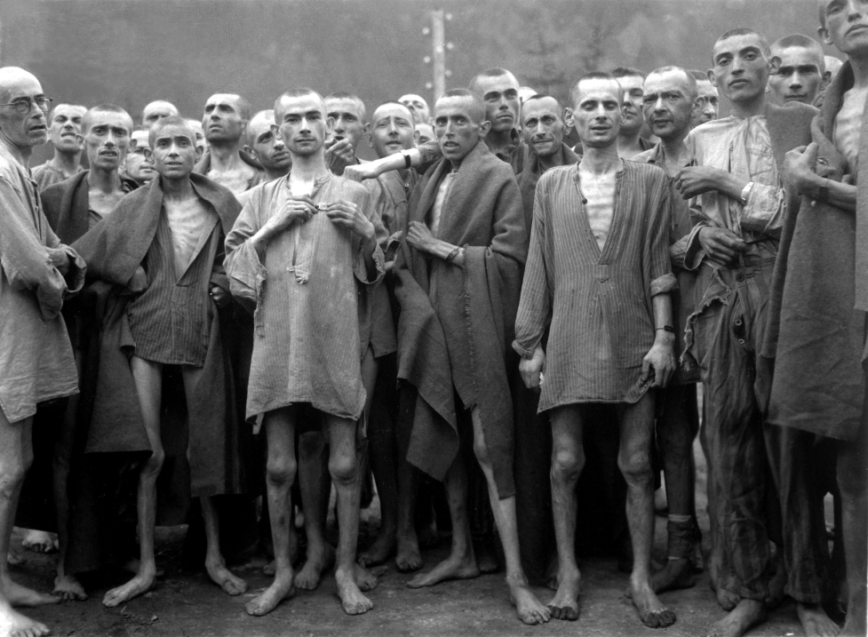
Concentration Camps
Many Jews taken to concentration camps, or labor camps
Camps originally prisons; given to SS to warehouse “undesirables”
Prisoners crammed into wooden barracks, given little food
Work dawn to dusk, 7 days per week
Those too weak to work are killed

Slide 8
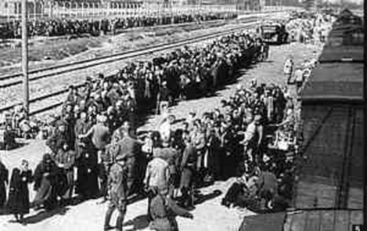
Mass Exterminations
Germans build death camps; gas chambers used to kill thousands
On arrival, SS doctors separate those who can work
Those who can’t work immediately killed in gas chamber
At first bodies buried in pits; later cremated to cover up evidence
Some are shot, hanged, poisoned, or die from experiments

Slide 9
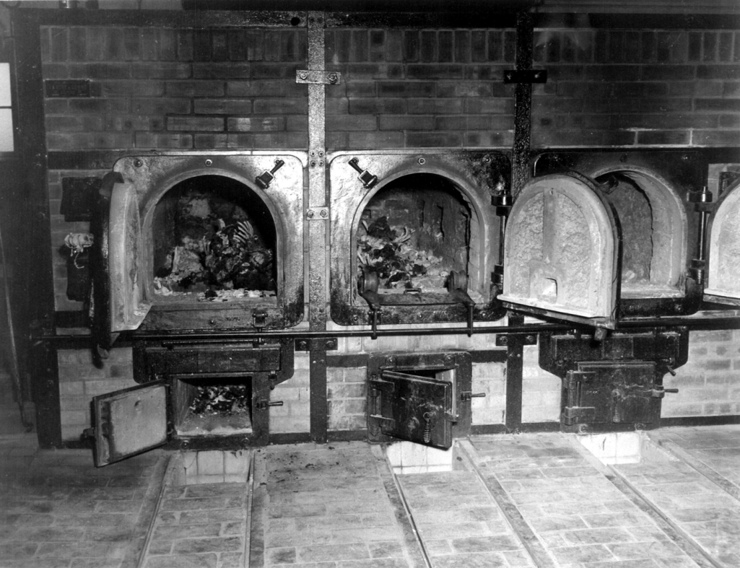
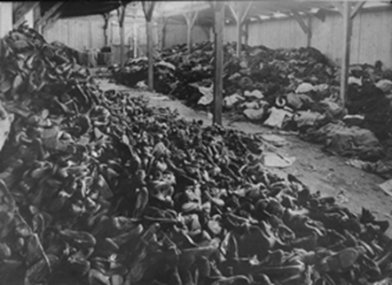
The Survivors
About 6 million Jews killed in death camps, massacres
Some escape, many with help from ordinary people
Some survive concentration camps
- survivors forever changed by experience

Slide 10
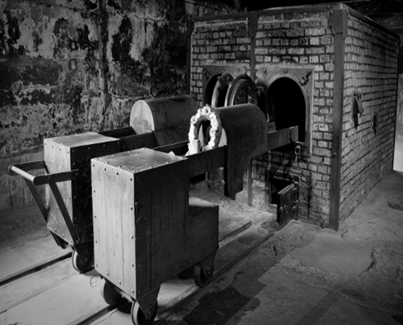
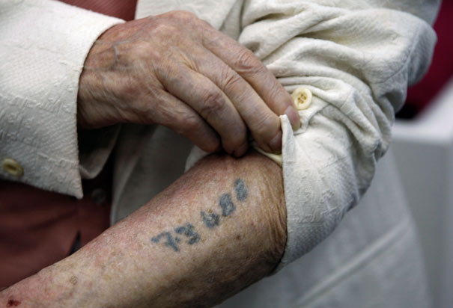

Slide 11
Inside A Nazi Death Camp
Why was Werth’s report not shown by the BBC?
What was Werth’s first opinion of the camp?
Where were the victims of the camp first sent?
How long did the Cyclon take to work?
How did the SS know the people inside were all dead?

