Slide 1
The Scopes Trial
John Scopes was arrested for teaching evolution
Scopes was guilty but evolution was on trial
What should be taught in school evolution or Creationism
Scopes was fined $100 and the law banning evolution remained in effect

Slide 2
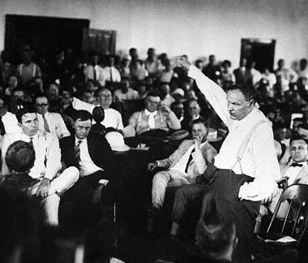
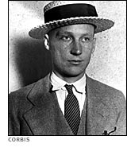

Slide 3
Period 2, 5, & 6
We will examine the conflicts that developed during the 1920’s.
Chapter 13.2 Reading
Chapter 13.2 Notes
Dances of the 1920s

Slide 4
Chapter 13.2
The Flapper
Free young woman who embraced new fashion and attitudes
Women became more assertive
Began smoking, drinking in public
Danced the foxtrot, Charleston, and the camel walk
Casual dating occurred. Men dated women they didn’t intend to marry. (courting)

Slide 5
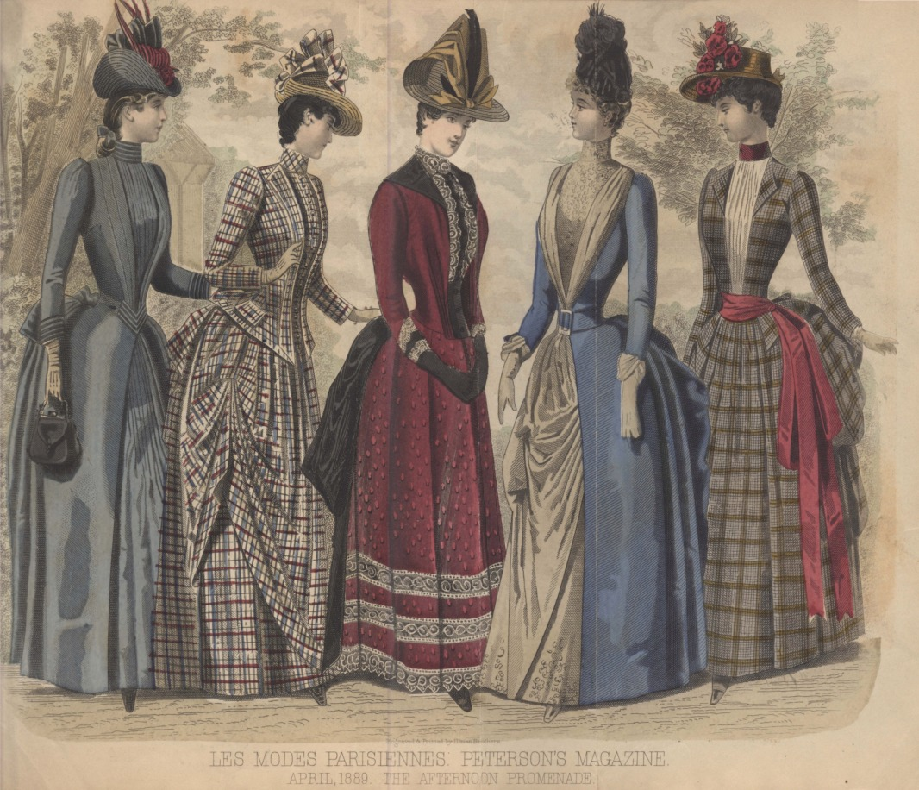

Slide 6
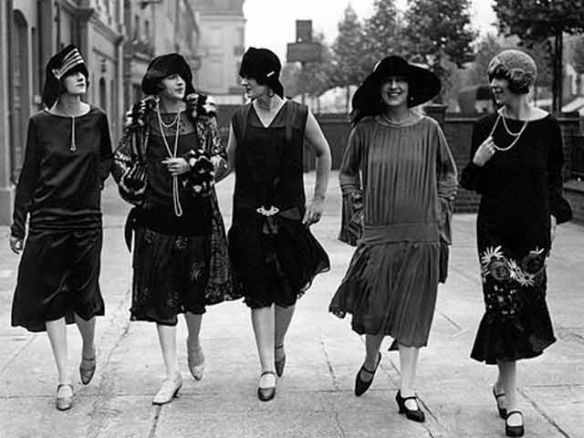

Slide 7
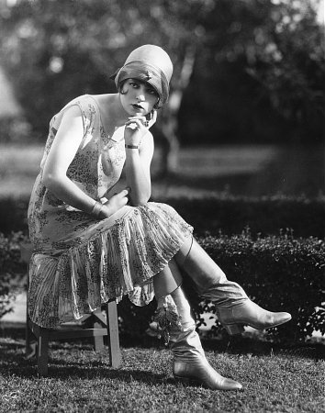
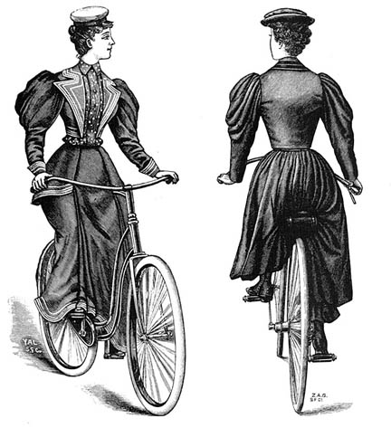

Slide 8
New Work Opportunities
Female college graduates became teachers, nurses, and librarians
Some women broke stereotypes by flying planes and driving taxis.
10 Million women were working
Few women were in managerial positions
Men argued that a woman’s place was in the home

Slide 9
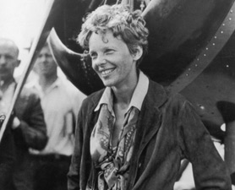
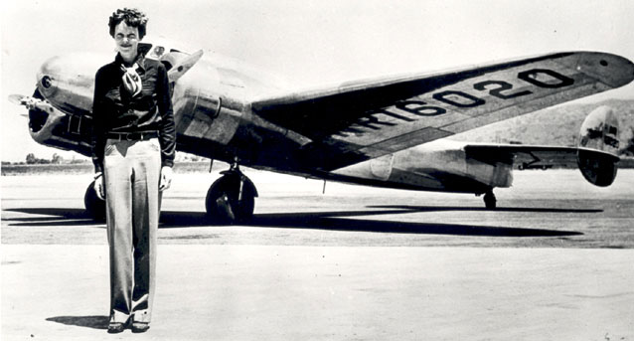

Slide 10
The Changing Family
The birthrate had declined
Due to increased availability of birth control
Margaret Sanger opened the first birth control clinic
Household life was made easier
Ready made clothes, sliced bread, canned food
New inventions made cleaning easier
Washer machine, vacuum cleaner

Slide 11
