Slide 1
Period 3 & 7
We will examine the events of Lexington and Concord and how they initiated the American Revolution.
Warm Up: How can a country with no military defeat the most powerful nation on the planet?
Details of the Battle of Lexington
Clip on Battle of Lexington
Complete causes chart

Slide 2
Readings
What story do the minutemen tell?
How does this differ from Barker’s account?
Which account do you find more reliable? Why?
Are there any facts that both accounts agree on?

Slide 3
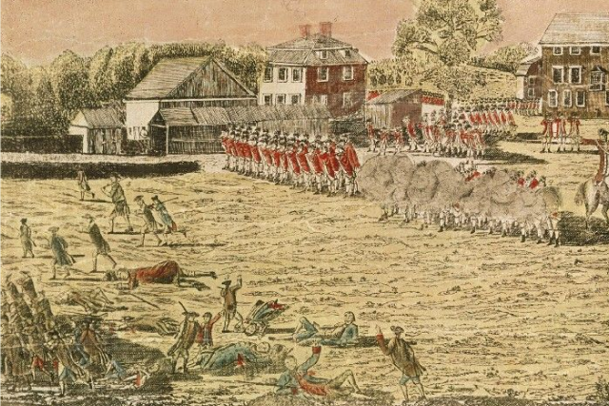
Amos Doolittle, 1775

Slide 4
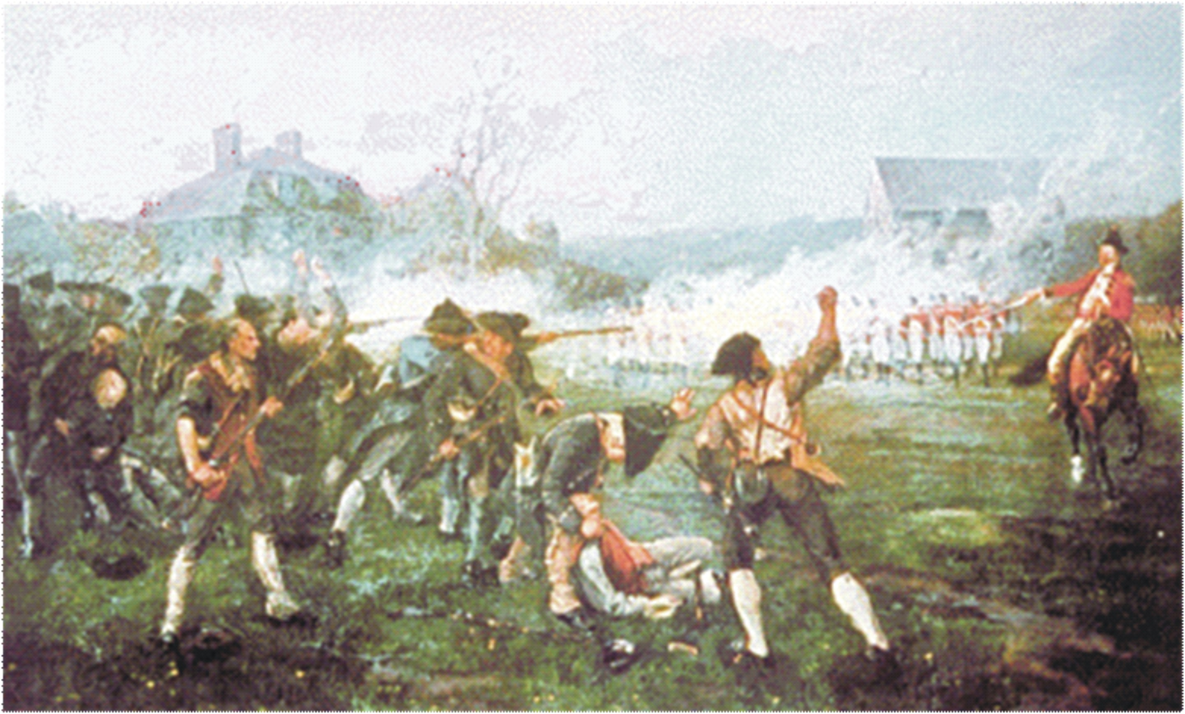
Henry Sandham, 1886

Slide 5
Which of these images is probably more accurate based on our reading of the documents?

